Slide 1
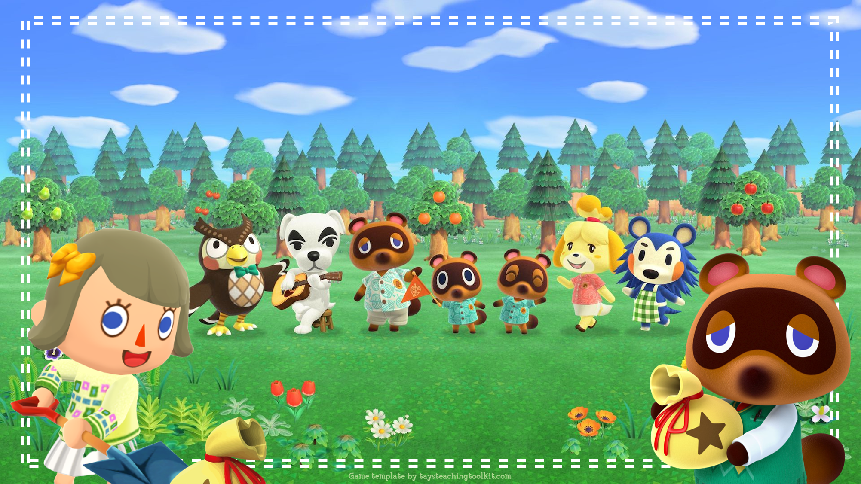

Notes:
This template is for educational, non-commercial purposes only. For more free game templates like this one, visit https://www.taysteachingtoolkit.com
------
Game adapted from ”Rabbit Hole” by Adam Zero https://adamzero.wixsite.com/main

Slide 2
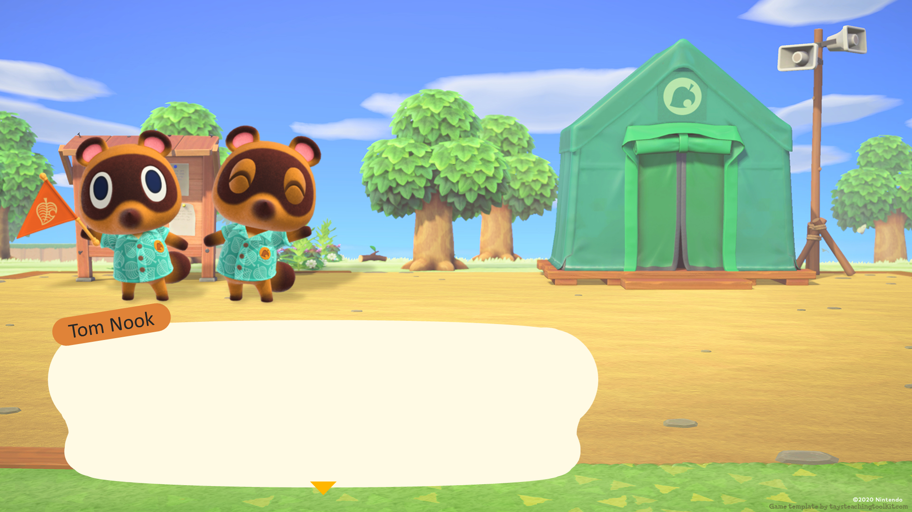
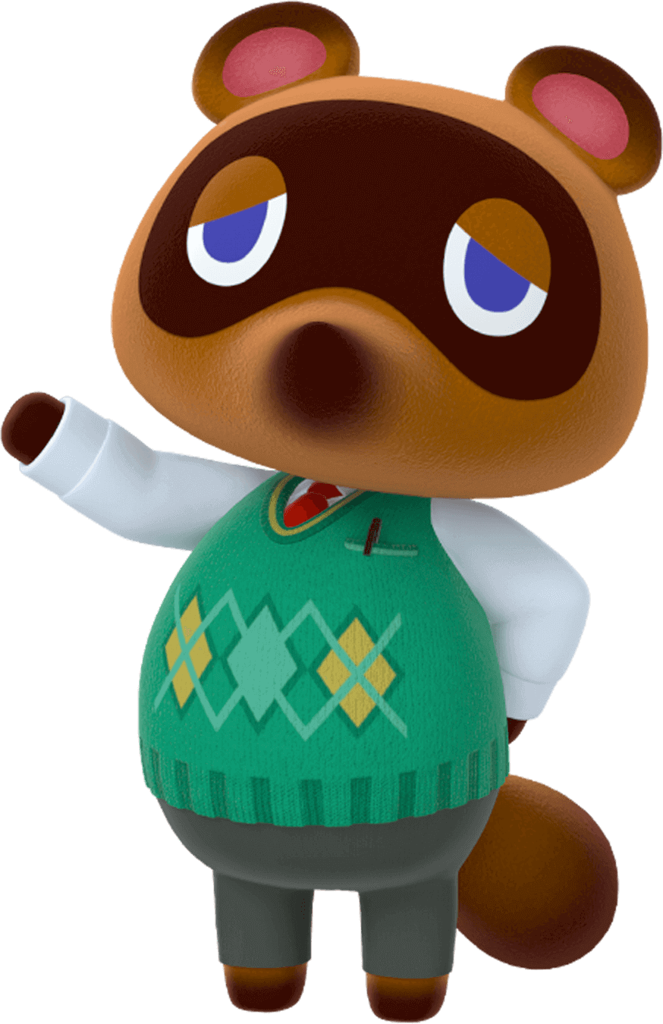
Welcome, everyone. Welcome to the game, Buried Bells. We are excited to have you here.
Notes:
TEACHER’S NOTES:
Before the game starts, split your class into teams. The amount of students that are on each team is up to you. Students can also play in pairs or individually depending on how many students you have.

Slide 3

Bell bags are buried on this island. See if you can find them!

Slide 4
But…first things first. Yes, yes! Let me tell you how to play the game.

Slide 5
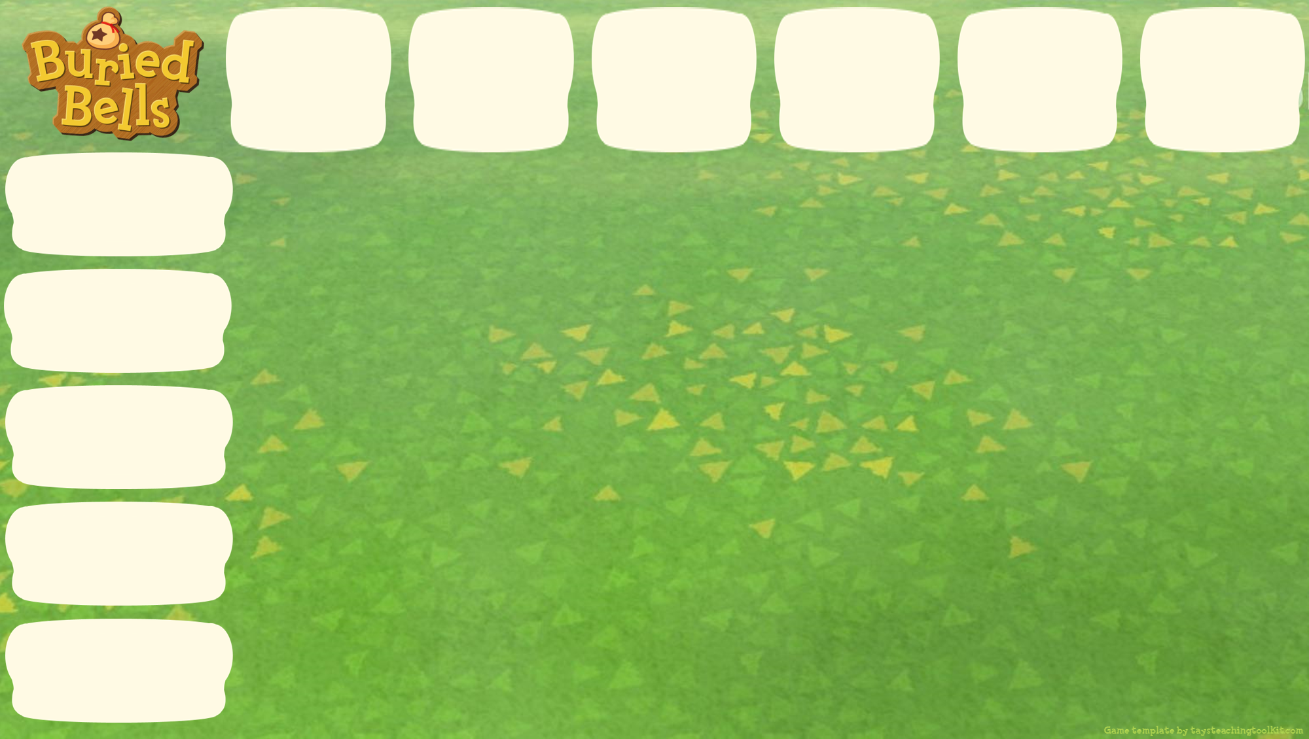






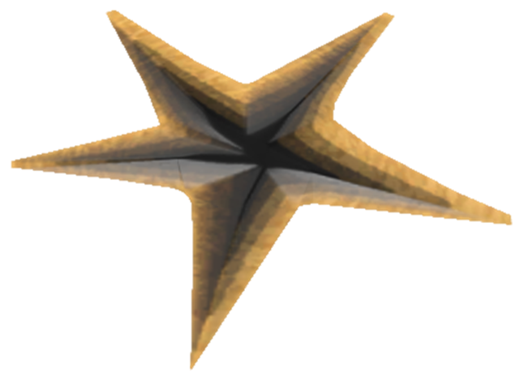

on
under
Say a sentence to choose a crack in the ground.
next to
behind
in front
of
Notes:
TEACHER’S NOTES:
Note, the current text and images on the signs are just an example. Replace them with the target language or vocabulary you will use in the game.

Slide 6

on
under
next to
behind
“It’s under the chair.”
in front
of
Notes:
TEACHER’S NOTES:
Note, the current text and images on the signs are just an example. Replace them with the target language or vocabulary you will use in the game.

Slide 7
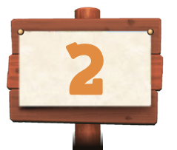
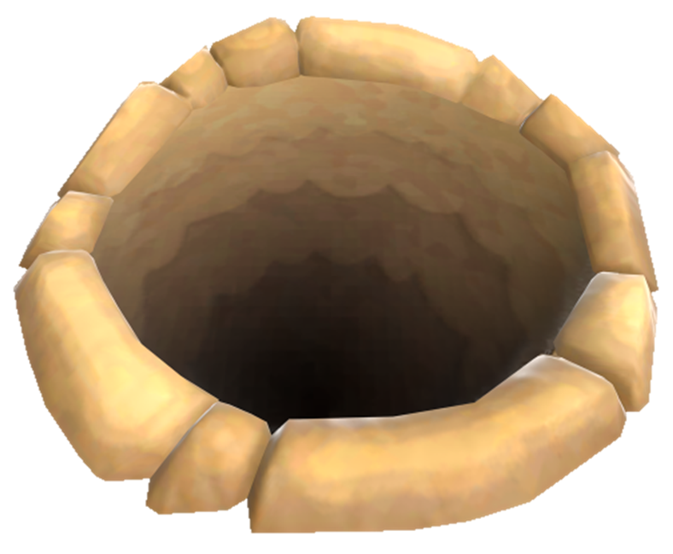

on
under
next to
Oops! Looks like you didn’t find the bell bag.
behind
in front
of
Notes:
TEACHER’S NOTES:
Note, the current text and images on the signs are just an example. Replace them with the target language or vocabulary you will use in the game.

Slide 8
on
under
next to
behind
But! The number is a hint.
in front
of
Notes:
TEACHER’S NOTES:
Note, the current text and images on the signs are just an example. Replace them with the target language or vocabulary you will use in the game.

Slide 9
on
under
next to
The bell bag is 2
spaces away.
behind
in front
of
Notes:
TEACHER’S NOTES:
Note, the current text and images on the signs are just an example. Replace them with the target language or vocabulary you will use in the game.

Slide 10
on
2
1
1
1
2
3
under
2
1
1
2
3
next to
2
1
1
1
2
3
behind
2
2
2
2
2
3
in front
of
3
3
3
3
3
3
Notes:
TEACHER’S NOTES:
Note, the current text and images on the signs are just an example. Replace them with the target language or vocabulary you will use in the game.

Slide 11
on
2
2
under
2
2
next to
2
2
behind
2
2
2
2
2
in front
of
Notes:
TEACHER’S NOTES:
Note, the current text and images on the signs are just an example. Replace them with the target language or vocabulary you will use in the game.

Slide 12
on
under
next to
behind
Let’s try again.
in front
of
Notes:
TEACHER’S NOTES:
Note, the current text and images on the signs are just an example. Replace them with the target language or vocabulary you will use in the game.

Slide 13
on
under
next to
behind
in front
of
Notes:
TEACHER’S NOTES:
Have students try to come up with the sentence without the prompts before you dig.
Note, the current text and images on the signs are just an example. Replace them with the target language or vocabulary you will use in the game.

Slide 14
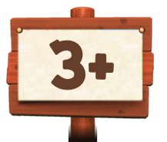
on
under
Oh no! Now the
bell bag is 3 or more spaces away!
next to
behind
in front
of
Notes:
TEACHER’S NOTES:
Note, the current text and images on the signs are just an example. Replace them with the target language or vocabulary you will use in the game.

Slide 15
on
3
3
under
3
2
next to
3
1
behind
3
2
1
1
in front
of
Notes:
TEACHER’S NOTES:
Note, the current text and images on the signs are just an example. Replace them with the target language or vocabulary you will use in the game.

Slide 16
on
3
3
under
3
next to
3
behind
3
in front
of
Notes:
TEACHER’S NOTES:
Note, the current text and images on the signs are just an example. Replace them with the target language or vocabulary you will use in the game.

Slide 17
on
under
next to
Let’s dig here!
behind
in front
of
Notes:
TEACHER’S NOTES:
Have students try to come up with the sentence without the prompts before you dig.
Note, the current text and images on the signs are just an example. Replace them with the target language or vocabulary you will use in the game.

Slide 18
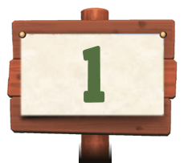
on
under
next to
behind
in front
of
Notes:
TEACHER’S NOTES:
Note, the current text and images on the signs are just an example. Replace them with the target language or vocabulary you will use in the game.

Slide 19
on
under
So close! The bell bag is only 1 space away. Where is it?
next to
behind
in front
of
Notes:
TEACHER’S NOTES:
Note, the current text and images on the signs are just an example. Replace them with the target language or vocabulary you will use in the game.

Slide 20
on
under
next to
behind
in front
of
Notes:
TEACHER’S NOTES:
Before you reveal the yellow box, see if students can come up with the answer on their own and then have them make a sentence.
Note, the current text and images on the signs are just an example. Replace them with the target language or vocabulary you will use in the game.

Slide 21
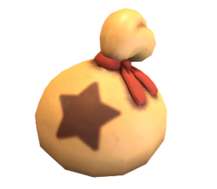

on
under
Great job! You found the bell bag!
next to
behind
in front
of
Notes:
TEACHER’S NOTES:
Note, the current text and images on the signs are just an example. Replace them with the target language or vocabulary you will use in the game.

Slide 22
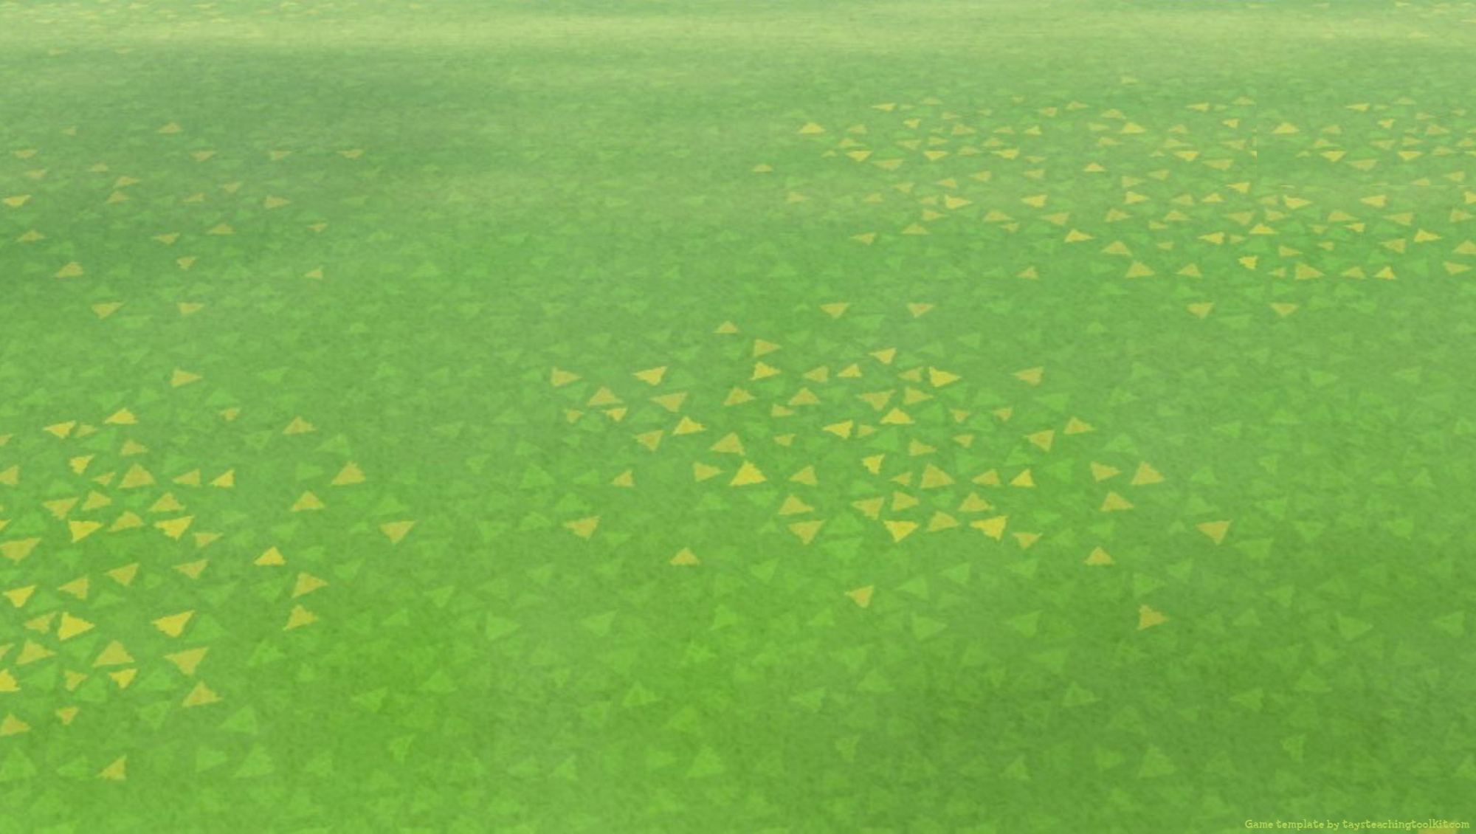
There are 3 types of
special signs:

Slide 23
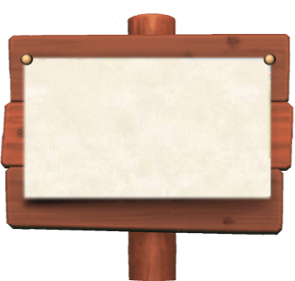




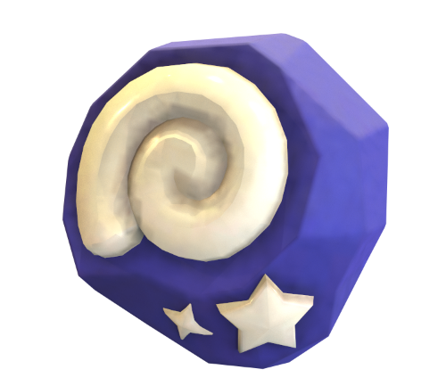
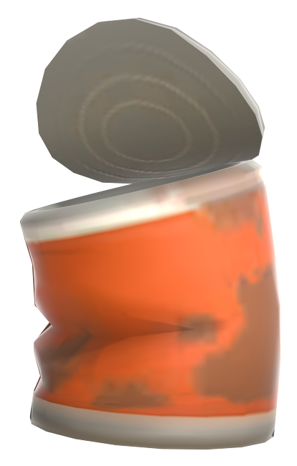

Watch out for special objects!
1
3+
3+ spaces away & lose
a turn
Your team gets 1 point!
1 space away & choose again
Notes:
TEACHER’S NOTES:
These are in addition to the regular 1, 2, and 3+ signs.

Slide 24
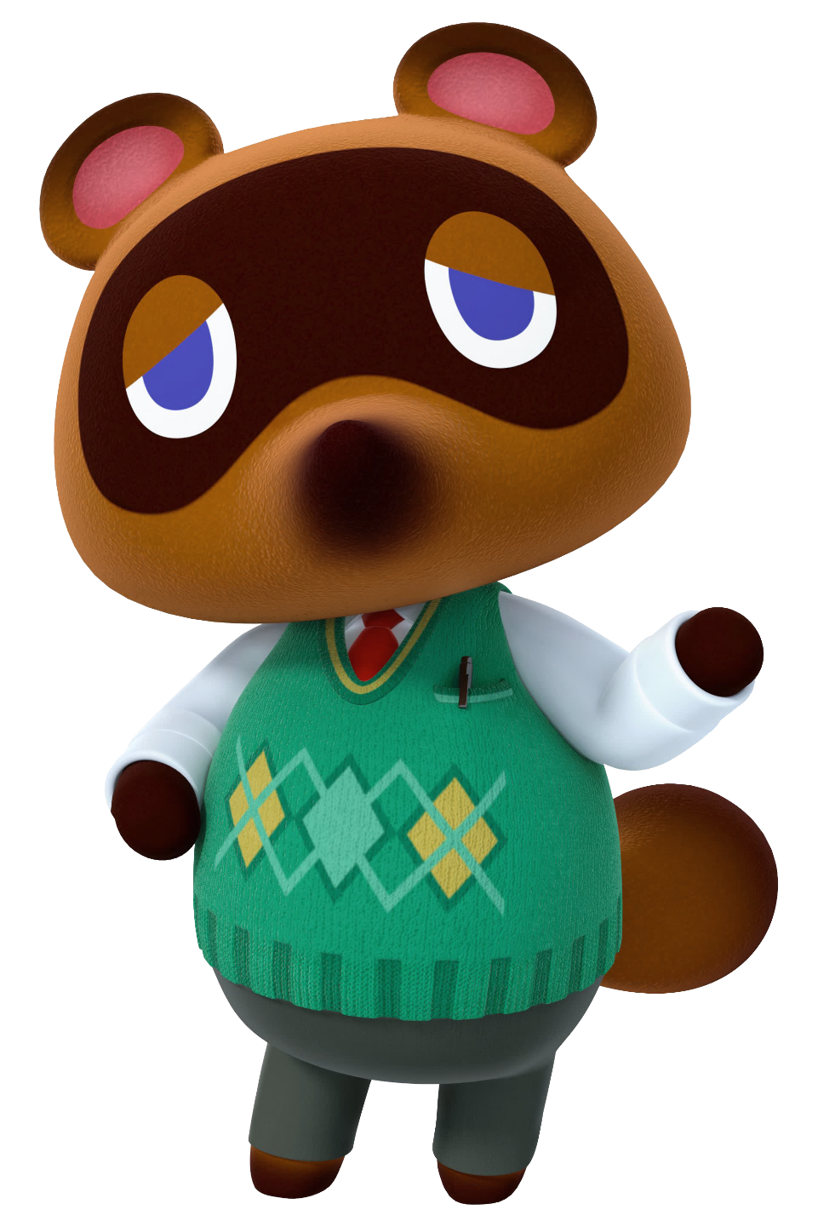
Now, is that everything…Yes, yes, I believe it is! Let’s get started with the game!

Slide 25
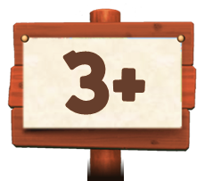
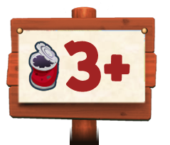




Text/
Image
Text/
Image
Text/
Image
Text/
Image
Text/
Image
Text/
Image
Text/Image
Text/Image
Text/Image
Text/Image
Text/Image
Notes:
TEACHER’S NOTES:
Replace the default text with the target language or vocabulary from your own classes (can be text or images).
After you insert the top row of text/images make sure you send them to the back (under the arrange menu) so they are behind the top row of signs.
After a student/pair/team chooses a crack, click on it to dig.
There are 30 game boards total for each of the 30 holes the bell bag can be in. So, if playing the game more than once with the same students, all you have to do is rearrange the game boards.

Slide 26

Text/
Image
Text/
Image
Text/
Image
Text/
Image
Text/
Image
Text/
Image
Text/Image
Text/Image
Text/Image
Text/Image
Text/Image
Notes:
TEACHER’S NOTES:
Replace the default text with the target language or vocabulary from your own classes (can be text or images).
After you insert the top row of text/images make sure you send them to the back (under the arrange menu) so they are behind the top row of signs.
After a student/pair/team chooses a crack, click on it to dig.
There are 30 game boards total for each of the 30 holes the bell bag can be in. So, if playing the game more than once with the same students, all you have to do is rearrange the game boards.

Slide 27
Text/
Image
Text/
Image
Text/
Image
Text/
Image
Text/
Image
Text/
Image
Text/Image
Text/Image
Text/Image
Text/Image
Text/Image
Notes:
TEACHER’S NOTES:
Replace the default text with the target language or vocabulary from your own classes (can be text or images).
After you insert the top row of text/images make sure you send them to the back (under the arrange menu) so they are behind the top row of signs.
After a student/pair/team chooses a crack, click on it to dig.
There are 30 game boards total for each of the 30 holes the bell bag can be in. So, if playing the game more than once with the same students, all you have to do is rearrange the game boards.

Slide 28
Text/
Image
Text/
Image
Text/
Image
Text/
Image
Text/
Image
Text/
Image
Text/Image
Text/Image
Text/Image
Text/Image
Text/Image
Notes:
TEACHER’S NOTES:
Replace the default text with the target language or vocabulary from your own classes (can be text or images).
After you insert the top row of text/images make sure you send them to the back (under the arrange menu) so they are behind the top row of signs.
After a student/pair/team chooses a crack, click on it to dig.
There are 30 game boards total for each of the 30 holes the bell bag can be in. So, if playing the game more than once with the same students, all you have to do is rearrange the game boards.

Slide 29
Text/
Image
Text/
Image
Text/
Image
Text/
Image
Text/
Image
Text/
Image
Text/Image
Text/Image
Text/Image
Text/Image
Text/Image
Notes:
TEACHER’S NOTES:
Replace the default text with the target language or vocabulary from your own classes (can be text or images).
After you insert the top row of text/images make sure you send them to the back (under the arrange menu) so they are behind the top row of signs.
After a student/pair/team chooses a crack, click on it to dig.
There are 30 game boards total for each of the 30 holes the bell bag can be in. So, if playing the game more than once with the same students, all you have to do is rearrange the game boards.

Slide 30
Text/
Image
Text/
Image
Text/
Image
Text/
Image
Text/
Image
Text/
Image
Text/Image
Text/Image
Text/Image
Text/Image
Text/Image
Notes:
TEACHER’S NOTES:
Replace the default text with the target language or vocabulary from your own classes (can be text or images).
After you insert the top row of text/images make sure you send them to the back (under the arrange menu) so they are behind the top row of signs.
After a student/pair/team chooses a crack, click on it to dig.
There are 30 game boards total for each of the 30 holes the bell bag can be in. So, if playing the game more than once with the same students, all you have to do is rearrange the game boards.

Slide 31
Text/
Image
Text/
Image
Text/
Image
Text/
Image
Text/
Image
Text/
Image
Text/Image
Text/Image
Text/Image
Text/Image
Text/Image
Notes:
TEACHER’S NOTES:
Replace the default text with the target language or vocabulary from your own classes (can be text or images).
After you insert the top row of text/images make sure you send them to the back (under the arrange menu) so they are behind the top row of signs.
After a student/pair/team chooses a crack, click on it to dig.
There are 30 game boards total for each of the 30 holes the bell bag can be in. So, if playing the game more than once with the same students, all you have to do is rearrange the game boards.

Slide 32
Text/
Image
Text/
Image
Text/
Image
Text/
Image
Text/
Image
Text/
Image
Text/Image
Text/Image
Text/Image
Text/Image
Text/Image
Notes:
TEACHER’S NOTES:
Replace the default text with the target language or vocabulary from your own classes (can be text or images).
After you insert the top row of text/images make sure you send them to the back (under the arrange menu) so they are behind the top row of signs.
After a student/pair/team chooses a crack, click on it to dig.
There are 30 game boards total for each of the 30 holes the bell bag can be in. So, if playing the game more than once with the same students, all you have to do is rearrange the game boards.

Slide 33
Text/
Image
Text/
Image
Text/
Image
Text/
Image
Text/
Image
Text/
Image
Text/Image
Text/Image
Text/Image
Text/Image
Text/Image
Notes:
TEACHER’S NOTES:
Replace the default text with the target language or vocabulary from your own classes (can be text or images).
After you insert the top row of text/images make sure you send them to the back (under the arrange menu) so they are behind the top row of signs.
After a student/pair/team chooses a crack, click on it to dig.
There are 30 game boards total for each of the 30 holes the bell bag can be in. So, if playing the game more than once with the same students, all you have to do is rearrange the game boards.

Slide 34
Text/
Image
Text/
Image
Text/
Image
Text/
Image
Text/
Image
Text/
Image
Text/Image
Text/Image
Text/Image
Text/Image
Text/Image
Notes:
TEACHER’S NOTES:
Replace the default text with the target language or vocabulary from your own classes (can be text or images).
After you insert the top row of text/images make sure you send them to the back (under the arrange menu) so they are behind the top row of signs.
After a student/pair/team chooses a crack, click on it to dig.
There are 30 game boards total for each of the 30 holes the bell bag can be in. So, if playing the game more than once with the same students, all you have to do is rearrange the game boards.

Slide 35
Text/
Image
Text/
Image
Text/
Image
Text/
Image
Text/
Image
Text/
Image
Text/Image
Text/Image
Text/Image
Text/Image
Text/Image
Notes:
TEACHER’S NOTES:
Replace the default text with the target language or vocabulary from your own classes (can be text or images).
After you insert the top row of text/images make sure you send them to the back (under the arrange menu) so they are behind the top row of signs.
After a student/pair/team chooses a crack, click on it to dig.
There are 30 game boards total for each of the 30 holes the bell bag can be in. So, if playing the game more than once with the same students, all you have to do is rearrange the game boards.

Slide 36
Text/
Image
Text/
Image
Text/
Image
Text/
Image
Text/
Image
Text/
Image
Text/Image
Text/Image
Text/Image
Text/Image
Text/Image
Notes:
TEACHER’S NOTES:
Replace the default text with the target language or vocabulary from your own classes (can be text or images).
After you insert the top row of text/images make sure you send them to the back (under the arrange menu) so they are behind the top row of signs.
After a student/pair/team chooses a crack, click on it to dig.
There are 30 game boards total for each of the 30 holes the bell bag can be in. So, if playing the game more than once with the same students, all you have to do is rearrange the game boards.

Slide 37
Text/
Image
Text/
Image
Text/
Image
Text/
Image
Text/
Image
Text/
Image
Text/Image
Text/Image
Text/Image
Text/Image
Text/Image
Notes:
TEACHER’S NOTES:
Replace the default text with the target language or vocabulary from your own classes (can be text or images).
After you insert the top row of text/images make sure you send them to the back (under the arrange menu) so they are behind the top row of signs.
After a student/pair/team chooses a crack, click on it to dig.
There are 30 game boards total for each of the 30 holes the bell bag can be in. So, if playing the game more than once with the same students, all you have to do is rearrange the game boards.

Slide 38
Text/
Image
Text/
Image
Text/
Image
Text/
Image
Text/
Image
Text/
Image
Text/Image
Text/Image
Text/Image
Text/Image
Text/Image
Notes:
TEACHER’S NOTES:
Replace the default text with the target language or vocabulary from your own classes (can be text or images).
After you insert the top row of text/images make sure you send them to the back (under the arrange menu) so they are behind the top row of signs.
After a student/pair/team chooses a crack, click on it to dig.
There are 30 game boards total for each of the 30 holes the bell bag can be in. So, if playing the game more than once with the same students, all you have to do is rearrange the game boards.

Slide 39
Text/
Image
Text/
Image
Text/
Image
Text/
Image
Text/
Image
Text/
Image
Text/Image
Text/Image
Text/Image
Text/Image
Text/Image
Notes:
TEACHER’S NOTES:
Replace the default text with the target language or vocabulary from your own classes (can be text or images).
After you insert the top row of text/images make sure you send them to the back (under the arrange menu) so they are behind the top row of signs.
After a student/pair/team chooses a crack, click on it to dig.
There are 30 game boards total for each of the 30 holes the bell bag can be in. So, if playing the game more than once with the same students, all you have to do is rearrange the game boards.

Slide 40
Text/
Image
Text/
Image
Text/
Image
Text/
Image
Text/
Image
Text/
Image
Text/Image
Text/Image
Text/Image
Text/Image
Text/Image
Notes:
TEACHER’S NOTES:
Replace the default text with the target language or vocabulary from your own classes (can be text or images).
After you insert the top row of text/images make sure you send them to the back (under the arrange menu) so they are behind the top row of signs.
After a student/pair/team chooses a crack, click on it to dig.
There are 30 game boards total for each of the 30 holes the bell bag can be in. So, if playing the game more than once with the same students, all you have to do is rearrange the game boards.

Slide 41
Text/
Image
Text/
Image
Text/
Image
Text/
Image
Text/
Image
Text/
Image
Text/Image
Text/Image
Text/Image
Text/Image
Text/Image
Notes:
TEACHER’S NOTES:
Replace the default text with the target language or vocabulary from your own classes (can be text or images).
After you insert the top row of text/images make sure you send them to the back (under the arrange menu) so they are behind the top row of signs.
After a student/pair/team chooses a crack, click on it to dig.
There are 30 game boards total for each of the 30 holes the bell bag can be in. So, if playing the game more than once with the same students, all you have to do is rearrange the game boards.

Slide 42
Text/
Image
Text/
Image
Text/
Image
Text/
Image
Text/
Image
Text/
Image
Text/Image
Text/Image
Text/Image
Text/Image
Text/Image
Notes:
TEACHER’S NOTES:
Replace the default text with the target language or vocabulary from your own classes (can be text or images).
After you insert the top row of text/images make sure you send them to the back (under the arrange menu) so they are behind the top row of signs.
After a student/pair/team chooses a crack, click on it to dig.
There are 30 game boards total for each of the 30 holes the bell bag can be in. So, if playing the game more than once with the same students, all you have to do is rearrange the game boards.

Slide 43
Text/
Image
Text/
Image
Text/
Image
Text/
Image
Text/
Image
Text/
Image
Text/Image
Text/Image
Text/Image
Text/Image
Text/Image
Notes:
TEACHER’S NOTES:
Replace the default text with the target language or vocabulary from your own classes (can be text or images).
After you insert the top row of text/images make sure you send them to the back (under the arrange menu) so they are behind the top row of signs.
After a student/pair/team chooses a crack, click on it to dig.
There are 30 game boards total for each of the 30 holes the bell bag can be in. So, if playing the game more than once with the same students, all you have to do is rearrange the game boards.

Slide 44
Text/
Image
Text/
Image
Text/
Image
Text/
Image
Text/
Image
Text/
Image
Text/Image
Text/Image
Text/Image
Text/Image
Text/Image
Notes:
TEACHER’S NOTES:
Replace the default text with the target language or vocabulary from your own classes (can be text or images).
After you insert the top row of text/images make sure you send them to the back (under the arrange menu) so they are behind the top row of signs.
After a student/pair/team chooses a crack, click on it to dig.
There are 30 game boards total for each of the 30 holes the bell bag can be in. So, if playing the game more than once with the same students, all you have to do is rearrange the game boards.

Slide 45
Text/
Image
Text/
Image
Text/
Image
Text/
Image
Text/
Image
Text/
Image
Text/Image
Text/Image
Text/Image
Text/Image
Text/Image
Notes:
TEACHER’S NOTES:
Replace the default text with the target language or vocabulary from your own classes (can be text or images).
After you insert the top row of text/images make sure you send them to the back (under the arrange menu) so they are behind the top row of signs.
After a student/pair/team chooses a crack, click on it to dig.
There are 30 game boards total for each of the 30 holes the bell bag can be in. So, if playing the game more than once with the same students, all you have to do is rearrange the game boards.

Slide 46
Text/
Image
Text/
Image
Text/
Image
Text/
Image
Text/
Image
Text/
Image
Text/Image
Text/Image
Text/Image
Text/Image
Text/Image
Notes:
TEACHER’S NOTES:
Replace the default text with the target language or vocabulary from your own classes (can be text or images).
After you insert the top row of text/images make sure you send them to the back (under the arrange menu) so they are behind the top row of signs.
After a student/pair/team chooses a crack, click on it to dig.
There are 30 game boards total for each of the 30 holes the bell bag can be in. So, if playing the game more than once with the same students, all you have to do is rearrange the game boards.

Slide 47
Text/
Image
Text/
Image
Text/
Image
Text/
Image
Text/
Image
Text/
Image
Text/Image
Text/Image
Text/Image
Text/Image
Text/Image
Notes:
TEACHER’S NOTES:
Replace the default text with the target language or vocabulary from your own classes (can be text or images).
After you insert the top row of text/images make sure you send them to the back (under the arrange menu) so they are behind the top row of signs.
After a student/pair/team chooses a crack, click on it to dig.
There are 30 game boards total for each of the 30 holes the bell bag can be in. So, if playing the game more than once with the same students, all you have to do is rearrange the game boards.

Slide 48
Text/
Image
Text/
Image
Text/
Image
Text/
Image
Text/
Image
Text/
Image
Text/Image
Text/Image
Text/Image
Text/Image
Text/Image
Notes:
TEACHER’S NOTES:
Replace the default text with the target language or vocabulary from your own classes (can be text or images).
After you insert the top row of text/images make sure you send them to the back (under the arrange menu) so they are behind the top row of signs.
After a student/pair/team chooses a crack, click on it to dig.
There are 30 game boards total for each of the 30 holes the bell bag can be in. So, if playing the game more than once with the same students, all you have to do is rearrange the game boards.

Slide 49
Text/
Image
Text/
Image
Text/
Image
Text/
Image
Text/
Image
Text/
Image
Text/Image
Text/Image
Text/Image
Text/Image
Text/Image
Notes:
TEACHER’S NOTES:
Replace the default text with the target language or vocabulary from your own classes (can be text or images).
After you insert the top row of text/images make sure you send them to the back (under the arrange menu) so they are behind the top row of signs.
After a student/pair/team chooses a crack, click on it to dig.
There are 30 game boards total for each of the 30 holes the bell bag can be in. So, if playing the game more than once with the same students, all you have to do is rearrange the game boards.

Slide 50
Text/
Image
Text/
Image
Text/
Image
Text/
Image
Text/
Image
Text/
Image
Text/Image
Text/Image
Text/Image
Text/Image
Text/Image
Notes:
TEACHER’S NOTES:
Replace the default text with the target language or vocabulary from your own classes (can be text or images).
After you insert the top row of text/images make sure you send them to the back (under the arrange menu) so they are behind the top row of signs.
After a student/pair/team chooses a crack, click on it to dig.
There are 30 game boards total for each of the 30 holes the bell bag can be in. So, if playing the game more than once with the same students, all you have to do is rearrange the game boards.

Slide 51
Text/
Image
Text/
Image
Text/
Image
Text/
Image
Text/
Image
Text/
Image
Text/Image
Text/Image
Text/Image
Text/Image
Text/Image
Notes:
TEACHER’S NOTES:
Replace the default text with the target language or vocabulary from your own classes (can be text or images).
After you insert the top row of text/images make sure you send them to the back (under the arrange menu) so they are behind the top row of signs.
After a student/pair/team chooses a crack, click on it to dig.
There are 30 game boards total for each of the 30 holes the bell bag can be in. So, if playing the game more than once with the same students, all you have to do is rearrange the game boards.

Slide 52
Text/
Image
Text/
Image
Text/
Image
Text/
Image
Text/
Image
Text/
Image
Text/Image
Text/Image
Text/Image
Text/Image
Text/Image
Notes:
TEACHER’S NOTES:
Replace the default text with the target language or vocabulary from your own classes (can be text or images).
After you insert the top row of text/images make sure you send them to the back (under the arrange menu) so they are behind the top row of signs.
After a student/pair/team chooses a crack, click on it to dig.
There are 30 game boards total for each of the 30 holes the bell bag can be in. So, if playing the game more than once with the same students, all you have to do is rearrange the game boards.

Slide 53
Text/
Image
Text/
Image
Text/
Image
Text/
Image
Text/
Image
Text/
Image
Text/Image
Text/Image
Text/Image
Text/Image
Text/Image
Notes:
TEACHER’S NOTES:
Replace the default text with the target language or vocabulary from your own classes (can be text or images).
After you insert the top row of text/images make sure you send them to the back (under the arrange menu) so they are behind the top row of signs.
After a student/pair/team chooses a crack, click on it to dig.
There are 30 game boards total for each of the 30 holes the bell bag can be in. So, if playing the game more than once with the same students, all you have to do is rearrange the game boards.

Slide 54
Text/
Image
Text/
Image
Text/
Image
Text/
Image
Text/
Image
Text/
Image
Text/Image
Text/Image
Text/Image
Text/Image
Text/Image
Notes:
TEACHER’S NOTES:
Replace the default text with the target language or vocabulary from your own classes (can be text or images).
After you insert the top row of text/images make sure you send them to the back (under the arrange menu) so they are behind the top row of signs.
After a student/pair/team chooses a crack, click on it to dig.
There are 30 game boards total for each of the 30 holes the bell bag can be in. So, if playing the game more than once with the same students, all you have to do is rearrange the game boards.

