Slide 1


Slide 2
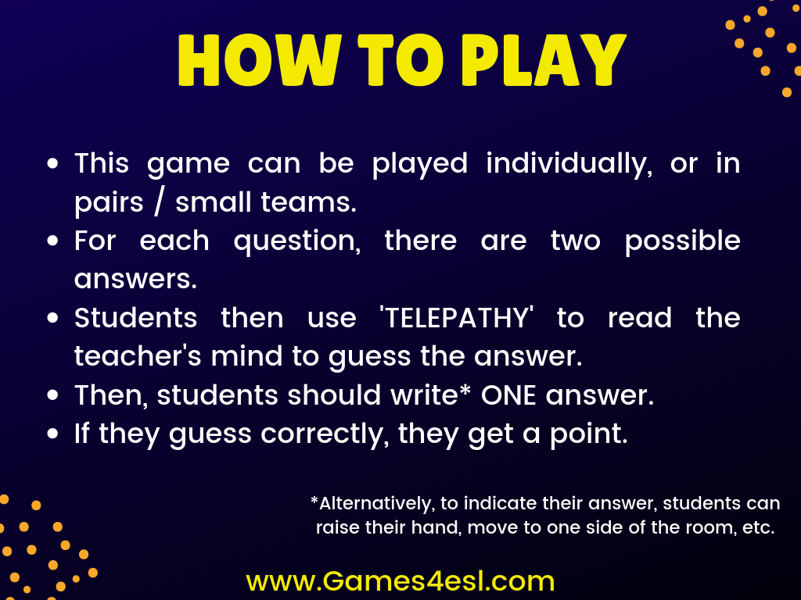

Slide 3


Slide 4

Question Here
Answer Here
Answer Here

Slide 5
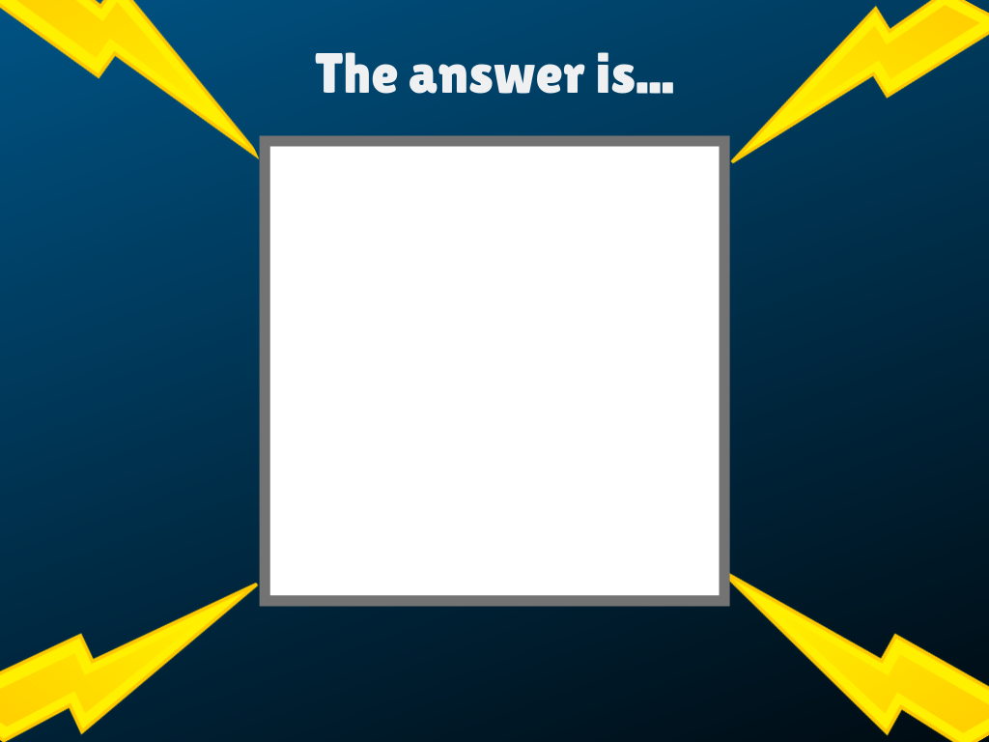
Answer Here

Slide 6


Slide 7
Question Here
Answer Here
Answer Here

Slide 8
Answer Here

Slide 9


Slide 10
Question Here
Answer Here
Answer Here

Slide 11
Answer Here

Slide 12


Slide 13
Question Here
Answer Here
Answer Here

Slide 14
Answer Here

Slide 15


Slide 16
Question Here
Answer Here
Answer Here

Slide 17
Answer Here

Slide 18


Slide 19
Question Here
Answer Here
Answer Here

Slide 20
Answer Here

Slide 21


Slide 22
Question Here
Answer Here
Answer Here

Slide 23
Answer Here

Slide 24


Slide 25
Question Here
Answer Here
Answer Here

Slide 26
Answer Here

Slide 27


Slide 28
Question Here
Answer Here
Answer Here

Slide 29
Answer Here

Slide 30


Slide 31
Question Here
Answer Here
Answer Here

Slide 32
Answer Here

Slide 33


