Slide 1

KNOCKOUT
GAME!
KNOCKOUT
GAME!
Notes:
Background created by gstudioimagen https://www.freepik.com/gstudioimagen
---
This template is for educational, non-commercial purposes only. For more free game templates like this one, visit https://www.taysteachingtoolkit.com

Slide 2

How to play:
All students
stand up.
Notes:
Optional: I’ve also played where all students are sitting, and they put their head down if they’re out. Depends how restless your class is.

Slide 3

How to play:
subject
One student
chooses a box
and makes a
sentence.
“My favorite subject
is art.”
Notes:
Optional: Have other students ask the student who’s choosing the box a question first. For example, “What’s your favorite subject?”

Slide 4
How to play:
subject
17
Behind every
box there’s
a number.
“My favorite subject
is art.”
Notes:
During the game, the teacher clicks the box the student chose to reveal the number.

Slide 5
How to play:
17
If it’s
your number
you’re out…
“My favorite subject
is English.”

Slide 6
How to play:
17
…but, you
get to choose
the next box.
“My favorite subject
is English.”
Notes:
Optional: Or the teacher always chooses who reads next

Slide 7

How to play:
After you say
your sentence,
sit down.
Notes:
Optional: I’ve also played where all students are sitting, and they put their head down if they’re out. Depends how restless your class is.

Slide 8


The last student standing
is the winner!

Slide 9

ROUND 1
ROUND 1
Notes:
Feel free to add as many rounds as you’d like. Typically for a class of 24-27 students, this game usually takes 20-25 minutes.

Slide 10
9 | 3 | 13 | 8 | 5 | 17
12 | 7 | 1 | 18 | 11 | 15
2 | 16 | 10 | 14 | 4 | 6
There is a sink.
What’s in the bedroom?
There is a fan.
There are board games.
There is a bed.
There are two chairs.
There are three bowls.
There is a table.
There are many books.
What’s in the kitchen?
There is a TV.
What’s in the bathroom?
What’s in the living room?
There are cookies.
There is a lamp.
There are many plates.
There is a stove.
There is a mirror.
Notes:
EXAMPLE USING ONLY WORDS
This example uses the key expressions is “What’s in the _______?” and “There is/are _______.”
In this case, I would treat this more as a reading game.
Click on the boxes to reveal the numbers behind them.
NOTE: I made each example round different just to showcase the different ways you can use this game. Typically, I would use the same type of game board for each round (just changing around the numbers behind the boxes), but feel free to play as you wish (even mix and match the types of boxes you use on the game board).

Slide 11
ROUND 2
ROUND 2
Notes:
Feel free to add as many rounds as you’d like. Typically for a class of 24-27 students, this game usually takes 20-25 minutes.

Slide 12
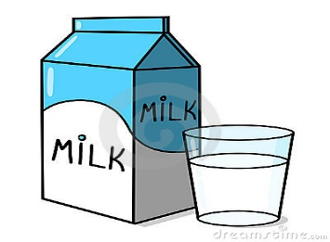

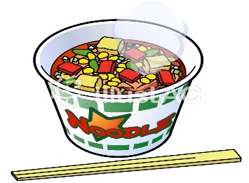
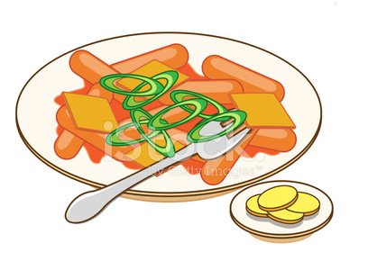

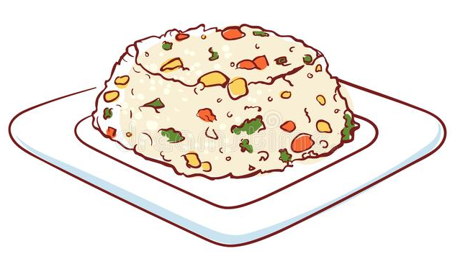


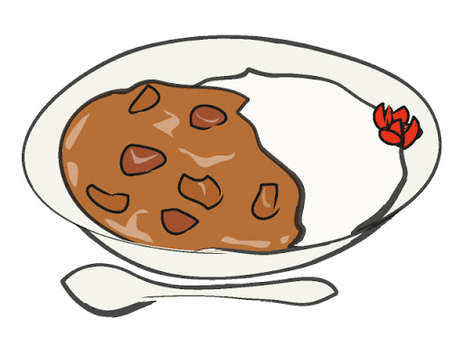
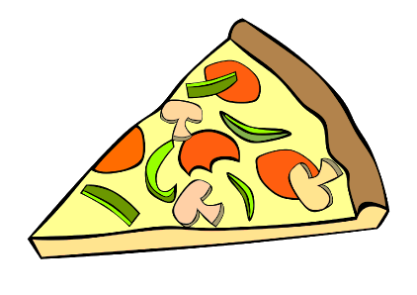
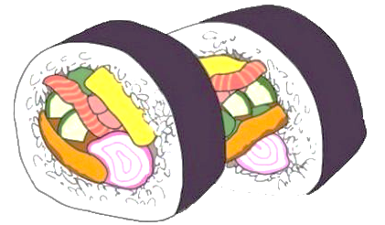
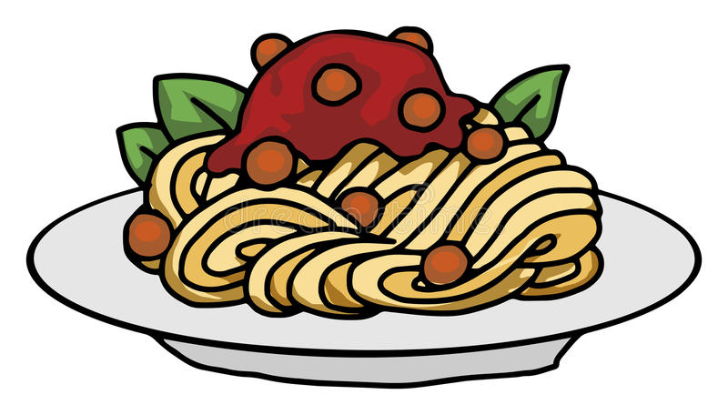

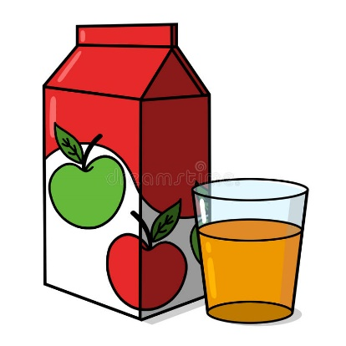
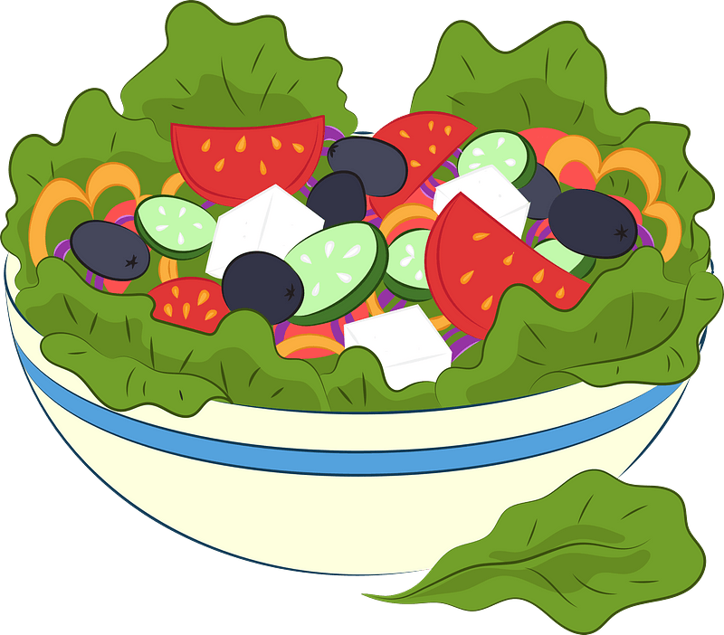
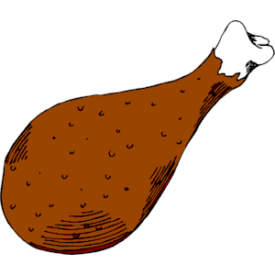


9 | 3 | 13 | 8 | 5 | 17
12 | 7 | 1 | 18 | 11 | 15
2 | 16 | 10 | 14 | 4 | 6
Notes:
EXAMPLE USING ONLY PICTURES
This example uses the key expressions is “What would you like to have?”, “I’d like _______.”, and “It’s _______.”
In this case, I would treat this more as a speaking game.
Click on the boxes to reveal the numbers behind them.
NOTE: I made each example round different just to showcase the different ways you can use this game. Typically, I would use the same type of game board for each round (just changing around the numbers behind the boxes), but feel free to play as you wish (even mix and match the types of boxes you use on the game board).

Slide 13
ROUND 3
ROUND 3
Notes:
Feel free to add as many rounds as you’d like. Typically for a class of 24-27 students, this game usually takes 20-25 minutes.

Slide 14


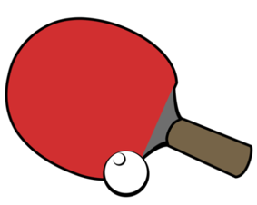








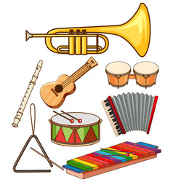





9 | 3 | 13 | 8 | 5 | 17
12 | 7 | 1 | 18 | 11 | 15
2 | 16 | 10 | 14 | 4 | 6
sport
subject
color
sport
subject
color
subject
color
sport
subject
color
sport
color
sport
subject
color
sport
subject
Notes:
EXAMPLE USING PICTURES & WORDS
This example uses the key expressions is “What’s your favorite _______?” and “My favorite _______ is ________.”
In this case, I would treat this more as a speaking game.
Click on the boxes to reveal the numbers behind them.
NOTE: I made each example round different just to showcase the different ways you can use this game. Typically, I would use the same type of game board for each round (just changing around the numbers behind the boxes), but feel free to play as you wish (even mix and match the types of boxes you use on the game board).

Slide 15

# | # | # | # | # | #
# | # | # | # | # | #
word or sentence
word or sentence
Notes:
Game board for ≤12 Students
Replace the pound signs with the numbers of your students (randomly). If your students don’t have numbers, assign them.
If you have extra boxes just leave them blank and don’t put a white box over them.
Choose the type of box of the 3 you will use for this game and just duplicate it to fill all the spaces.
NOTE: The animations when you click on the boxes will automatically duplicate correctly as well, so no need to mess around with those in the animation panel
If using a box that has a picture, to change the picture without disrupting the animation, click the group, then click the picture to select only the picture icon. Right click on the picture icon and press “Change picture…” Choose the picture you want to replace it with from your files and click “Insert.” The picture must be saved to your computer for this to work, no copying and pasting.
When finished, drag your slide under the round you want to use it for

Slide 16
# | # | # | # | # | #
# | # | # | # | # | #
# | # | # | # | # | #
word or sentence
word or sentence
Notes:
Game board for 13-18 Students
Replace the pound signs with the numbers of your students (randomly). If your students don’t have numbers, assign them.
If you have extra boxes just leave them blank and don’t put a white box over them.
Choose the type of box of the 3 you will use for this game and just duplicate it to fill all the spaces.
NOTE: The animations when you click on the boxes will automatically duplicate correctly as well, so no need to mess around with those in the animation panel
If using a box that has a picture, to change the picture without disrupting the animation, click the group, then click the picture to select only the picture icon. Right click on the picture icon and press “Change picture…” Choose the picture you want to replace it with from your files and click “Insert.” The picture must be saved to your computer for this to work, no copying and pasting.

Slide 17
# | # | # | # | # | # | # | #
# | # | # | # | # | # | # | #
# | # | # | # | # | # | # | #
word or sentence
word or sentence
Notes:
Game board for 19-24 Students
Replace the pound signs with the numbers of your students (randomly). If your students don’t have numbers, assign them.
If you have extra boxes just leave them blank and don’t put a white box over them.
Choose the type of box of the 3 you will use for this game and just duplicate it to fill all the spaces.
NOTE: The animations when you click on the boxes will automatically duplicate correctly as well, so no need to mess around with those in the animation panel
If using a box that has a picture, to change the picture without disrupting the animation, click the group, then click the picture to select only the picture icon. Right click on the picture icon and press “Change picture…” Choose the picture you want to replace it with from your files and click “Insert.” The picture must be saved to your computer for this to work, no copying and pasting.

Slide 18

# | # | # | # | # | # | # | # | # | #
# | # | # | # | # | # | # | # | # | #
# | # | # | # | # | # | # | # | # | #
word or sentence
word or sentence
Notes:
Game board for 25-30 Students
Replace the pound signs with the numbers of your students (randomly). If your students don’t have numbers, assign them.
If you have extra boxes just leave them blank and don’t put a white box over them.
Choose the type of box of the 3 you will use for this game and just duplicate it to fill all the spaces.
NOTE: The animations when you click on the boxes will automatically duplicate correctly as well, so no need to mess around with those in the animation panel
If using a box that has a picture, to change the picture without disrupting the animation, click the group, then click the picture to select only the picture icon. Right click on the picture icon and press “Change picture…” Choose the picture you want to replace it with from your files and click “Insert.” The picture must be saved to your computer for this to work, no copying and pasting.

