Slide 1
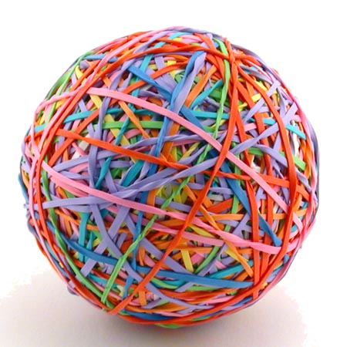

Dear teacher ☺
Pass the ball. When the music stops – whoever has the ball have to give the summary by using words.
Notes:
Find the conversation question sheets (on many topics!) by clicking the Pass the Paper picture!

Slide 2

Pass the BALL!

Slide 4
Pass the BALL!

Slide 6
Pass the BALL!

Slide 8
Pass the BALL!

Slide 10
Pass the BALL!

Slide 12
You are a perfect student.

