Slide 1


Slide 2
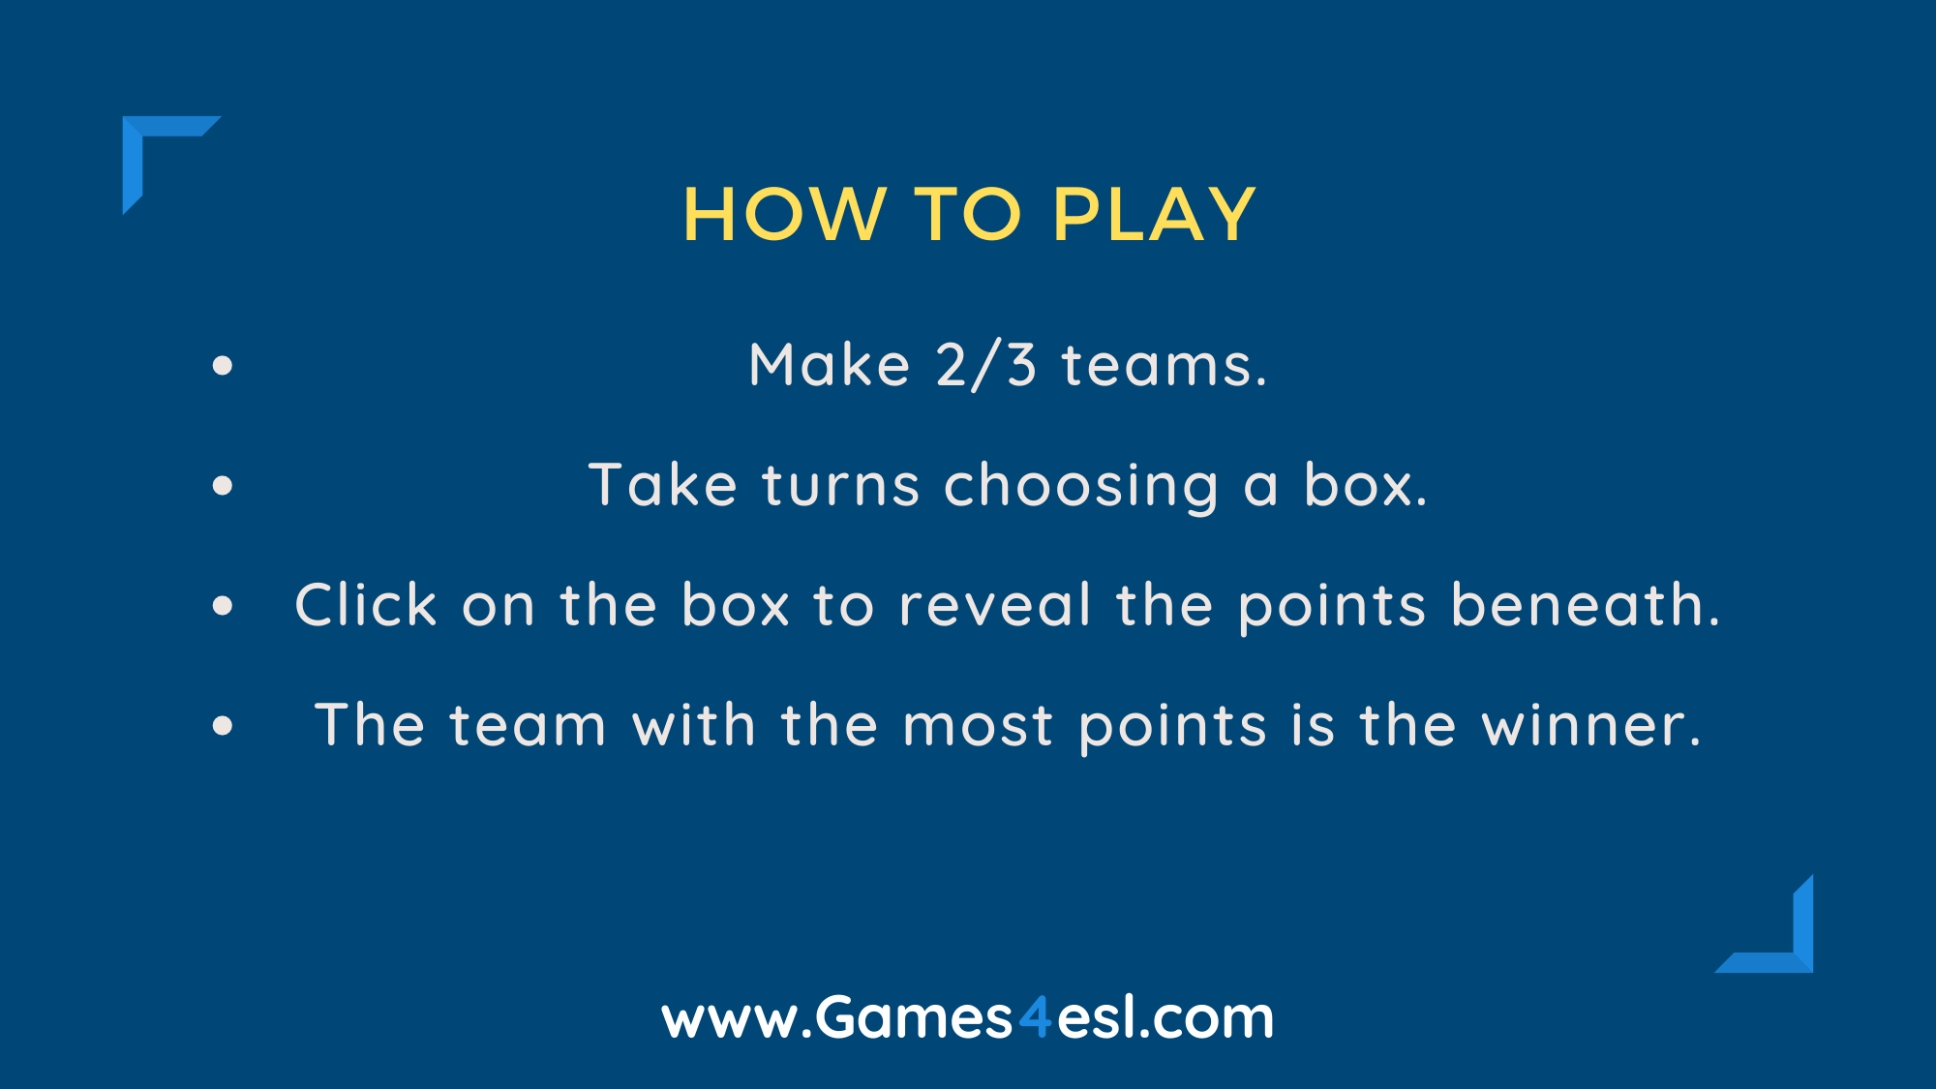

Slide 3





soccer
baseball
tennis
basketball
volleyball
golf
fishing
table tennis
badminton
squash
swimming
archery
darts
cricket
boxing
cycling
wrestling
taekwondo
hockey
gymnastics

