Slide 1
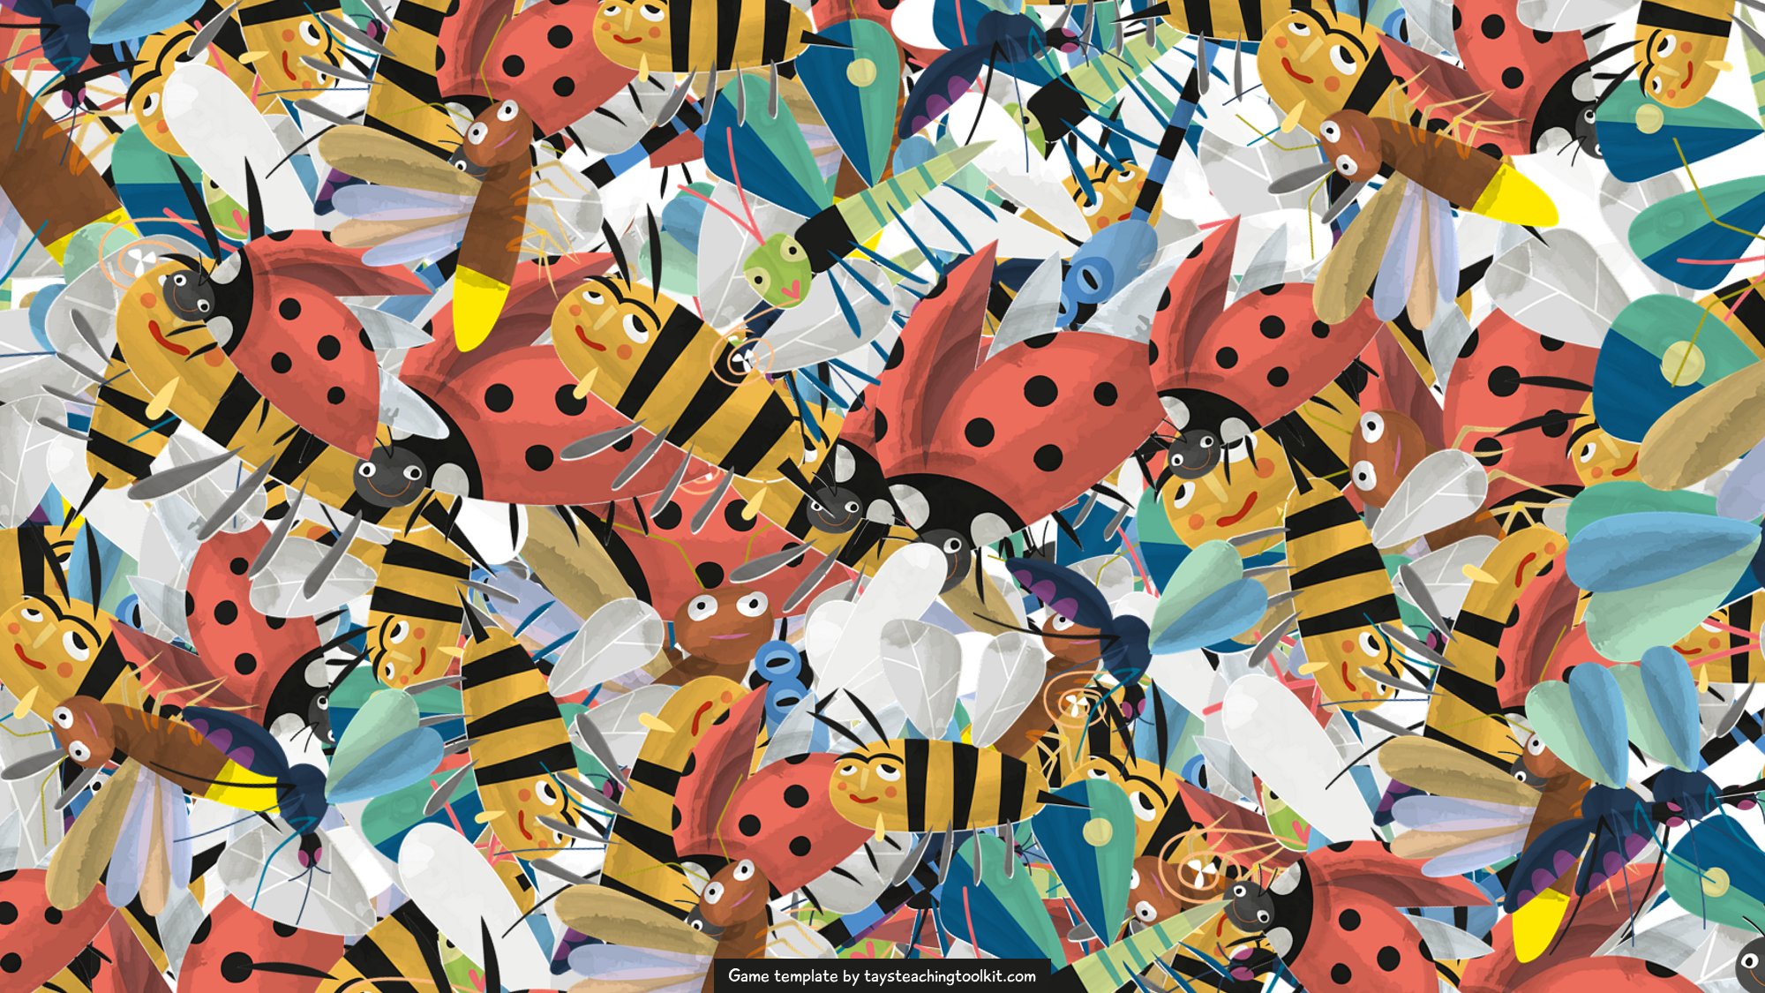






Notes:
This template is for educational, non-commercial purposes only. For more free game templates like this one, visit https://www.taysteachingtoolkit.com

Slide 2
How to Play
How to Play
I will show you a word. For example…

Slide 3


Your word is…
word here
Notes:
TEACHER’S NOTES:
Type an example vocabulary word where it says “word here.”
Background created by upklyak - www.freepik.com

Slide 4
How to Play
How to Play
Count that word on the next slide.

Slide 5
Ready?
Notes:
Background created by upklyak - www.freepik.com

Slide 6


word
word
word
word
word
word
word
Notes:
TEACHER’S NOTES:
Replace the text on the signs the bugs are holding with the same word you typed on Slide 3.
If you need to make the text box longer, click on a group, then click on the text box. While holding down “Ctrl” drag out the point on the box on either the right or left side.
Background created by upklyak - www.freepik.com

Slide 7
Write the sentence that’s
next to your answer.
How many did you read?
5
sentence goes here
6
sentence goes here
7
sentence goes here
Notes:
GAME VERSION: Write or read the answer
TEACHER’S NOTES:
Type 3 different example sentences where it says “sentence goes here.”
For the read-the-answer version, I go through each number one by one. As I go through each answer, I have the students who think that number is correct stand up and read the sentence next to it together.
If playing this version, change the word “Write” to “Read” in the instructions at the top of the slide.
You can also use the “Swarm Guessing Worksheet” for this version instead of the “Swarm Writing Worksheet”
If using this game version, hide or delete slides 8 and 9.
Background created by upklyak - www.freepik.com

Slide 8

Say the sentence above
your answer.
How many did you read?
5
6
7
Notes:
GAME VERSION: Say the answer
TEACHER’S NOTES:
Replace the image icons in the boxes with 3 different images related to your vocabulary or target sentences.
This version is played like the read-the-answer version on the previous slide except instead of reading, students say a sentence based on the picture above their answer.
This version uses the “Swarm Guessing Worksheet.”
If using this game version, hide or delete slides 7 and 9.
Background created by upklyak - www.freepik.com

Slide 9
How many did you read?
7
Notes:
GAME VERSION: Only guess the answer
TEACHER’S NOTES:
It’s up to you how you want to play this version. I usually have students write their guess down on the “Swarm Guessing Worksheet,” then I call on some volunteers to say their guess before revealing the answer.
If using this game version, hide or delete slides 7 and 8.
Background created by upklyak - www.freepik.com

Slide 10
How to Play
How to Play
If you’re right, you get the same points as the answer.

Slide 11
Write the sentence that’s
next to your answer.
5
sentence goes here
6
sentence goes here
7
sentence goes here
+7 pts!
Notes:
GAME VERSION: Write or read the answer
TEACHER’S NOTES:
Type the same 3 sentences you have on Slide 7.
If playing the read-your-answer version, change the word “Write” to “Read” in the instructions at the top of the slide.
If using this game version, hide or delete slides 12 and 13.
Background created by upklyak - www.freepik.com

Slide 12
Say the sentence above
your answer.
+7 pts!
5
6
7
Notes:
GAME VERSION: Say the answer
TEACHER’S NOTES:
Replace the image icons in the boxes with the same 3 images you have on slide 8.
If using this game version, hide or delete slides 11 and 13.
Background created by upklyak - www.freepik.com

Slide 13
How many did you read?
7
+7 pts!
Notes:
GAME VERSION: Only guess the answer
TEACHER’S NOTES:
If using this game version, hide or delete slides 11 and 12.
Background created by upklyak - www.freepik.com

Slide 14
How to Play
How to Play
But! That’s too easy.

Slide 15
How to Play
How to Play
There will also
be other words to trick you!

Slide 16

How to Play
How to Play
word
word
wr. word
Notes:
TEACHER’S NOTES:
Where it says, “word,” replace the text with the same word you typed on Slide 6.
Where it says, “wr. word,” replace it with a “wrong word” that is different the other word you typed on Slide 6 (ex. Ladybug 1- cat; Ladybug 2- cat; Ladybug 3- hat).

Slide 17
How to Play
How to Play
Read carefully and try your best!

Slide 18
LET’S PLAY!
LET’S PLAY!

Slide 19
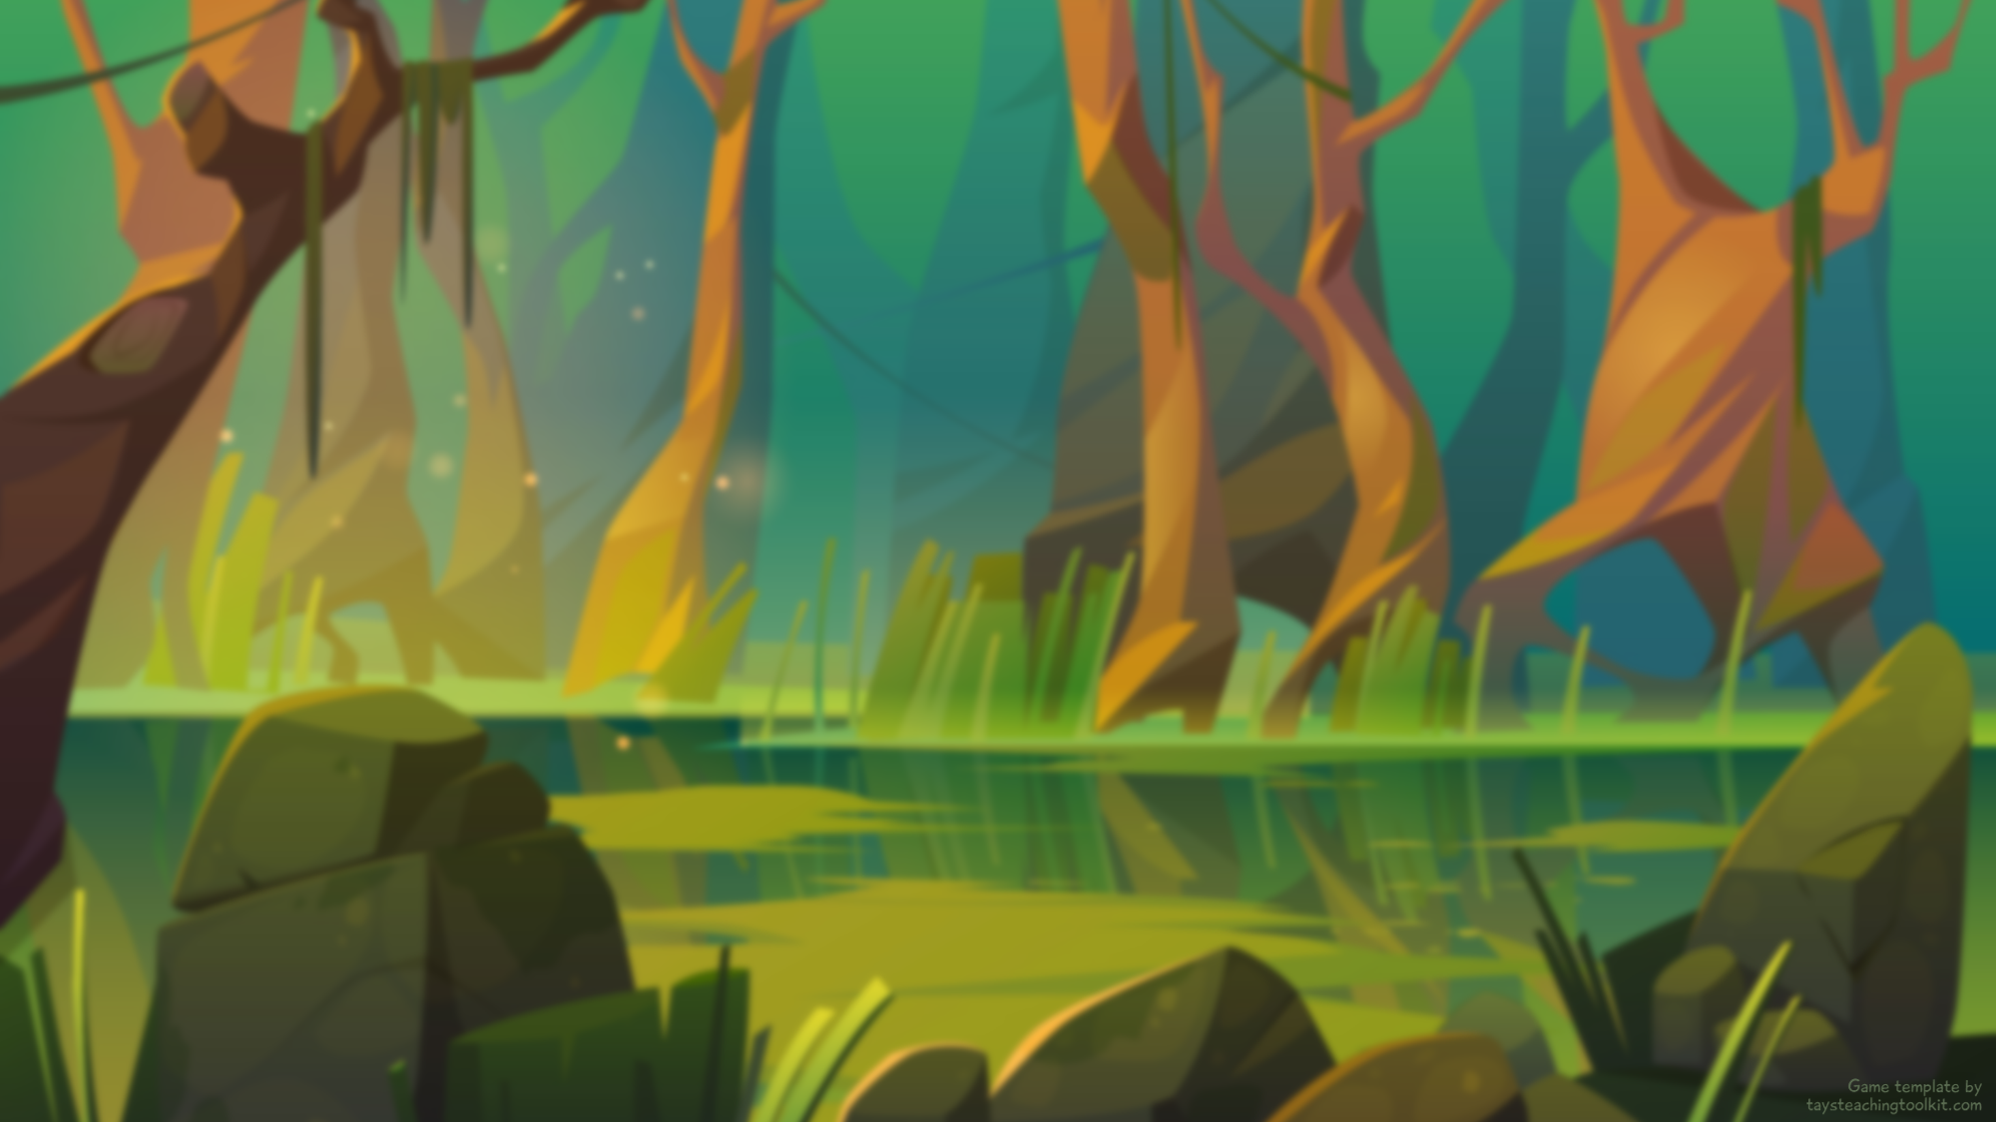
1
Your word is…
word here
Notes:
TEACHER’S NOTES:
Type a vocabulary word where it says “word here.”
Background created by upklyak - www.freepik.com

Slide 20
Ready?
Notes:
Background created by upklyak - www.freepik.com

Slide 21

word
wr. word
word
word
word
word
word
Notes:
TEACHER’S NOTES:
If a bug is holding a sign that says, “word,” replace the text with the same word you typed on Slide 19.
If a bug is holding a sign that says, “wr. word,” (“wrong word”) replace the text with a different word than what you typed on Slide 19 to throw students off.
If you need to make the text box longer, click on a group, then click on the text box. While holding down “Ctrl” drag out the point on the box on either the right or left side.
Do NOT change the placement of words and wrong words (unless you’re familiar with adjusting animations in PowerPoint) as that will change the number of the answer.
If you feel the slide as it is currently is too hard or too easy for your students, see the “How to Adjust the Game Difficulty” document included in the game package file for instructions on how to adjust the difficulty of these slides.
Background created by upklyak - www.freepik.com

Slide 22
1
How many did you read?
9
sentence goes here
10
sentence goes here
11
sentence goes here
Notes:
GAME VERSION: Write or read the answer
TEACHER’S NOTES:
Type 3 different sentences where it says “sentence goes here.”
If using this game version, hide or delete slides 23 and 24.
Background created by upklyak - www.freepik.com

Slide 23

1
How many did you read?
9
10
11
Notes:
GAME VERSION: Say the answer
TEACHER’S NOTES:
Replace the image icons in the boxes with 3 different images related to your vocabulary or target sentences.
If using this game version, hide or delete slides 22 and 24.
Background created by upklyak - www.freepik.com

Slide 24
1
How many did you read?
9
Notes:
GAME VERSION: Only guess the answer
TEACHER’S NOTES:
If using this game version, hide or delete slides 22 and 23.
Background created by upklyak - www.freepik.com

Slide 25
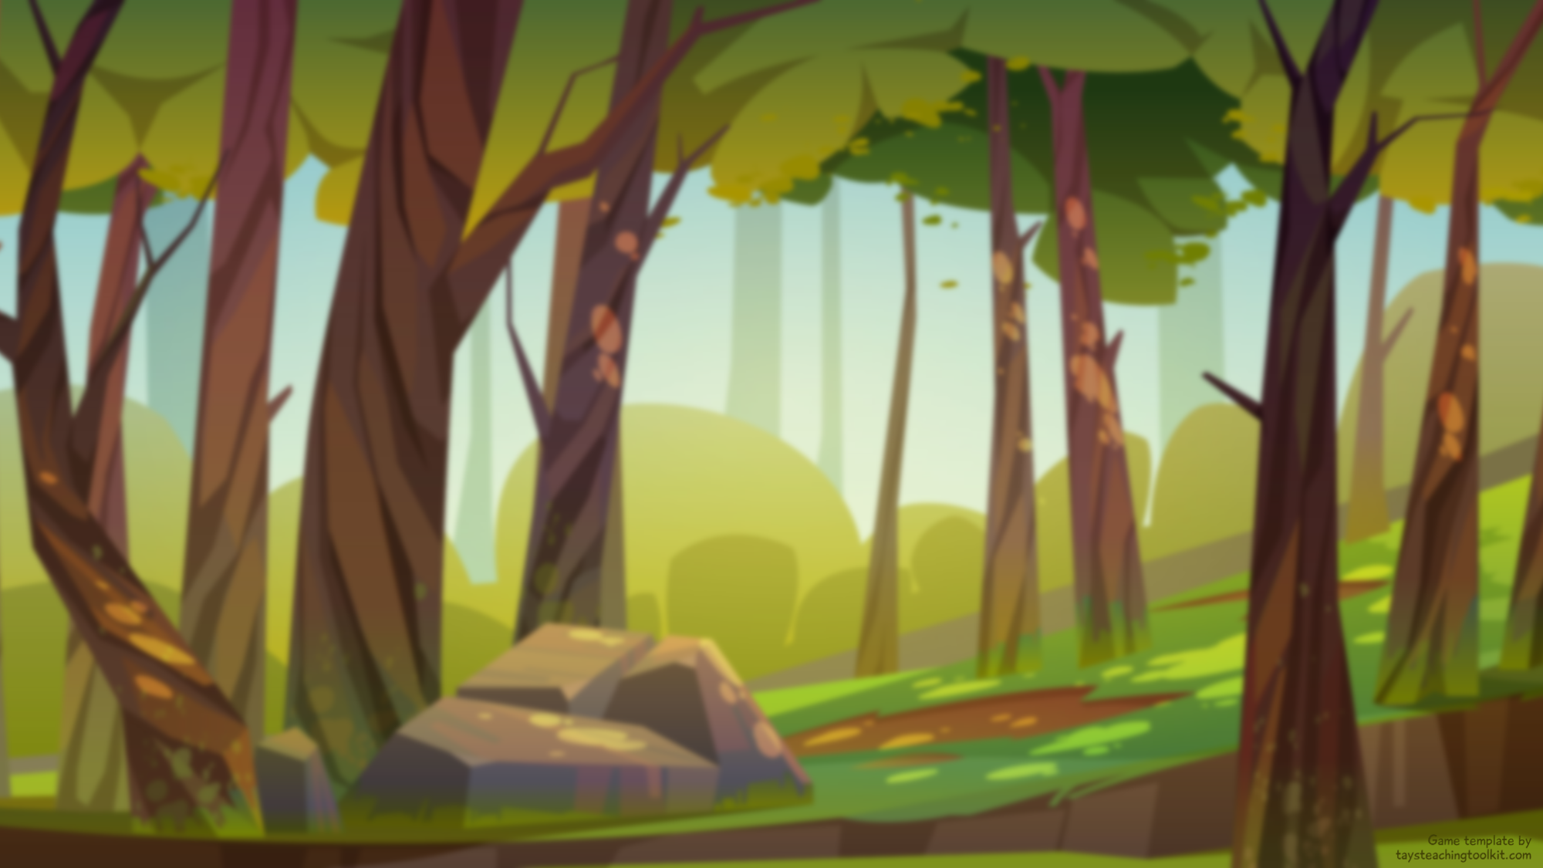
2
Your word is…
word here
Notes:
TEACHER’S NOTES:
Type a vocabulary word where it says “word here.”
Background created by upklyak - www.freepik.com

Slide 26
Ready?
Notes:
Background created by upklyak - www.freepik.com

Slide 27
word
word
wr. word
word
word
word
word
Notes:
TEACHER’S NOTES:
If a bug is holding a sign that says, “word,” replace the text with the same word you typed on Slide 25.
If a bug is holding a sign that says, “wr. word,” (“wrong word”) replace the text with a different word than what you typed on Slide 25 to throw students off.
If you need to make the text box longer, click on a group, then click on the text box. While holding down “Ctrl” drag out the point on the box on either the right or left side.
Do NOT change the placement of words and wrong words (unless you’re familiar with adjusting animations in PowerPoint) as that will change the number of the answer.
If you feel the slide as it is currently is too hard or too easy for your students, see the “How to Adjust the Game Difficulty” document included in the game package file for instructions on how to adjust the difficulty of these slides.
Background created by upklyak - www.freepik.com

Slide 28
2
How many did you read?
16
sentence goes here
17
sentence goes here
18
sentence goes here
Notes:
GAME VERSION: Write or read the answer
TEACHER’S NOTES:
Type 3 different sentences where it says “sentence goes here.”
If using this game version, hide or delete slides 29 and 30.
Background created by upklyak - www.freepik.com

Slide 29
2
How many did you read?
16
17
18
Notes:
GAME VERSION: Say the answer
TEACHER’S NOTES:
Replace the image icons in the boxes with 3 different images related to your vocabulary or target sentences.
If using this game version, hide or delete slides 28 and 30.
Background created by upklyak - www.freepik.com

Slide 30
2
How many did you read?
16
Notes:
GAME VERSION: Only guess the answer
TEACHER’S NOTES:
If using this game version, hide or delete slides 28 and 29.
Background created by upklyak - www.freepik.com

Slide 31

3
Your word is…
word here
Notes:
TEACHER’S NOTES:
Type a vocabulary word where it says “word here.”
Background created by upklyak - www.freepik.com

Slide 32
Ready?
Notes:
Background created by upklyak - www.freepik.com

Slide 33

wr. word
word
word
word
word
wr. word
word
Notes:
TEACHER’S NOTES:
If a bug is holding a sign that says, “word,” replace the text with the same word you typed on Slide 31.
If a bug is holding a sign that says, “wr. word,” (“wrong word”) replace the text with a different word than what you typed on Slide 31 to throw students off. It’s up to you if you want all the “wrong words” on the slide to be the same word or different words.
If you need to make the text box longer, click on a group, then click on the text box. While holding down “Ctrl” drag out the point on the box on either the right or left side.
Do NOT change the placement of words and wrong words (unless you’re familiar with adjusting animations in PowerPoint) as that will change the number of the answer.
If you feel the slide as it is currently is too hard or too easy for your students, see the “How to Adjust the Game Difficulty” document included in the game package file for instructions on how to adjust the difficulty of these slides.
Background created by upklyak - www.freepik.com

Slide 34
3
How many did you read?
13
sentence goes here
14
sentence goes here
15
sentence goes here
Notes:
GAME VERSION: Write or read the answer
TEACHER’S NOTES:
Type 3 different sentences where it says “sentence goes here.”
If using this game version, hide or delete slides 35 and 36.
Background created by upklyak - www.freepik.com

Slide 35
3
How many did you read?
13
14
15
Notes:
GAME VERSION: Say the answer
TEACHER’S NOTES:
Replace the image icons in the boxes with 3 different images related to your vocabulary or target sentences.
If using this game version, hide or delete slides 34 and 36.
Background created by upklyak - www.freepik.com

Slide 36
3
How many did you read?
13
Notes:
GAME VERSION: Only guess the answer
TEACHER’S NOTES:
If using this game version, hide or delete slides 34 and 35.
Background created by upklyak - www.freepik.com

Slide 37
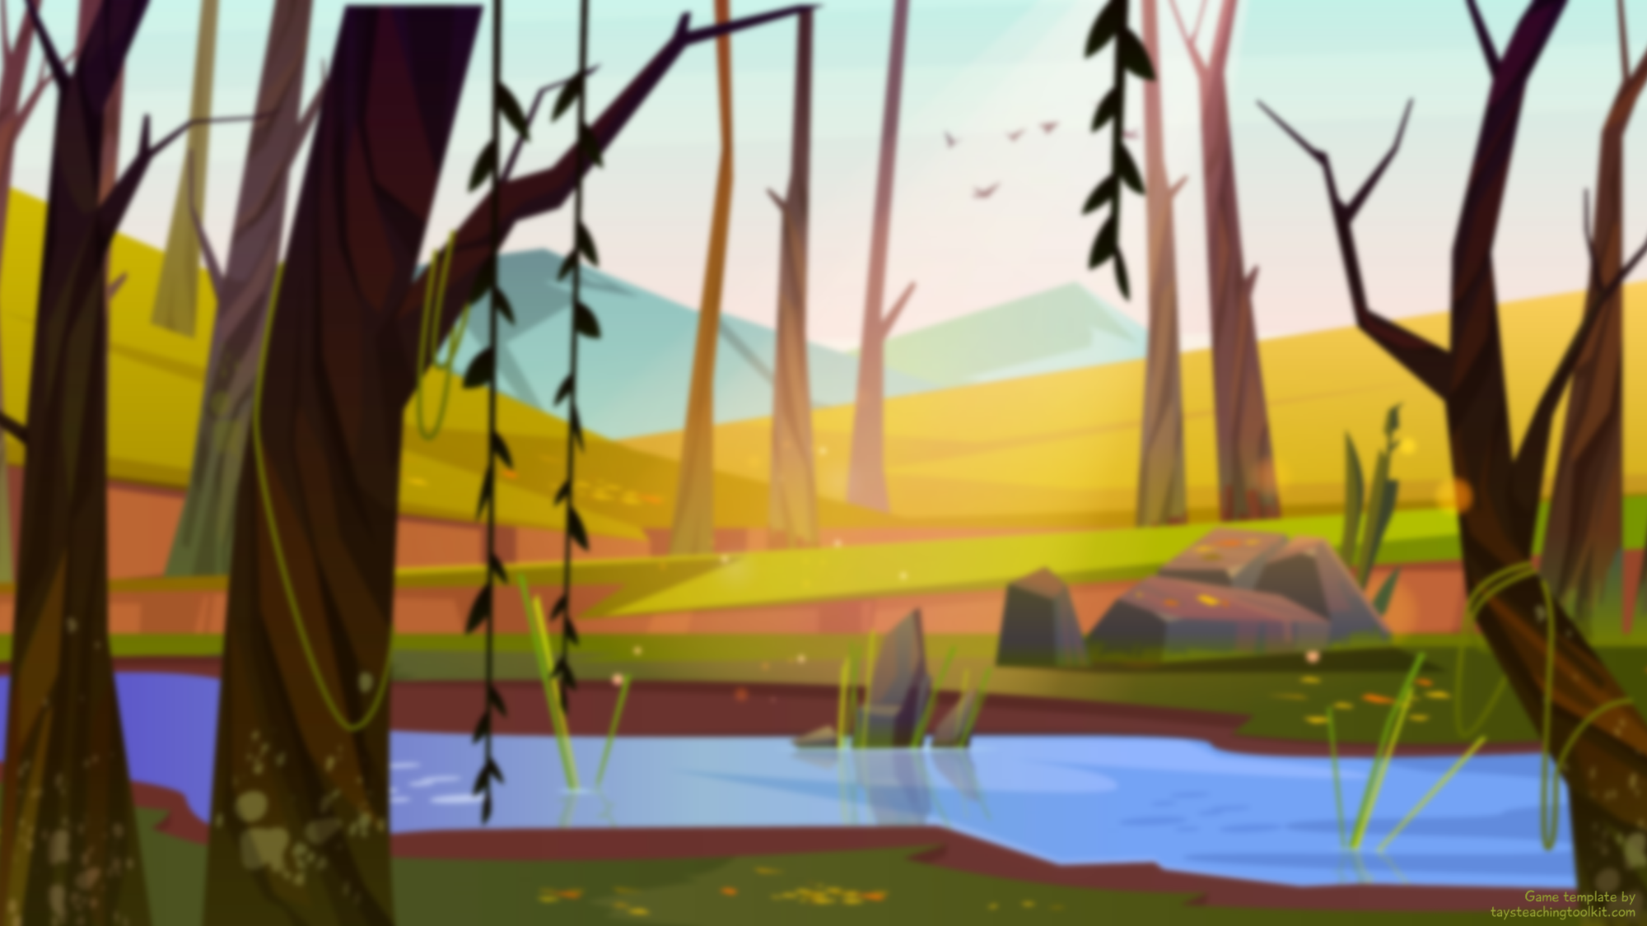
4
Your word is…
word here
Notes:
TEACHER’S NOTES:
Type a vocabulary word where it says “word here.”
Background created by upklyak - www.freepik.com

Slide 38
Ready?
Notes:
Background created by upklyak - www.freepik.com

Slide 39

wr. word
word
word
word
wr. word
word
word
Notes:
TEACHER’S NOTES:
If a bug is holding a sign that says, “word,” replace the text with the same word you typed on Slide 37.
If a bug is holding a sign that says, “wr. word,” (“wrong word”) replace the text with a different word than what you typed on Slide 37 to throw students off. It’s up to you if you want all the “wrong words” on the slide to be the same word or different words.
If you need to make the text box longer, click on a group, then click on the text box. While holding down “Ctrl” drag out the point on the box on either the right or left side.
Do NOT change the placement of words and wrong words (unless you’re familiar with adjusting animations in PowerPoint) as that will change the number of the answer.
If you feel the slide as it is currently is too hard or too easy for your students, see the “How to Adjust the Game Difficulty” document included in the game package file for instructions on how to adjust the difficulty of these slides.
Background created by upklyak - www.freepik.com

Slide 40
4
How many did you read?
17
sentence goes here
18
sentence goes here
19
sentence goes here
Notes:
GAME VERSION: Write or read the answer
TEACHER’S NOTES:
Type 3 different sentences where it says “sentence goes here.”
If using this game version, hide or delete slides 41 and 42.
Background created by upklyak - www.freepik.com

Slide 41
4
How many did you read?
17
18
19
Notes:
GAME VERSION: Say the answer
TEACHER’S NOTES:
Replace the image icons in the boxes with 3 different images related to your vocabulary or target sentences.
If using this game version, hide or delete slides 40 and 42.
Background created by upklyak - www.freepik.com

Slide 42
4
How many did you read?
18
Notes:
GAME VERSION: Only guess the answer
TEACHER’S NOTES:
If using this game version, hide or delete slides 40 and 41.
Background created by upklyak - www.freepik.com

Slide 43
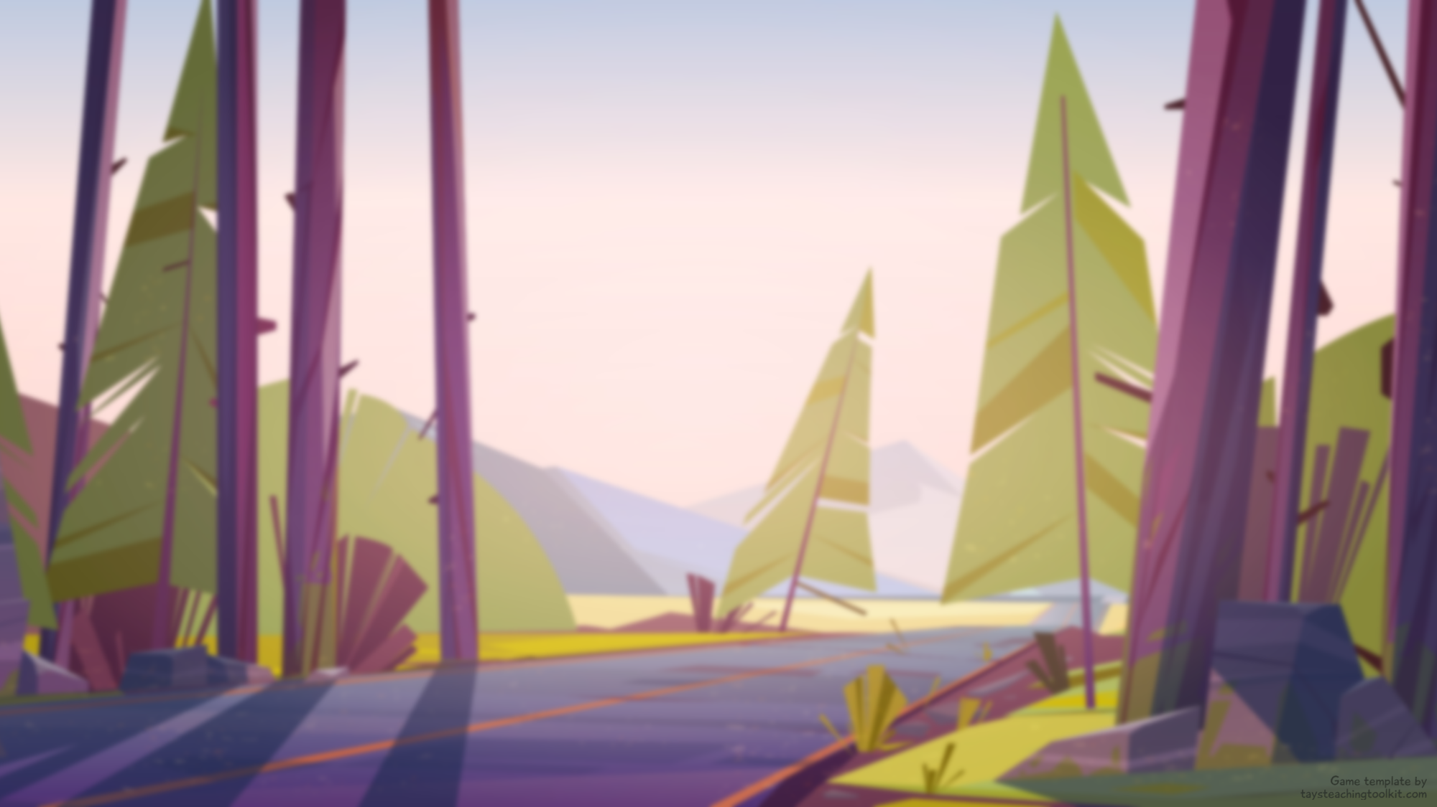
5
Your word is…
word here
Notes:
TEACHER’S NOTES:
Type a vocabulary word where it says “word here.”
Background created by upklyak - www.freepik.com

Slide 44
Ready?
Notes:
Background created by upklyak - www.freepik.com

Slide 45
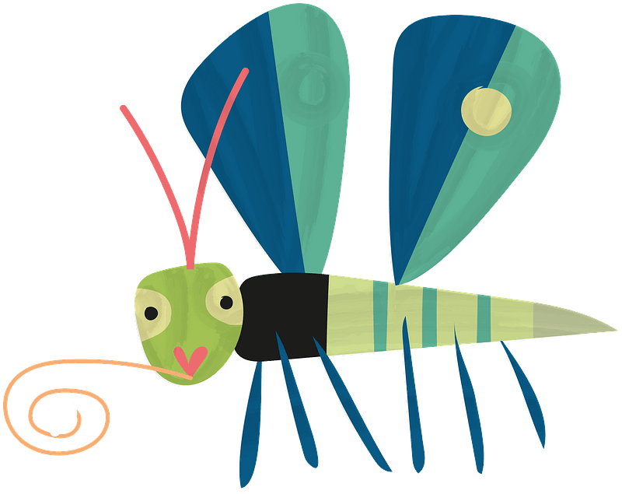
word
word
wr. word
word
word
word
word
word
wr. word
word
word
word
word
word
Notes:
TEACHER’S NOTES:
If a bug is holding a sign that says, “word,” replace the text with the same word you typed on Slide 43.
If a bug is holding a sign that says, “wr. word,” (“wrong word”) replace the text with a different word than what you typed on Slide 43 to throw students off. It’s up to you if you want all the “wrong words” on the slide to be the same word or different words.
If you need to make the text box longer, click on a group, then click on the text box. While holding down “Ctrl” drag out the point on the box on either the right or left side.
Do NOT change the placement of words and wrong words (unless you’re familiar with adjusting animations in PowerPoint) as that will change the number of the answer.
If you feel the slide as it is currently is too hard or too easy for your students, see the “How to Adjust the Game Difficulty” document included in the game package file for instructions on how to adjust the difficulty of these slides.
Background created by upklyak - www.freepik.com

Slide 46
5
How many did you read?
24
sentence goes here
25
sentence goes here
26
sentence goes here
Notes:
GAME VERSION: Write or read the answer
TEACHER’S NOTES:
Type 3 different sentences where it says “sentence goes here.”
If using this game version, hide or delete slides 47 and 48
Background created by upklyak - www.freepik.com

Slide 47
5
How many did you read?
24
25
26
Notes:
GAME VERSION: Say the answer
TEACHER’S NOTES:
Replace the image icons in the boxes with 3 different images related to your vocabulary or target sentences.
If using this game version, hide or delete slides 46 and 48.
Background created by upklyak - www.freepik.com

Slide 48
5
How many did you read?
25
Notes:
GAME VERSION: Only guess the answer
TEACHER’S NOTES:
If using this game version, hide or delete slides 46 and 47.
Background created by upklyak - www.freepik.com

Slide 49
6
Your word is…
word here
Notes:
TEACHER’S NOTES:
Type a vocabulary word where it says “word here.”
Background created by upklyak - www.freepik.com

Slide 50
Ready?
Notes:
Background created by upklyak - www.freepik.com

Slide 51
word
word
word
wr. word
wr. word
word
word
word
word
word
word
word
word
wr. word
Notes:
TEACHER’S NOTES:
If a bug is holding a sign that says, “word,” replace the text with the same word you typed on Slide 49.
If a bug is holding a sign that says, “wr. word,” (“wrong word”) replace the text with a different word than what you typed on Slide 49 to throw students off. It’s up to you if you want all the “wrong words” on the slide to be the same word or different words.
If you need to make the text box longer, click on a group, then click on the text box. While holding down “Ctrl” drag out the point on the box on either the right or left side.
Do NOT change the placement of words and wrong words (unless you’re familiar with adjusting animations in PowerPoint) as that will change the number of the answer.
If you feel the slide as it is currently is too hard or too easy for your students, see the “How to Adjust the Game Difficulty” document included in the game package file for instructions on how to adjust the difficulty of these slides.
Background created by upklyak - www.freepik.com

Slide 52
6
How many did you read?
19
sentence goes here
20
sentence goes here
21
sentence goes here
Notes:
GAME VERSION: Write or read the answer
TEACHER’S NOTES:
Type 3 different sentences where it says “sentence goes here.”
If using this game version, hide or delete slides 53 and 54.
Background created by upklyak - www.freepik.com

Slide 53
6
How many did you read?
19
20
21
Notes:
GAME VERSION: Say the answer
TEACHER’S NOTES:
Replace the image icons in the boxes with 3 different images related to your vocabulary or target sentences.
If using this game version, hide or delete slides 52 and 54.
Background created by upklyak - www.freepik.com

Slide 54
6
How many did you read?
19
Notes:
GAME VERSION: Only guess the answer
TEACHER’S NOTES:
If using this game version, hide or delete slides 52 and 53.
Background created by upklyak - www.freepik.com

Slide 55
7
Your word is…
word here
Notes:
TEACHER’S NOTES:
Type a vocabulary word where it says “word here.”
Background created by upklyak - www.freepik.com

Slide 56
Ready?
Notes:
Background created by upklyak - www.freepik.com

Slide 57
wr. word
word
word
word
word
word
word
wr. word
word
word
word
word
word
wr. word
Notes:
TEACHER’S NOTES:
If a bug is holding a sign that says, “word,” replace the text with the same word you typed on Slide 55.
If a bug is holding a sign that says, “wr. word,” (“wrong word”) replace the text with a different word than what you typed on Slide 55 to throw students off. It’s up to you if you want all the “wrong words” on the slide to be the same word or different words.
If you need to make the text box longer, click on a group, then click on the text box. While holding down “Ctrl” drag out the point on the box on either the right or left side.
Do NOT change the placement of words and wrong words (unless you’re familiar with adjusting animations in PowerPoint) as that will change the number of the answer.
If you feel the slide as it is currently is too hard or too easy for your students, see the “How to Adjust the Game Difficulty” document included in the game package file for instructions on how to adjust the difficulty of these slides.
Background created by upklyak - www.freepik.com

Slide 58
7
How many did you read?
21
sentence goes here
22
sentence goes here
23
sentence goes here
Notes:
GAME VERSION: Write or read the answer
TEACHER’S NOTES:
Type 3 different sentences where it says “sentence goes here.”
If using this game version, hide or delete slides 59 and 60.
Background created by upklyak - www.freepik.com

Slide 59
7
How many did you read?
21
22
23
Notes:
GAME VERSION: Say the answer
TEACHER’S NOTES:
Replace the image icons in the boxes with 3 different images related to your vocabulary or target sentences.
If using this game version, hide or delete slides 58 and 60.
Background created by upklyak - www.freepik.com

Slide 60
7
How many did you read?
23
Notes:
GAME VERSION: Only guess the answer
TEACHER’S NOTES:
If using this game version, hide or delete slides 58 and 59.
Background created by upklyak - www.freepik.com

Slide 61
8
Your word is…
word here
Notes:
TEACHER’S NOTES:
Type a vocabulary word where it says “word here.”
Background created by upklyak - www.freepik.com

Slide 62
Ready?
Notes:
Background created by upklyak - www.freepik.com

Slide 63
word
word
word
wr. word
wr. word
word
word
word
wr. word
word
word
word
word
word
Notes:
TEACHER’S NOTES:
If a bug is holding a sign that says, “word,” replace the text with the same word you typed on Slide 61.
If a bug is holding a sign that says, “wr. word,” (“wrong word”) replace the text with a different word than what you typed on Slide 61 to throw students off. It’s up to you if you want all the “wrong words” on the slide to be the same word or different words.\If you need to make the text box longer, click on a group, then click on the text box. While holding down “Ctrl” drag out the point on the box on either the right or left side.
Do NOT change the placement of words and wrong words (unless you’re familiar with adjusting animations in PowerPoint) as that will change the number of the answer.
If you feel the slide as it is currently is too hard or too easy for your students, see the “How to Adjust the Game Difficulty” document included in the game package file for instructions on how to adjust the difficulty of these slides.
Background created by upklyak - www.freepik.com

Slide 64
8
How many did you read?
25
sentence goes here
26
sentence goes here
27
sentence goes here
Notes:
GAME VERSION: Write or read the answer
TEACHER’S NOTES:
Type 3 different sentences where it says “sentence goes here.”
If using this game version, hide or delete slides 65 and 66.
Background created by upklyak - www.freepik.com

Slide 65
8
How many did you read?
25
26
27
Notes:
GAME VERSION: Say the answer
TEACHER’S NOTES:
Replace the image icons in the boxes with 3 different images related to your vocabulary or target sentences.
If using this game version, hide or delete slides 64 and 66.
Background created by upklyak - www.freepik.com

Slide 66
8
How many did you read?
27
Notes:
GAME VERSION: Only guess the answer
TEACHER’S NOTES:
If using this game version, hide or delete slides 64 and 65.
Background created by upklyak - www.freepik.com

Slide 67
9
Your word is…
word here
Notes:
TEACHER’S NOTES:
Type a vocabulary word where it says “word here.”
Background created by upklyak - www.freepik.com

Slide 68
Ready?
Notes:
Background created by upklyak - www.freepik.com

Slide 69
word
word
word
wr. word
word
word
wr. word
word
word
word
word
word
word
wr. word
Notes:
TEACHER’S NOTES:
If a bug is holding a sign that says, “word,” replace the text with the same word you typed on Slide 67.
If a bug is holding a sign that says, “wr. word,” (“wrong word”) replace the text with a different word than what you typed on Slide 67 to throw students off. It’s up to you if you want all the “wrong words” on the slide to be the same word or different words.
If you need to make the text box longer, click on a group, then click on the text box. While holding down “Ctrl” drag out the point on the box on either the right or left side.
Do NOT change the placement of words and wrong words (unless you’re familiar with adjusting animations in PowerPoint) as that will change the number of the answer.
If you feel the slide as it is currently is too hard or too easy for your students, see the “How to Adjust the Game Difficulty” document included in the game package file for instructions on how to adjust the difficulty of these slides.
Background created by upklyak - www.freepik.com

Slide 70
9
How many did you read?
31
sentence goes here
32
sentence goes here
33
sentence goes here
Notes:
GAME VERSION: Write or read the answer
TEACHER’S NOTES:
Type 3 different sentences where it says “sentence goes here.”
If using this game version, hide or delete slides 71 and 72.
Background created by upklyak - www.freepik.com

Slide 71
9
How many did you read?
31
32
33
Notes:
GAME VERSION: Say the answer
TEACHER’S NOTES:
Replace the image icons in the boxes with 3 different images related to your vocabulary or target sentences.
If using this game version, hide or delete slides 70 and 72.
Background created by upklyak - www.freepik.com

Slide 72
9
How many did you read?
32
Notes:
GAME VERSION: Only guess the answer
TEACHER’S NOTES:
If using this game version, hide or delete slides 70 and 71.
Background created by upklyak - www.freepik.com

Slide 73
10
Your word is…
word here
Notes:
TEACHER’S NOTES:
Type a vocabulary word where it says “word here.”
Background created by upklyak - www.freepik.com

Slide 74
Ready?
Notes:
Background created by upklyak - www.freepik.com

Slide 75
word
word
wr. word
word
word
word
word
word
wr. word
word
word
wr. word
word
word
Notes:
TEACHER’S NOTES:
If a bug is holding a sign that says, “word,” replace the text with the same word you typed on Slide 73.
If a bug is holding a sign that says, “wr. word,” (“wrong word”) replace the text with a different word than what you typed on Slide 73 to throw students off. It’s up to you if you want all the “wrong words” on the slide to be the same word or different words.
If you need to make the text box longer, click on a group, then click on the text box. While holding down “Ctrl” drag out the point on the box on either the right or left side.
Do NOT change the placement of words and wrong words (unless you’re familiar with adjusting animations in PowerPoint) as that will change the number of the answer.
If you feel the slide as it is currently is too hard or too easy for your students, see the “How to Adjust the Game Difficulty” document included in the game package file for instructions on how to adjust the difficulty of these slides.
Background created by upklyak - www.freepik.com

Slide 76
10
How many did you read?
28
sentence goes here
29
sentence goes here
30
sentence goes here
Notes:
GAME VERSION: Write or read the answer
TEACHER’S NOTES:
Type 3 different sentences where it says “sentence goes here.”
If using this game version, hide or delete slides 77 and 78.
Background created by upklyak - www.freepik.com

Slide 77
10
How many did you read?
28
29
30
Notes:
GAME VERSION: Say the answer
TEACHER’S NOTES:
Replace the image icons in the boxes with 3 different images related to your vocabulary or target sentences.
If using this game version, hide or delete slides 76 and 78.
Background created by upklyak - www.freepik.com

Slide 78
10
How many did you read?
30
Notes:
GAME VERSION: Only guess the answer
TEACHER’S NOTES:
If using this game version, hide or delete slides 76 and 77.
Background created by upklyak - www.freepik.com

Slide 79
11
Your word is…
word here
Notes:
TEACHER’S NOTES:
Type a vocabulary word where it says “word here.”
Background created by upklyak - www.freepik.com

Slide 80
Ready?
Notes:
Background created by upklyak - www.freepik.com

Slide 81
word
wr. word
word
word
word
word
wr. word
word
wr. word
word
word
wr. word
word
word
Notes:
TEACHER’S NOTES:
If a bug is holding a sign that says, “word,” replace the text with the same word you typed on Slide 79.
If a bug is holding a sign that says, “wr. word,” (“wrong word”) replace the text with a different word than what you typed on Slide 79 to throw students off. It’s up to you if you want all the “wrong words” on the slide to be the same word or different words.
If you need to make the text box longer, click on a group, then click on the text box. While holding down “Ctrl” drag out the point on the box on either the right or left side.
Do NOT change the placement of words and wrong words (unless you’re familiar with adjusting animations in PowerPoint) as that will change the number of the answer.
If you feel the slide as it is currently is too hard or too easy for your students, see the “How to Adjust the Game Difficulty” document included in the game package file for instructions on how to adjust the difficulty of these slides.
Background created by upklyak - www.freepik.com

Slide 82
11
How many did you read?
36
sentence goes here
37
sentence goes here
38
sentence goes here
Notes:
GAME VERSION: Write or read the answer
TEACHER’S NOTES:
Type 3 different sentences where it says “sentence goes here.”
If using this game version, hide or delete slides 83 and 84.
Background created by upklyak - www.freepik.com

Slide 83
11
How many did you read?
36
37
38
Notes:
GAME VERSION: Say the answer
TEACHER’S NOTES:
Replace the image icons in the boxes with 3 different images related to your vocabulary or target sentences.
If using this game version, hide or delete slides 82 and 84.
Background created by upklyak - www.freepik.com

Slide 84
11
How many did you read?
36
Notes:
GAME VERSION: Only guess the answer
TEACHER’S NOTES:
If using this game version, hide or delete slides 82 and 83.
Background created by upklyak - www.freepik.com

Slide 85
GREAT JOB!
GREAT JOB!

