Slide 1


Slide 2
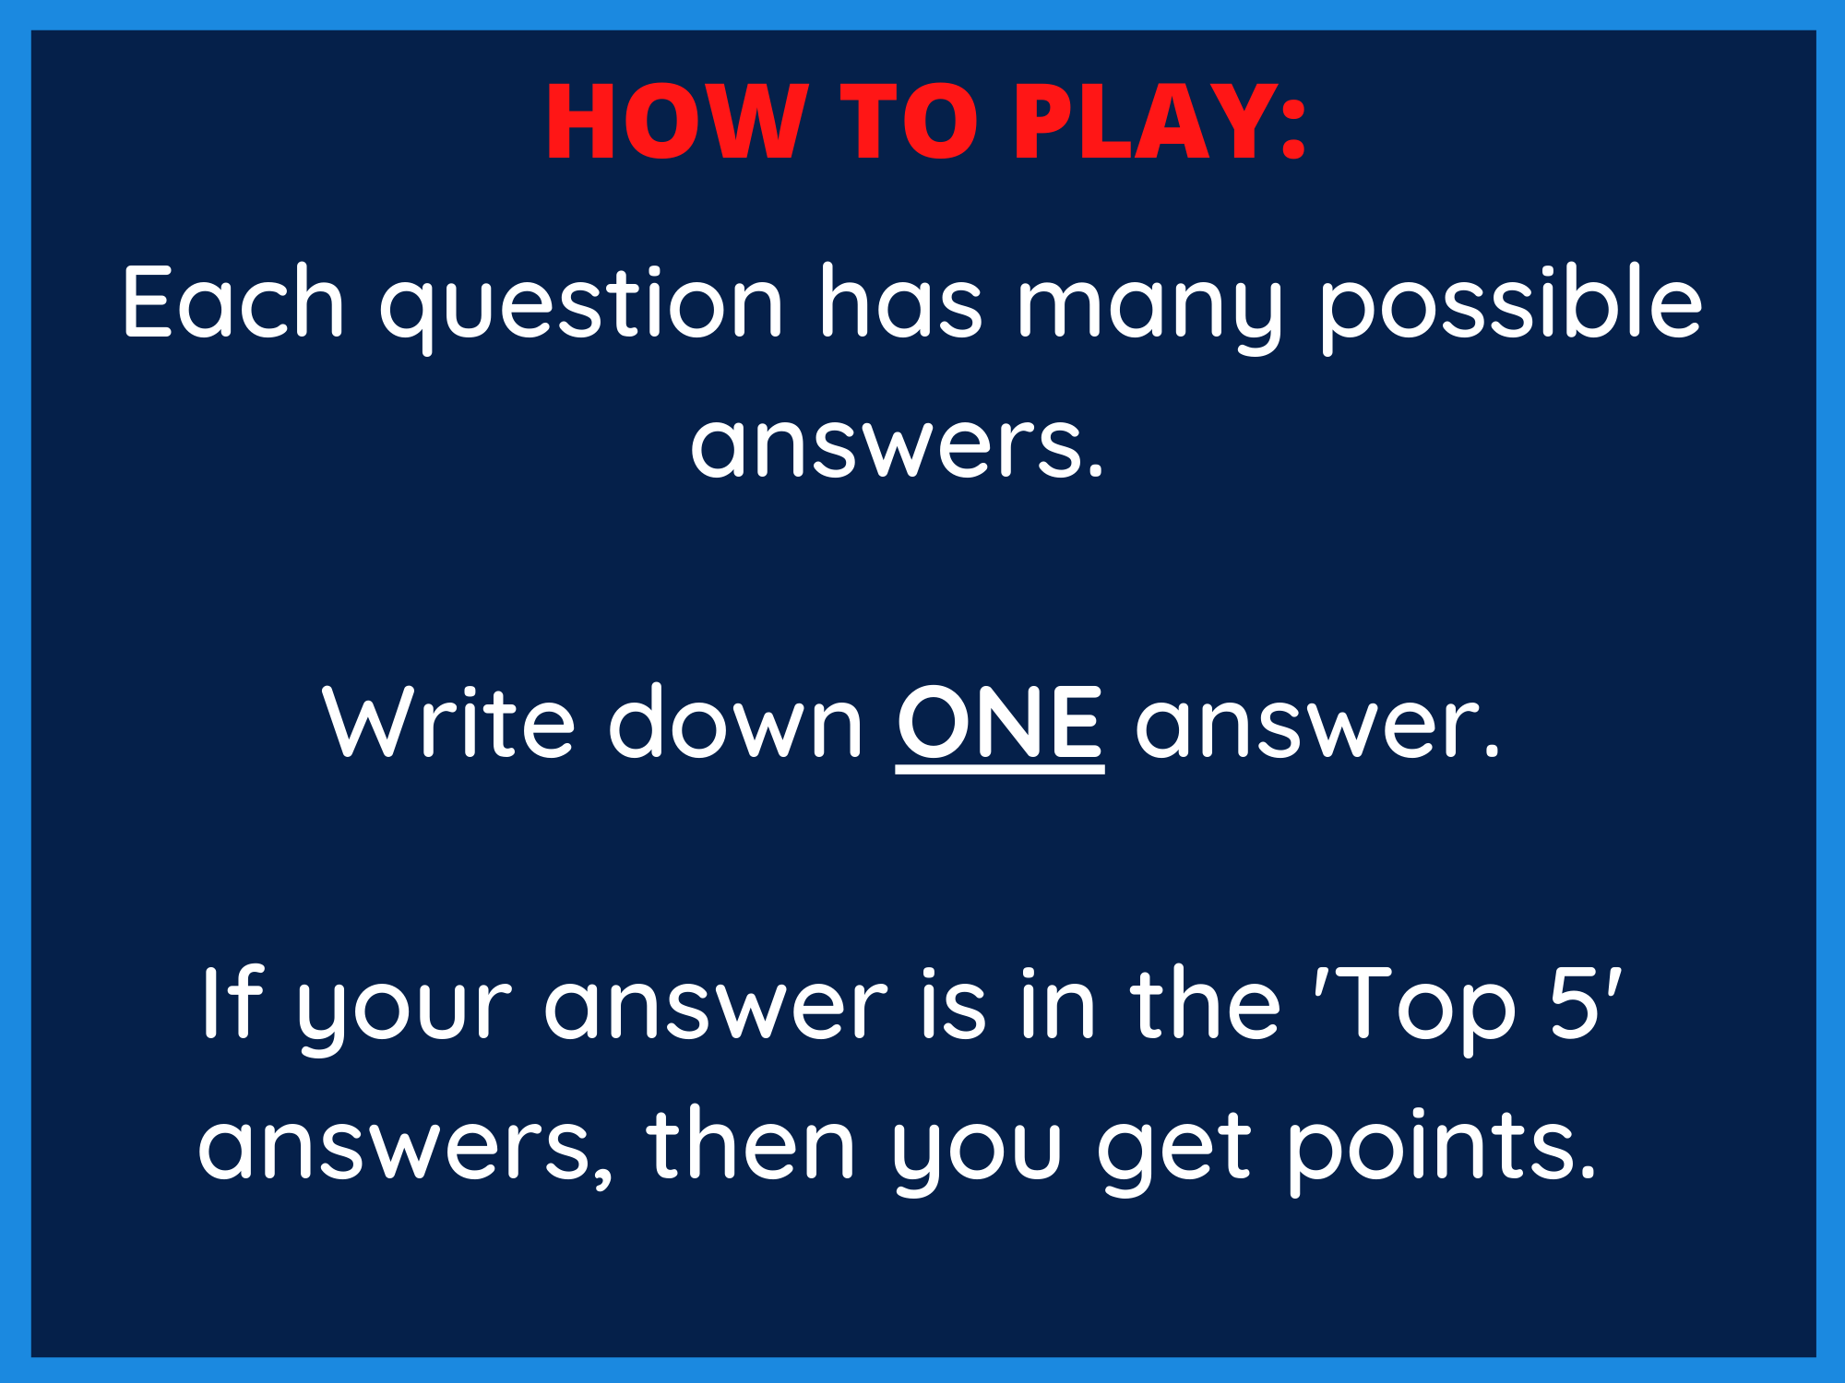

Slide 3


Slide 4
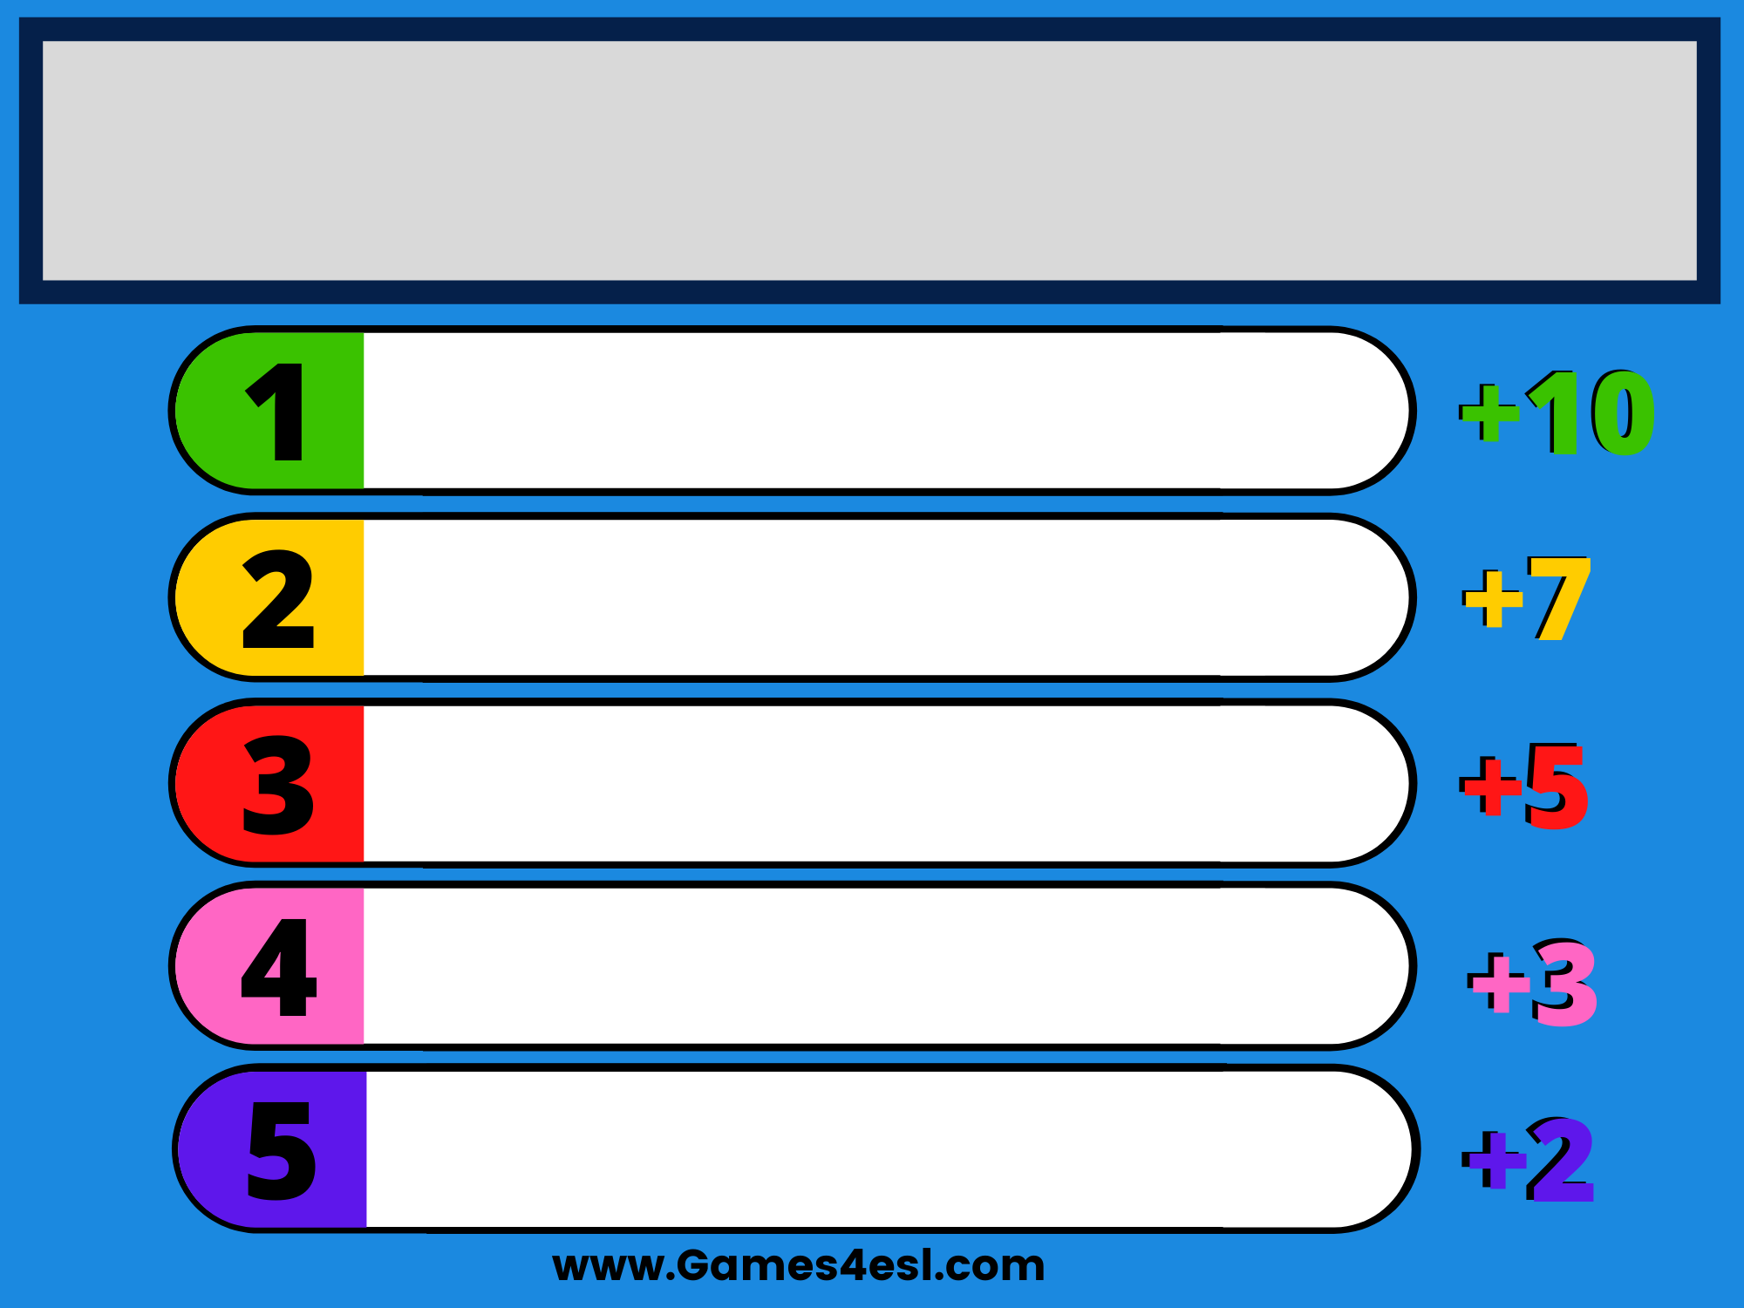
Type Question Here
Answer Here
Answer Here
Answer Here
Answer Here
Answer Here

Slide 5


Slide 6
Type Question Here
Answer Here
Answer Here
Answer Here
Answer Here
Answer Here

Slide 7


Slide 8
Type Question Here
Answer Here
Answer Here
Answer Here
Answer Here
Answer Here

Slide 9


Slide 10
Type Question Here
Answer Here
Answer Here
Answer Here
Answer Here
Answer Here

Slide 11


Slide 12
Type Question Here
Answer Here
Answer Here
Answer Here
Answer Here
Answer Here

Slide 13


Slide 14
Type Question Here
Answer Here
Answer Here
Answer Here
Answer Here
Answer Here

Slide 15


Slide 16
Type Question Here
Answer Here
Answer Here
Answer Here
Answer Here
Answer Here

Slide 17


Slide 18
Type Question Here
Answer Here
Answer Here
Answer Here
Answer Here
Answer Here

Slide 19


Slide 20
Type Question Here
Answer Here
Answer Here
Answer Here
Answer Here
Answer Here

Slide 21


Slide 22
Type Question Here
Answer Here
Answer Here
Answer Here
Answer Here
Answer Here

