Slide 1
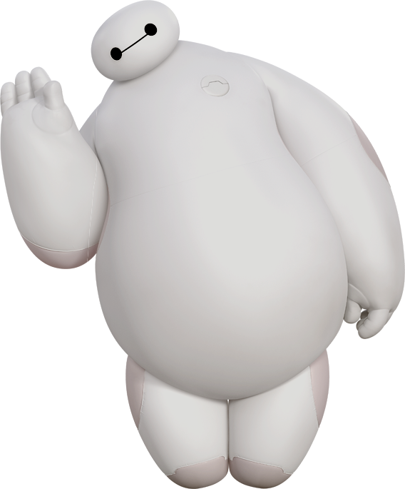
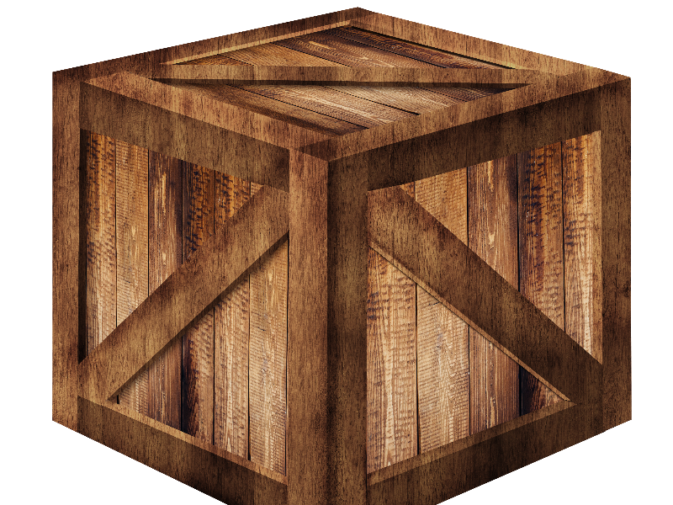
WHAT’S
IN THE
BOX?
?

Slide 2
Hi! I’m Baymax.
Can you guess
what’s inside my box?
You can ask me questions, but I can only answer with “Yes” or “No”.
Ready? Let’s start!
?

Slide 3
Baymax, is it something _______?
Yes, it is.
No, it isn’t.
big, small
round, square
hard, soft
yellow, green
?

Slide 4
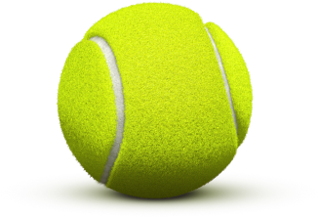
It’s a TENNIS BALL!

Slide 5
Baymax, does it
have ______?
Yes, it does.
No, it doesn’t.
legs, eyes
fur, feathers
wings
a sound
?

Slide 6
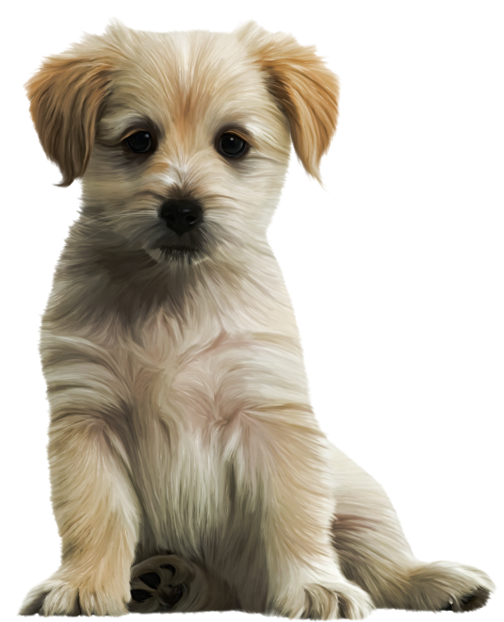
It’s a PUPPY!

Slide 7
Baymax, can I _______ it?
Yes, you can.
No, you can’t.
eat, drink
sleep on
ride on
play with
?

Slide 8
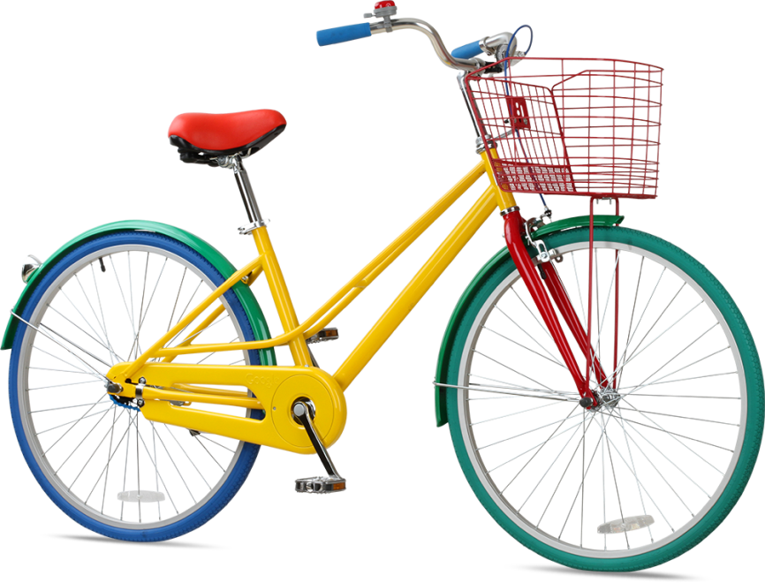
It’s a BICYCLE!

Slide 9
It’s your turn!
Think of something.
I will try to guess what it is.
Can I ______ it?
Yes, you can.
No, you can’t.
Does it have _____?
Yes, it does.
No, it doesn’t.
Is it _________?
Yes, it is.
No, it isn’t.
?

Slide 10
It’s a ______!

