Slide 1
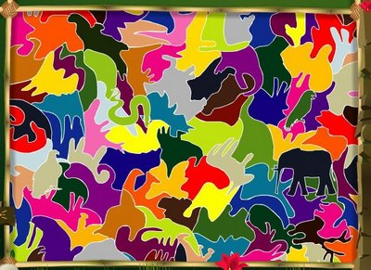
GAME:
DISCOVER
THE
ANIMALS!

Slide 2
WHAT ANIMALS CAN YOU SEE IN THE FOLLOWING IMAGES?
WIN A HAPPY FACE FOR EACH!
☺

Slide 3
LOOK FOR
1
ANIMAL

Slide 4

A BUTTERFLY

Slide 5

A BIRD

Slide 6

A TIGER

Slide 7
LOOK FOR
2
ANIMALS

Slide 8

BIRDS AND FISH

Slide 9

BUTTERFLY AND SEAHORSES

Slide 10

COCODRILES AND EAGLE

Slide 11

ELEPHANTS AND SNAKE

Slide 12

MONKEYS AND SHEEP

Slide 13

PIGS AND BAT

Slide 14
LOOK FOR
6
ANIMALS

Slide 15


Slide 16
LOOK FOR
6
ANIMALS
IN THE FOREST

Slide 17
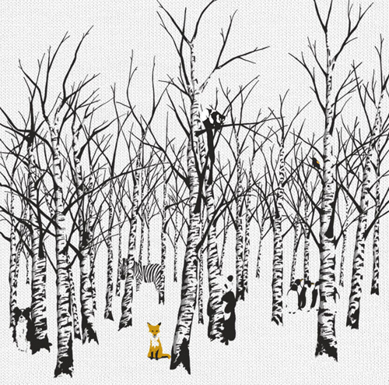

Slide 18
LOOK FOR
COLOURED
ANIMALS

Slide 20
TRY TO FIND
SOME ANIMALS

Slide 21
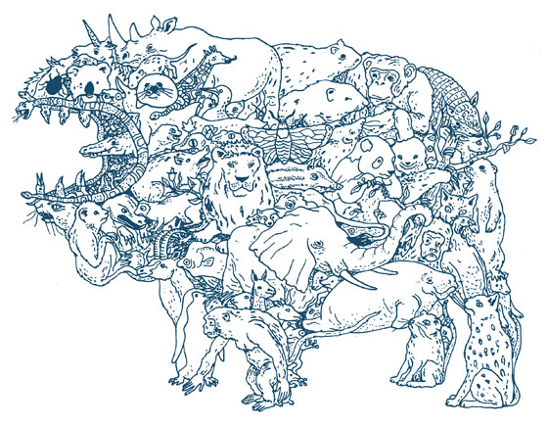

Slide 22
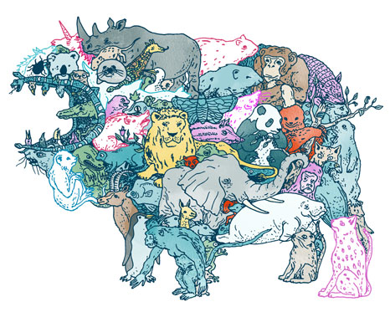

Slide 23
THE END
HAVE YOU ENJOYED THE GAME?

