Slide 1
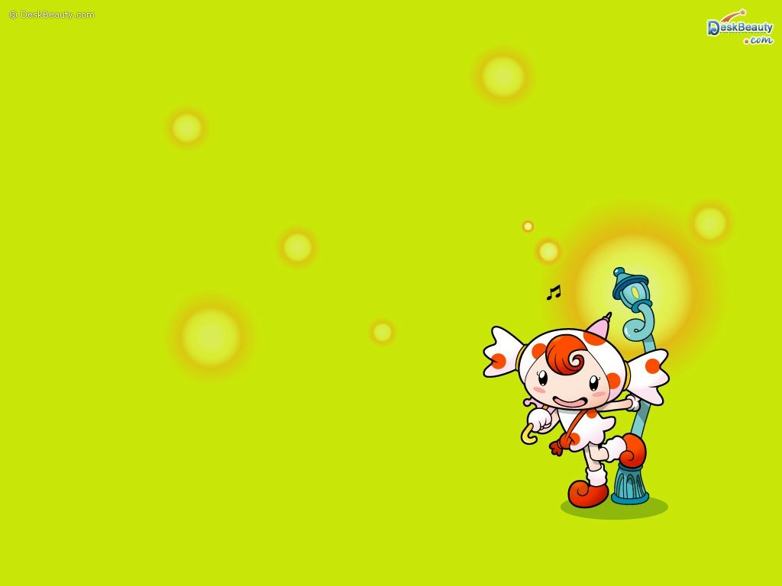
Guessing Game

Slide 2
1
Bathroom
Bedroom
Living room
Who am I?
I am part of the house
I am a room
You can find pillow and bed
I am used for sleeping

Slide 3
2
Doctor
Chef
Architect
Who am I?
I am human
I work in hospital
I treat the sick people
I give injection and medicine

Slide 4
3
Clown fish
Jellyfish
Shark
Who am I?
I am wild animal
I live under the sea
I have big body
I have sharp teeth

Slide 5
4
Train
Bus
Truck
Who am I?
I am means of transportation
I have long body
I have many iron wheels
I run in a railway

Slide 6
5
Chips
Candy
Chocolate
Who am I?
I am food
Children like me
I am sweet
My color is brown

Slide 7
6
Squidward
Patrick
Sandy
Who am I?
I am cartoon character
I live in the sea
I am SpongeBob's friend
My shape is star

Slide 8
7
Whiteboard
Table
Bookcase
Who am I?
I am classroom equipment
I am in front of the students in the class
My color is white
You can write and draw anything in me

Slide 9
8
Coat
Swimsuit
Pajamas
Who am I?
I am clothes
I consists of shirt and pants
You wear me when you are going to sleep

Slide 10
9
Teeth
Tongue
Nails
Who am I?
I am part of body
You have to brush me everyday
I am in mouth
You use me for biting the foods

Slide 11
10
Water
Juice
Milk
Who am I?
I am one of drinks
My taste is sweet
I have many vitamin and mineral
I am produced from cow

Slide 12
11
Grandmother
Mother
Sister
Who am I?
I am family member
I am woman
I have husband
I have son and daughter

Slide 13
12
Handphone
Computer
Calculator
Who am I?
I am means of telecommunication
My body is small
I am used for calling someone
You can send messages too

Slide 14
13
Eagle
Cockatoo
Owl
Who am I?
I am bird
I have two big eyes
I sleep in the afternoon
I twit and look for food in the night

Slide 15
14
Table
Chair
bookcase
Who am I?
I am furniture
I made from wood
I have four legs
You can sit on me

Slide 16
15
Spaghetti
Pizza
Burger
Who am I?
I am food
I made from bread, meat, and vegetables
My shape is thin and circle
You can find me in Pizza Hut

Slide 17
16
Komodo
Crocodile
Dinosaurs
Who am I?
I am huge animal
I live a very long time ago
My friends are Tyrex and Brontosaurs
But we are extinct now

Slide 18
17
Ruler
Rubber
Sharpener
Who am I?
I am school equipment
I have thin and long body
You can use me to make lines
I am used for measuring something

Slide 19
18
Fox
Bear
Penguin
Who am I?
I am small animal
My body is black and white
I live in polar
My food is fish

Slide 20
19
Roof
Raincoat
Umbrella
Who am I?
I am a useful and colorful thing
I have a handle in my body
I have an arched cover too
I protect you from the rain

Slide 21
20
Refrigerator
Stove
Microwave
Who am I?
I am a useful thing
Usually, I am in the kitchen
I can make your food and drinks cold
I can produce ice

Slide 22
CONGRATULATION!!!
YOU DID IT VERY WELL.
GOOD JOB!

Slide 23

Great
GREAT!

Slide 24

sorry
UPS, SORRY!

