Slide 1
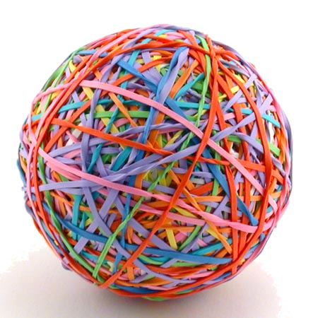
Instruments
Pass the ball. When the music stops – whoever has the ball must name the instrument!
Notes:
Find the conversation question sheets (on many topics!) by clicking the Pass the Paper picture!

Slide 2

Pass the BALL!

Slide 4
Pass the BALL!

Slide 5
hen

Slide 6
Pass the BALL!

Slide 7
hit

Slide 8
Pass the BALL!

Slide 9
hand

Slide 10
Pass the BALL!

Slide 11
hen

Slide 12
Pass the BALL!

Slide 13
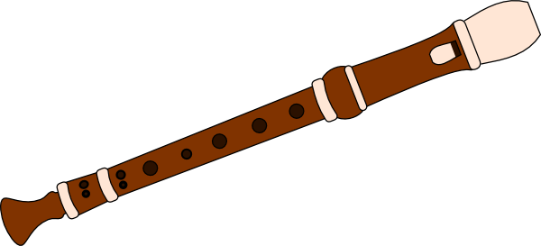
What is it?

Slide 14
Pass the BALL!

Slide 15
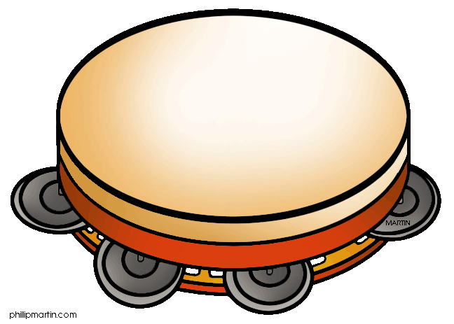
What is it?

Slide 16
Pass the BALL!

Slide 17

What is it?

Slide 18
Pass the BALL!

Slide 19
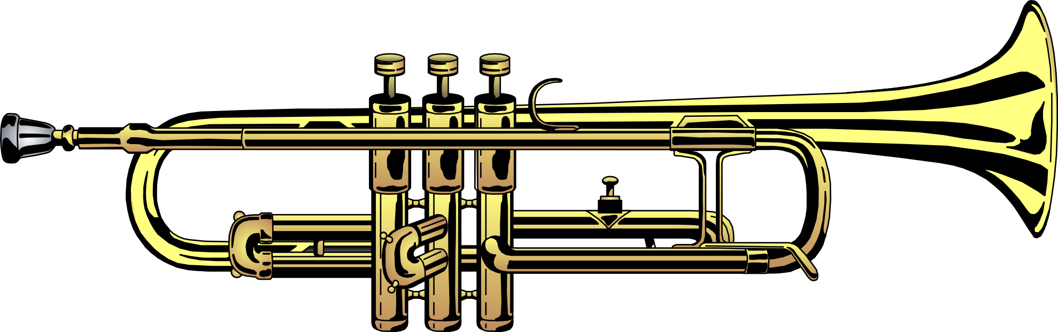
What is it?

Slide 20
Pass the BALL!

Slide 21
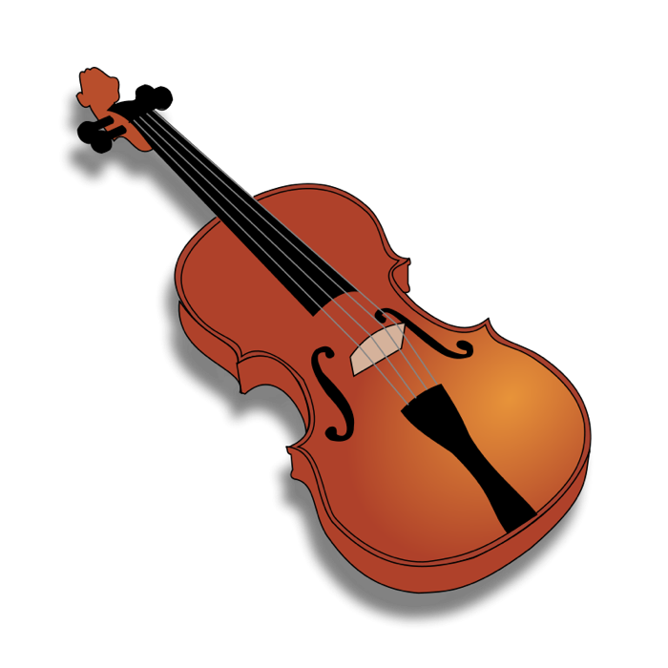
What is it?

Slide 22
Pass the BALL!

Slide 23
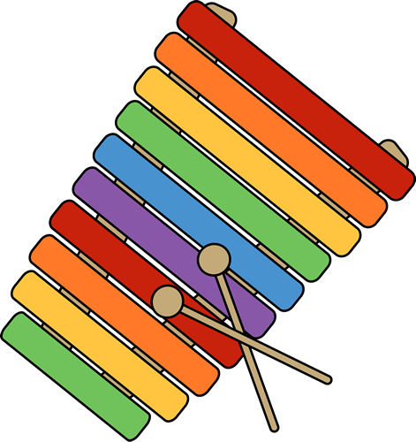
What is it?

