Slide 1





Riddles
by Richard
next

Slide 2
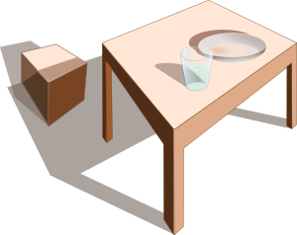
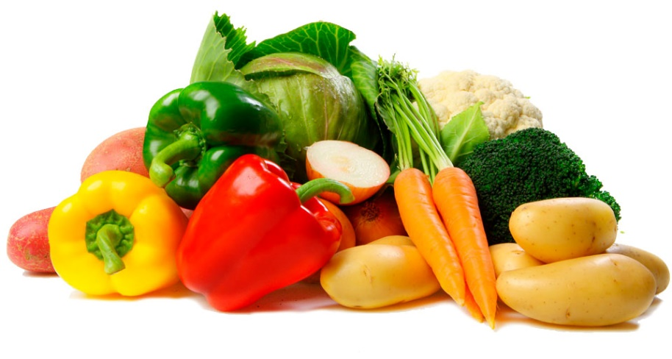
Which table has no legs?
Help
v
e
g
e
t
a
b
l
e
next

Slide 3

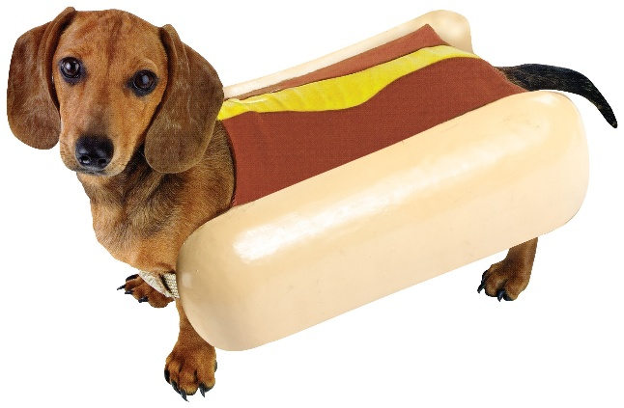
Which kind of dog never bites?
Help
h
o
t
d
o
g
next

Slide 4
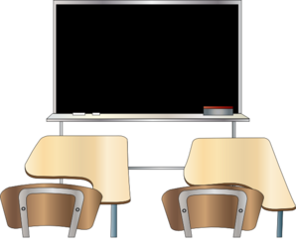
It is black, but you say it is clean. It is white, but you say it is dirty. What is it?
Help
b
l
a
c
k
b
o
a
r
d
next

Slide 5
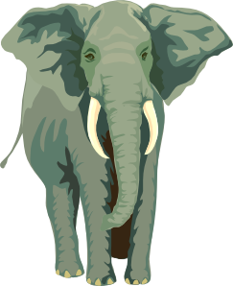
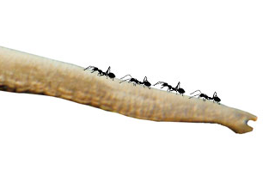
What is the largest ant in the world?
Help
e
l
e
p
h
a
n
t
next

Slide 6
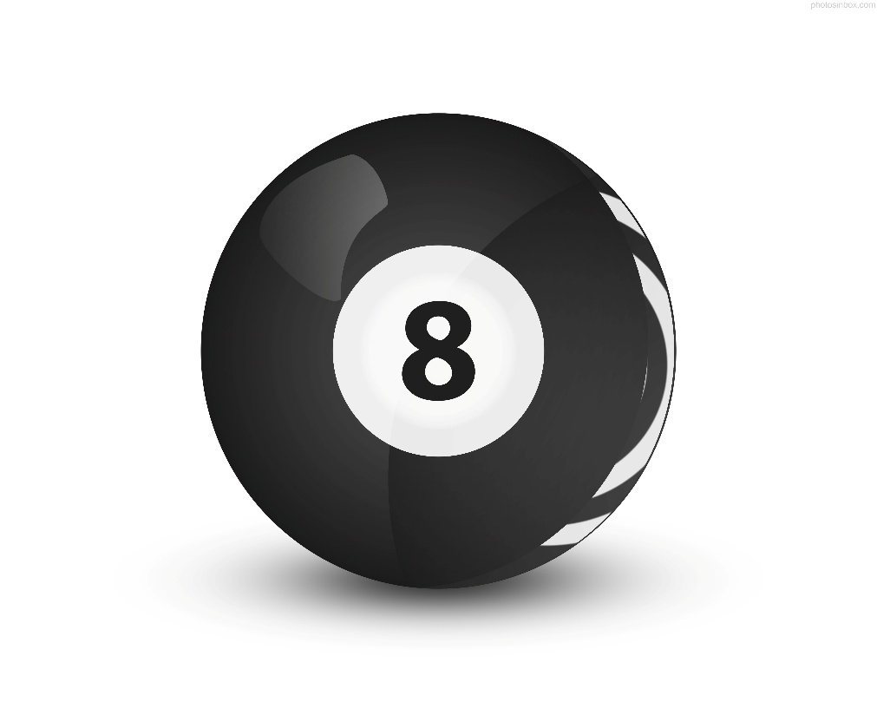
From what number can you take half and leave nothing?
Help
e
i
g
h
t
next

Slide 7

Help
What has hands but no feet, a face but no eyes, no body, tells but does not talk?
c
l
o
c
k
next

Slide 8
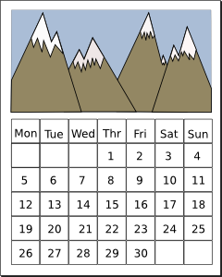
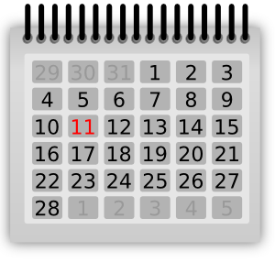
How many months have 28 days?
Help
t
w
e
l
v
e
next

Slide 9

What 5-letter word has six left when you take 2 letters away?
Help
s
i
x
t
y
next

Slide 10
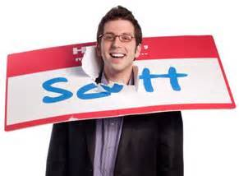
What belongs only to you and yet is used more by others than by yourself?
Help
n
a
m
e
next

Slide 11
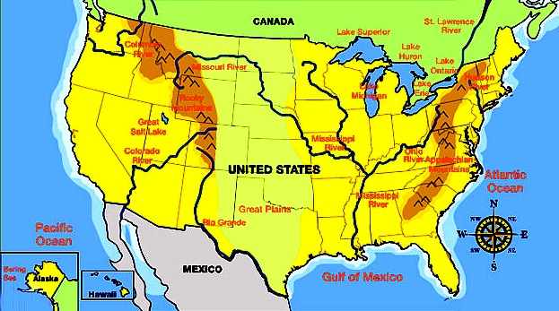
Help
I have cities but no houses, forests but no trees; rivers but no water; what am I?
m
a
p
next

Slide 12



What man cannot live inside a house?
Help
s
n
o
w
m
a
n
next

Slide 13
My uncle's sister is not my aunt: who is she?
Help
m
o
t
h
e
r
next

Slide 14
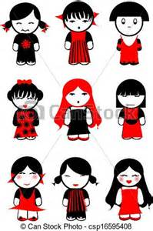
Help
Mrs. Smith has nine children, half of them are girls. How many girls does she have?
n
i
n
e
next

Slide 15
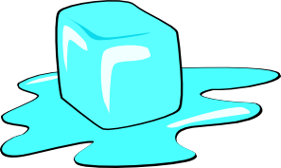
How can a net hold water?
Help
i
c
e
next

Slide 16

Help
I’m a green house. Inside me is a white house. Inside my white house is a red house and inside my red house are my babies. What am I?
w
a
t
e
r
m
e
l
o
n
next

Slide 17
?
Help
v
e
g
e
t
a
b
l
e
next

