Slide 1

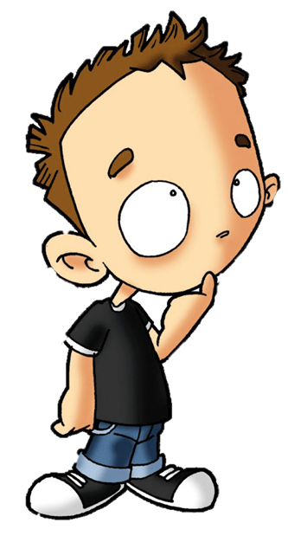


Slide 2

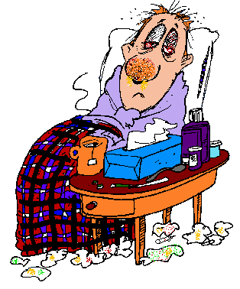
1/20
What can you catch but not throw?
A cold
HINT
NEXT

Slide 3

2/20
What goes around the world but stays in a corner?
A stamp
HINT
NEXT

Slide 4

3/20
Give me food, and I will live; give me water, and I will die. What am I?
Fire
HINT
NEXT

Slide 5
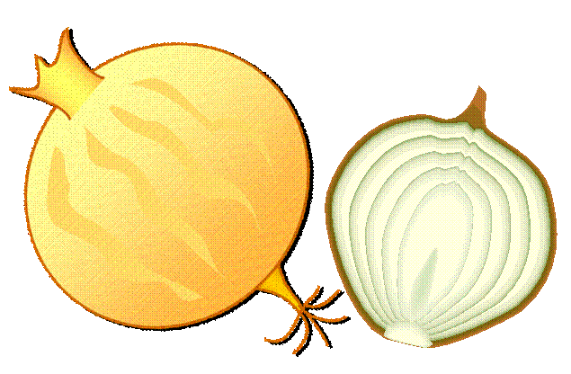
4/20
You use a knife to slice my head
and weep beside me when I am dead.
What am I?
An onion
HINT
NEXT

Slide 6
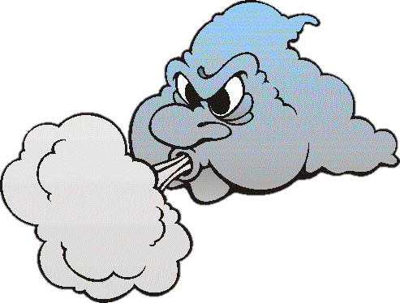
5/20
All about, but cannot be seen,
Can be captured, cannot be held,
No throat, but can be heard.
What is it?
The wind
HINT
NEXT

Slide 7

6/20
When I am filled, I can point the way;
When I am empty, nothing moves me.
I have two skins,
One without and one within.
What am I?
A glove
HINT
NEXT

Slide 8

7/20
The more you have of it, the less you see. What is it?
Darkness
HINT
NEXT

Slide 9

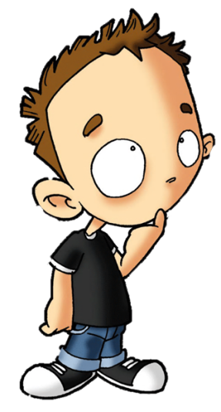
8/20
What is in seasons, seconds, centuries and minutes but not in decades, years or days?
The letter “N”
HINT
NEXT

Slide 10
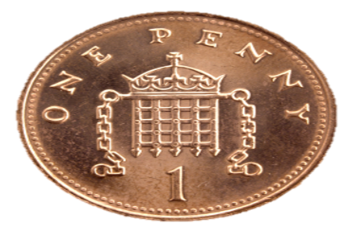
9/20
What has a head, a tail, is brown,
and has no legs?
A penny
HINT
NEXT

Slide 11
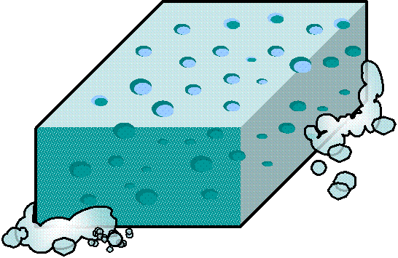
10/20
I'm full of holes, yet I'm full of water. What am I?
A sponge
HINT
NEXT

Slide 12

11/20
It's red, blue, purple and green,
no one can reach it,
not even the queen.
What is it?
The rainbow
HINT
NEXT

Slide 13

12/20
The more you take, the more you leave behind.
Footsteps
HINT
NEXT

Slide 14
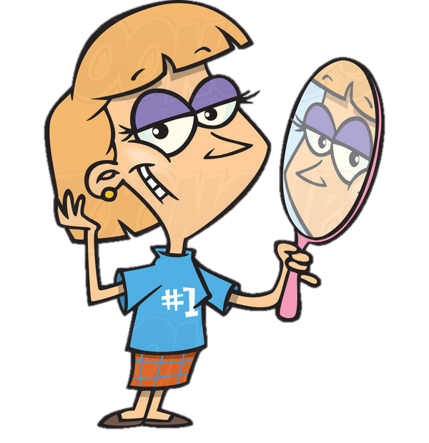
13/20
If you drop me I'm sure to crack
but give me a smile
and I'll always smile back.
A mirror
HINT
NEXT

Slide 15
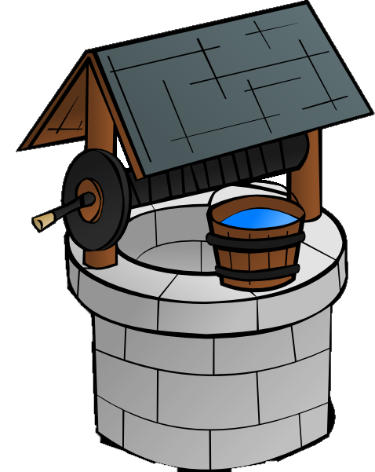
14/20
Round like an apple, deep like a cup,
yet all the king's horses
cannot pull it up.
A well
HINT
NEXT

Slide 16

15/20
Tall in the morning, short at noon, gone at night but I'll be back soon. What am I?
A shadow
HINT
NEXT

Slide 17

16/20
What comes down but never goes up?
Rain
HINT
NEXT

Slide 18
17/20
Poor people have it. Rich people need it. If you eat it you die. What is it?
Nothing
HINT
NEXT

Slide 19

18/20
I’m tall when I’m young and I’m short when I’m old. What am I?
A candle
HINT
NEXT

Slide 20
19/20
Mary’s father has 5 daughters – Nana, Nene, Nini, Nono. What is the fifth daughter’s name?
Nunu?
Mary
HINT
NEXT

Slide 21
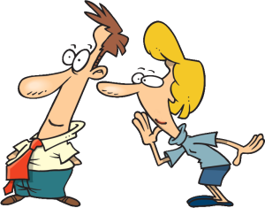
20/20
If I have it, I don’t share it. If I share it, I don’t have it. What is it?
A secret
HINT
NEXT

Slide 22
THE END

