Slide 3
Topic
Question
Example Answer
I’m well, thanks. How about you?
Hello
Hello, how are you?
Name
What’s your name?
My name is Shawn.
How do you spell your first name?
S-H-A-W-N
Spell/name
Surname
What’s your surname?
It’s Benson.
Where are you from?
Nationality
I’m from Scotland.
Address
What’s your address?
Where do you live?
I live at 52 Mill Road, Glasgow.

Slide 4
Topic
Question
Example Answer
What’s your phone number?
Phone number
It’s 078-347-12
What’s your email address?
It’s shawn.benson_1@gmail.com
Email address
Do you have any brothers or sisters?
I have one brother and two sisters.
Family
Job
What do you do?
I’m a doctor.
What’s your favourite food?
Favourite food
I love pizza.
Date today
What’s the date today?
It’s the 29th of March, 2022.

Slide 5
Topic
Question
Example Answer
Hungry
Are you hungry?
No, I’m not.
Tired
Are you tired?
Yes, I am!
I’m thirty five years old.
Age
How old are you?
Time
What time is it?
It’s five thirty.
Where do you go to English class?
I go to the Mill Road Academy.
English class
When’s your birthday?
My birthday is on the 12th of July.
Birthday
What’s the weather like today?
Weather
It’s cloudy and rainy.

Slide 6



Can you remember the question and answer?
Phone number
Email address
Favourite Sport
Family
Date today
Job

Slide 7
Can you remember the question and answer?
English class
Weather
Birthday
Tired
Time
Age

Slide 8
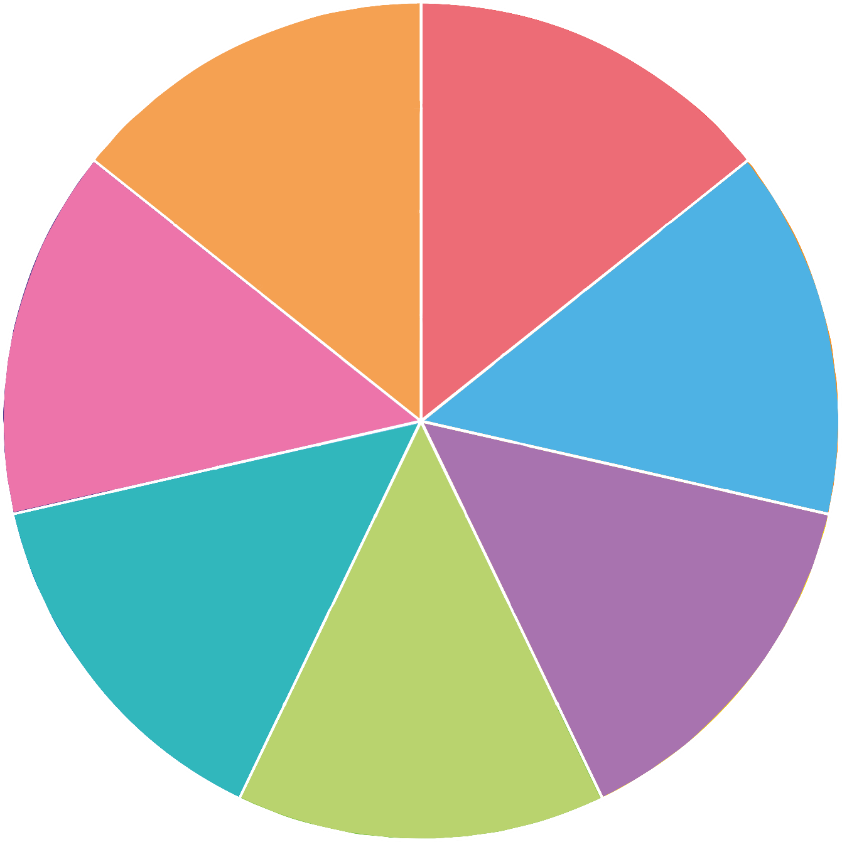
Can you remember the question and answer?
English class
Hungry
Weather
Birthday
Tired
Time
Age

