Slide 1


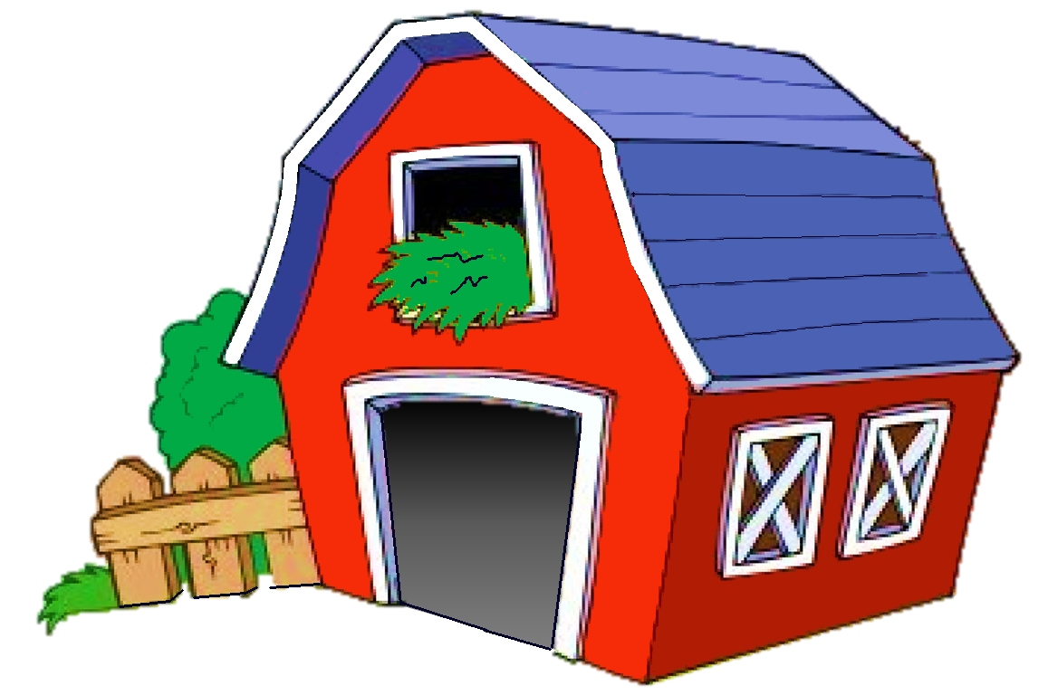
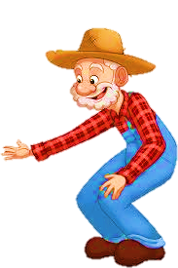
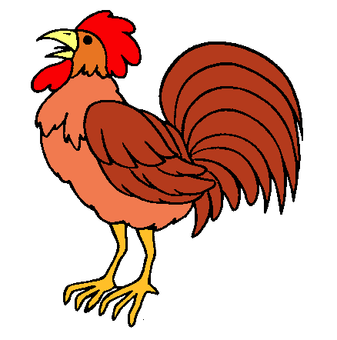
PLAY

Slide 2

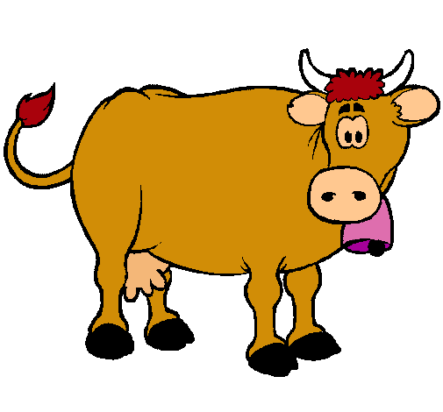
1/10
Click on the speaker and guess
NEXT
a goat
a cow
a duck

Slide 3
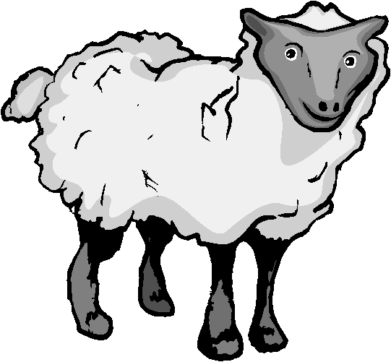
2/10
Click on the speaker and guess
NEXT
a sheep
a goat
a duck

Slide 4
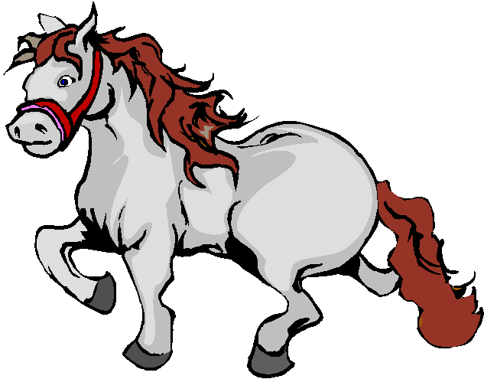
3/10
NEXT
a goat
a horse
a donkey

Slide 5
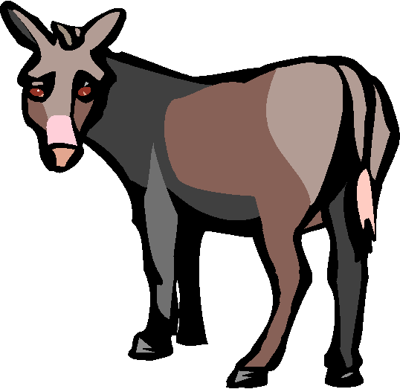
4/10
Click on the speaker and guess
NEXT
a goat
a rooster
a donkey

Slide 6
5/10
Click on the speaker and guess
NEXT
a rooster
a duck
a hen

Slide 7
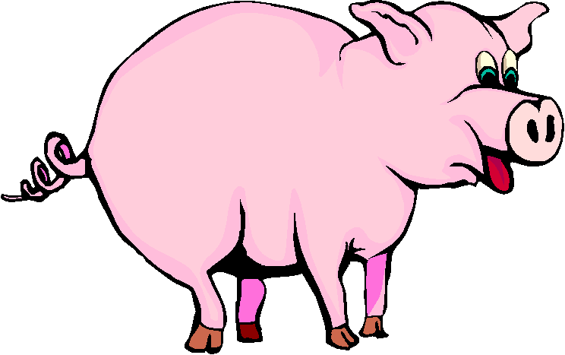
6/10
Click on the speaker and guess
NEXT
a duck
a pig
a hen

Slide 8
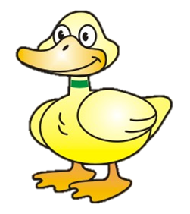
7/10
Click on the speaker and guess
NEXT
a duck
a turkey
a hen

Slide 9
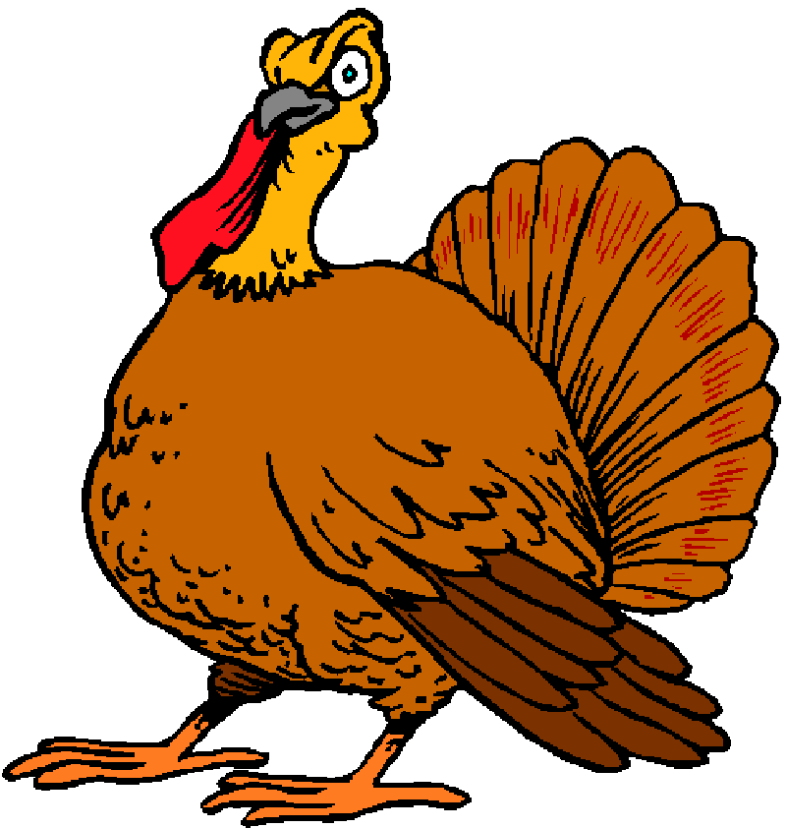
8/10
Click on the speaker and guess
NEXT
a hen
a goat
a turkey

Slide 10
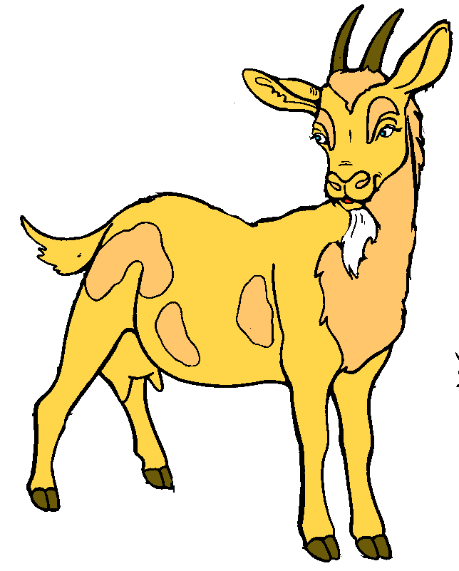
9/10
Click on the speaker and guess
NEXT
a hen
a goat
a rabbit

Slide 11
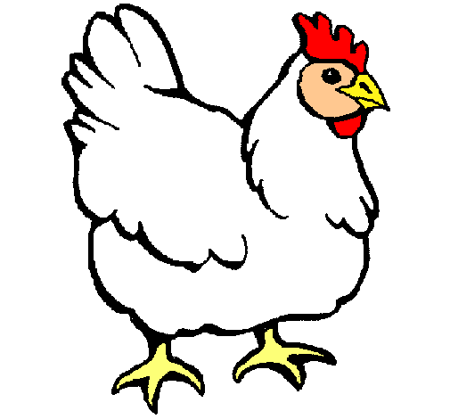
10/10
Click on the speaker and guess
EXIT
a hen
a chick
a rooster

