Slide 1

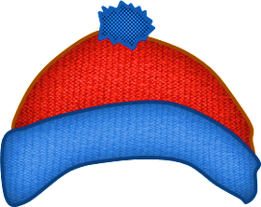

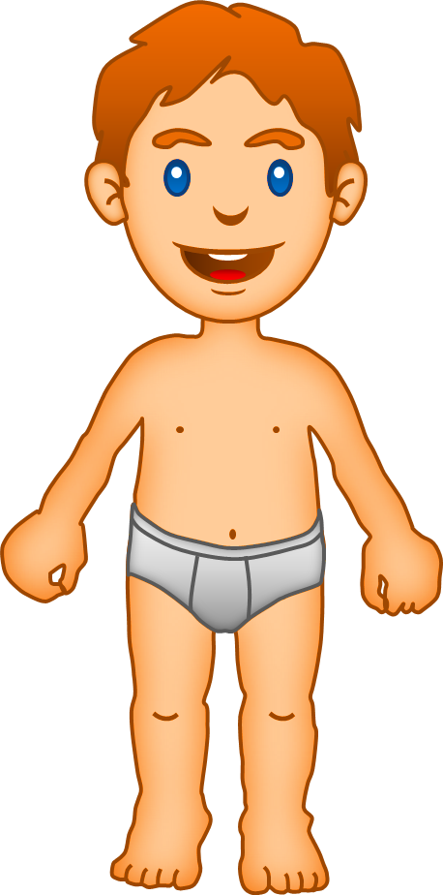






Help me, please!

Slide 2

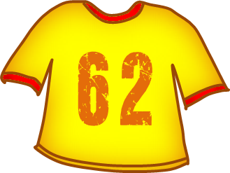
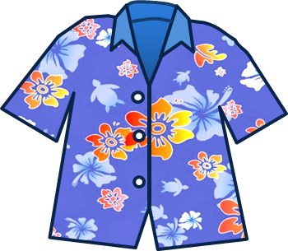
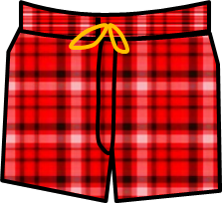
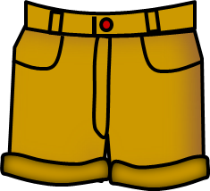

I need my T-shirt
Click on the right picture

Slide 3

I need my shorts
GOOOOOOD!
Click on the right picture

Slide 4
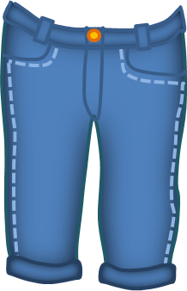
I need my sandals
GOOOOOOD!
Click on the right picture

Slide 5

I need my sweatshirt
GOOOOOOD!
Click on the right picture

Slide 6

THANK YOU!
GOOOOOOD!
sport

Slide 7


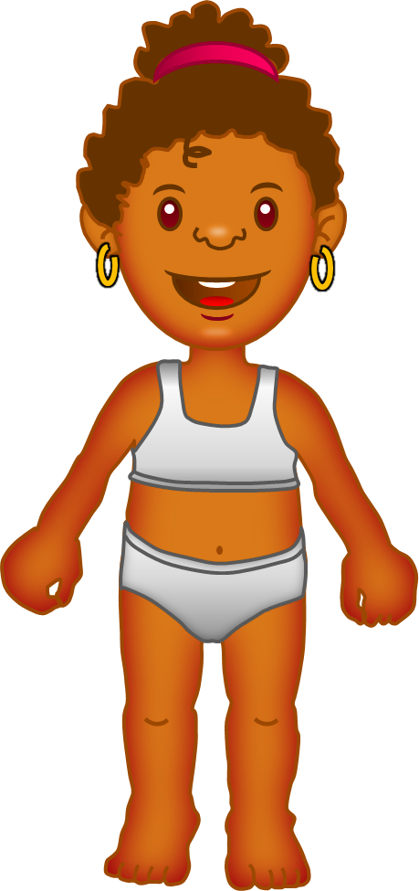
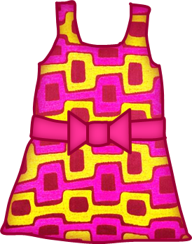
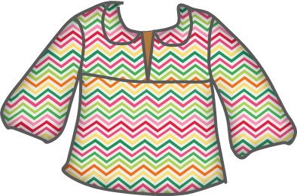
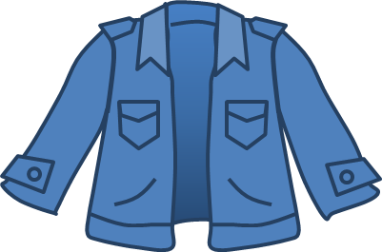

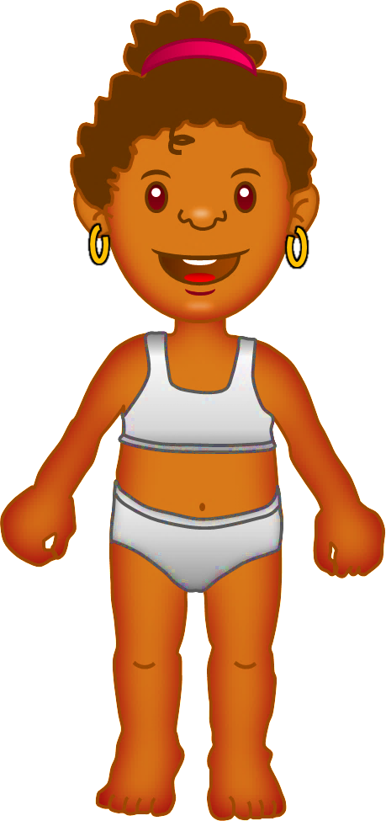

I need my dress
Click on the right picture

Slide 8
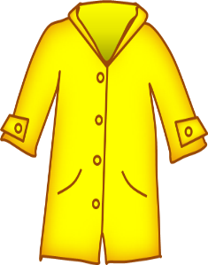
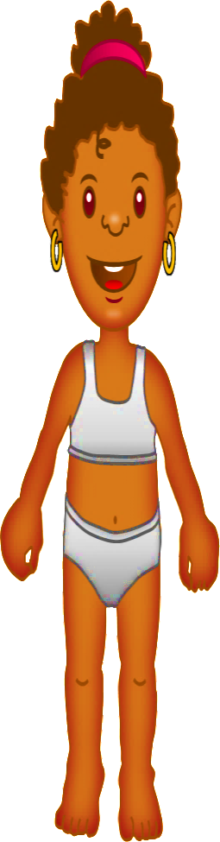
I need my jacket
GOOOOOOD!
Click on the right picture

Slide 9
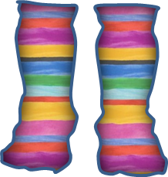
I need my socks
GOOOOOOD!
Click on the right picture

Slide 10
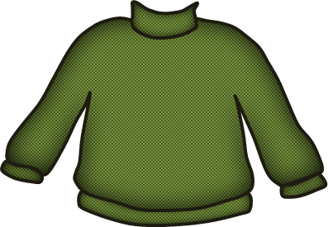
I need my trainers
GOOOOOOD!
Click on the right picture

Slide 11
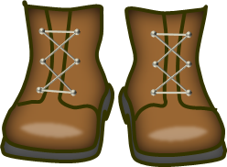
I need my hat
GOOOOOOD!
Click on the right picture

Slide 12
I need my handbag
GOOOOOOD!
Click on the right picture

Slide 13
Thank you!
GOOOOOOD!

Slide 14
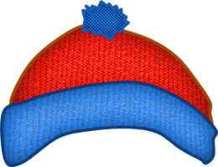
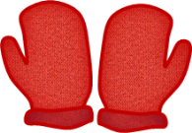
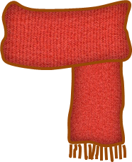
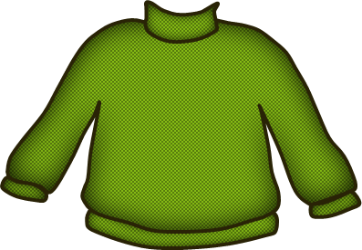
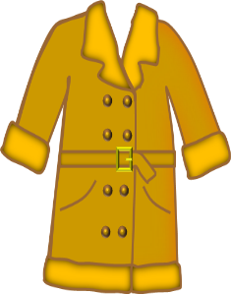
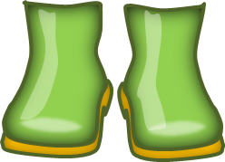

I need my jumper
Click on the right picture

Slide 15
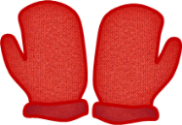
I need my jeans
GOOOOOOD!
Click on the right picture

Slide 16
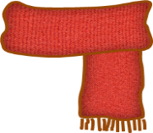
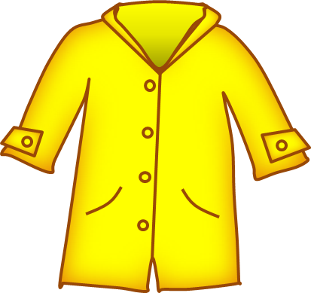
I need my boots
GOOOOOOD!
Click on the right picture

Slide 17
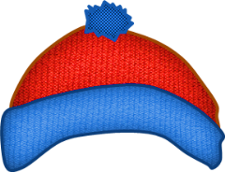
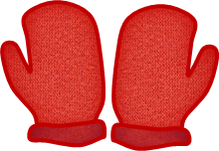

I need my
wooly hat
GOOOOOOD!
Click on the right picture

Slide 18
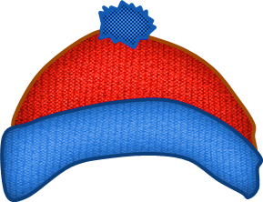

I need my coat
GOOOOOOD!
Click on the right picture

Slide 19
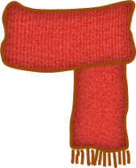
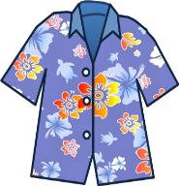
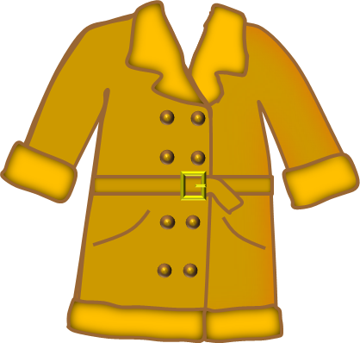
I need my scarf
GOOOOOOD!
Click on the right picture

Slide 20

I need my mittens
GOOOOOOD!
Click on the right picture

Slide 21
THANK YOU!
GOOOOOOD!

Slide 22
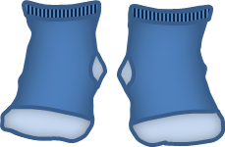
I need my blouse
Click on the right picture

Slide 23
I need my skirt
GOOOOOOD!
Click on the right picture

Slide 24
I need my socks
GOOOOOOD!
Click on the right picture

Slide 25
I need my wellies
GOOOOOOD!
Click on the right picture

Slide 26
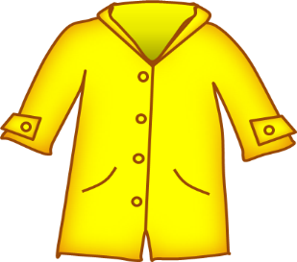
I need my raincoat
GOOOOOOD!
Click on the right picture

Slide 27
I need my umbrella
GOOOOOOD!
Click on the right picture

Slide 28
THANK YOU!
GOOOOOOD!

Slide 29
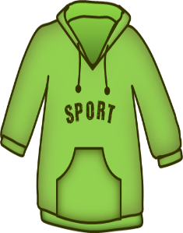
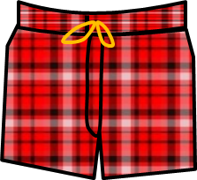
I need my trunks
Click on the right picture

Slide 30
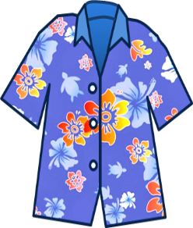
I need my shirt
GOOOOOOD!
Click on the right picture

Slide 31

I need my flip-flops
GOOOOOOD!
Click on the right picture

Slide 32

I need my sunglasses
GOOOOOOD!
Click on the right picture

Slide 33

I need my cap
GOOOOOOD!
Click on the right picture

Slide 34
THANK YOU!
GOOOOOOD!
EXIT

