Slide 1


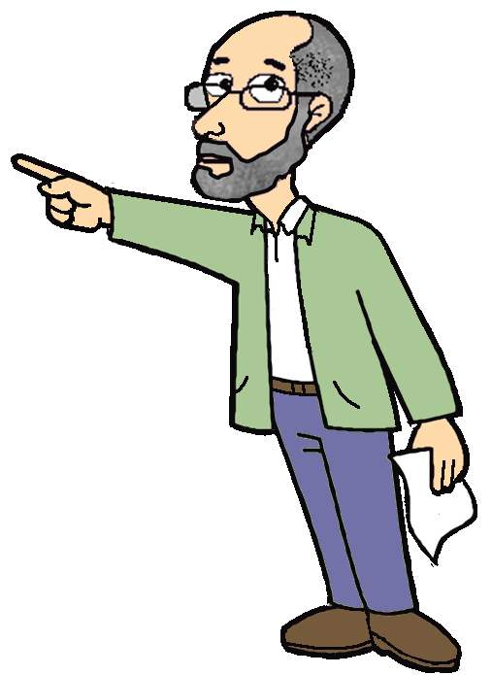
by HERBER

Slide 2
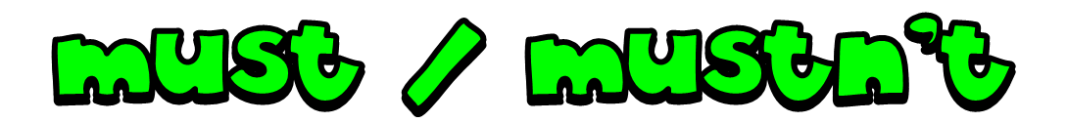

Must is most commonly used to express certainty. It can also be used to express necessity or strong recommendation.
Example:
This must be the right answer.
You must study hard .

Slide 3
must not = mustn’t can be used to prohibit actions.
Example:
You mustn’t kick the ball
when you play basketball.

Slide 4

He must do his homework.

Slide 5
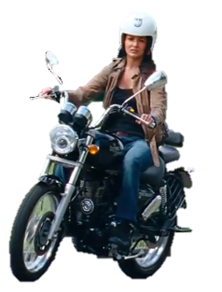
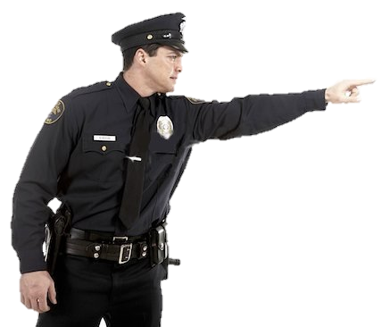
She must wear a helmet.

Slide 6
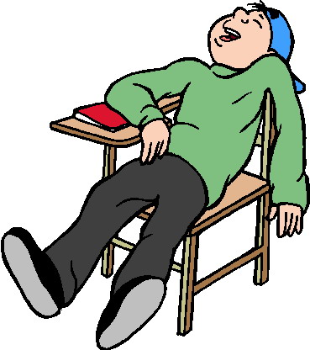
He mustn’t sleep in class.

Slide 7
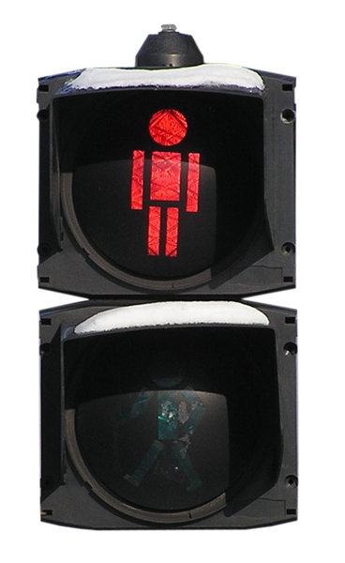
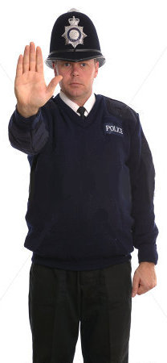
You must stop here.
You mustn’t cross the street now.

Slide 8
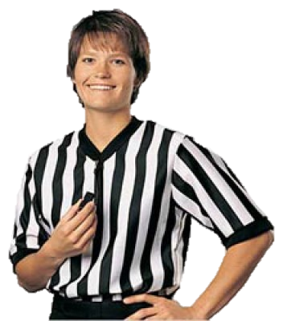
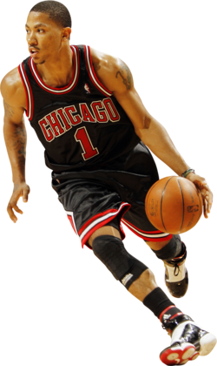
He mustn’t kick the ball.

Slide 9

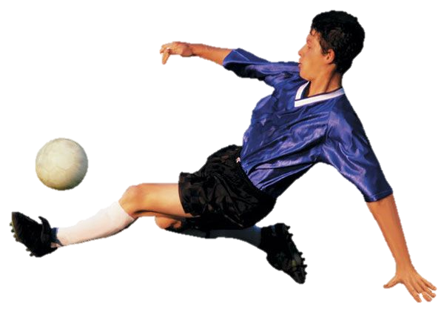
You mustn’t touch the ball with your hands

Slide 10
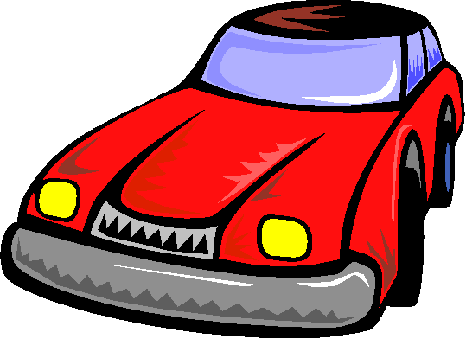
DRIVING TEST
must or mustn’t ?

Slide 11

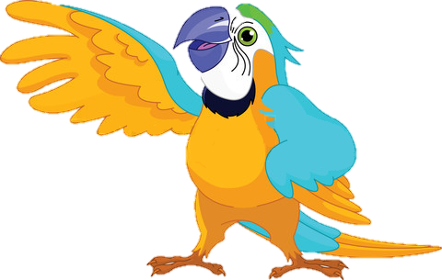
You ___________ turn right
must
mustn’t

Slide 12

You ___________ turn left
must
mustn’t

Slide 13
You ___________ turn left
must
mustn’t

Slide 14

You ___________ stop here
must
mustn’t

Slide 15

You ___________ park here
must
mustn’t

Slide 16
You ___________ turn right
must
mustn’t

Slide 17
You ___________ enter
must
mustn’t

Slide 18

You ___________ go ahead
must
mustn’t

Slide 19

You ___________ stop here
must
mustn’t

Slide 20
BYE BYE!

