Slide 1


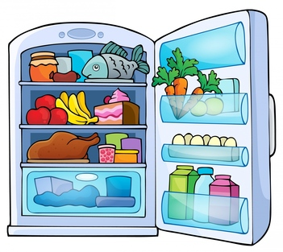








any
lots of
little
much
no
few
a(n)
milk
many
some

Slide 2


click the right word to complete the sentence
lots of
many
much
some
any
no
little
few
milk
a(n)
There is ____ empty water bottle.
an

Slide 3
click the right word to complete the sentence
lots of
many
much
some
any
no
little
few
milk
a(n)
There isn’t _______ cake left.
much

Slide 4
click the right word to complete the sentence
lots of
many
much
some
any
no
little
few
milk
a(n)
There are only a ______ onions.
few

Slide 5
click the right word to complete the sentence
lots of
many
much
some
any
no
little
few
milk
a(n)
How _______ eggs are there?
many

Slide 6
click the right word to complete the sentence
lots of
many
much
some
any
no
little
few
milk
a(n)
There is ____ butter in the fridge.
no

Slide 7
click the right word to complete the sentence
lots of
many
much
some
any
no
little
few
milk
a(n)
There aren’t _____ mushrooms.
any

Slide 8
click the right word to complete the sentence
lots of
many
much
some
any
no
little
few
milk
a(n)
There is only a ______ orange juice.
little

Slide 9
click the right word to complete the sentence
lots of
many
much
some
any
no
little
few
milk
a(n)
There is _______ milk in the fridge.
lots of

Slide 10
click the right word to complete the sentence
lots of
many
much
some
any
no
little
few
milk
a(n)
Is there _____ ham?
any

Slide 11
click the right word to complete the sentence
lots of
many
much
some
any
no
little
few
milk
a(n)
Would you like ______ ham?
some

Slide 12
click the right word to complete the sentence
lots of
many
much
some
any
no
little
few
milk
a(n)
There is ____ small sausage.
a

Slide 13
click the right word to complete the sentence
lots of
many
much
some
any
no
little
few
milk
a(n)
There isn’t _____ beef.
any

Slide 14
click the right word to complete the sentence
lots of
many
much
some
any
no
little
few
milk
a(n)
How_______ fish is there?
much

Slide 15
click the right word to complete the sentence
lots of
many
much
some
any
no
little
few
milk
a(n)
There are ________ food containers.
lots of

Slide 16
click the right word to complete the sentence
lots of
many
much
some
any
no
little
few
milk
a(n)
There is a _______ cheese.
little

Slide 17
click the right word to complete the sentence
lots of
many
much
some
any
no
little
few
milk
a(n)
There are ______ apples and bananas.
some

Slide 18
click the right word to complete the sentence
lots of
many
much
some
any
no
little
few
milk
a(n)
There aren’t _______ carrots.
many

Slide 19
click the right word to complete the sentence
lots of
many
much
some
any
no
little
few
milk
a(n)
There are only a ______ strawberries.
few

Slide 20

click the right word to complete the sentence
lots of
many
much
some
any
no
little
few
milk
a(n)
There is ____ roast chicken.
a

