Slide 1


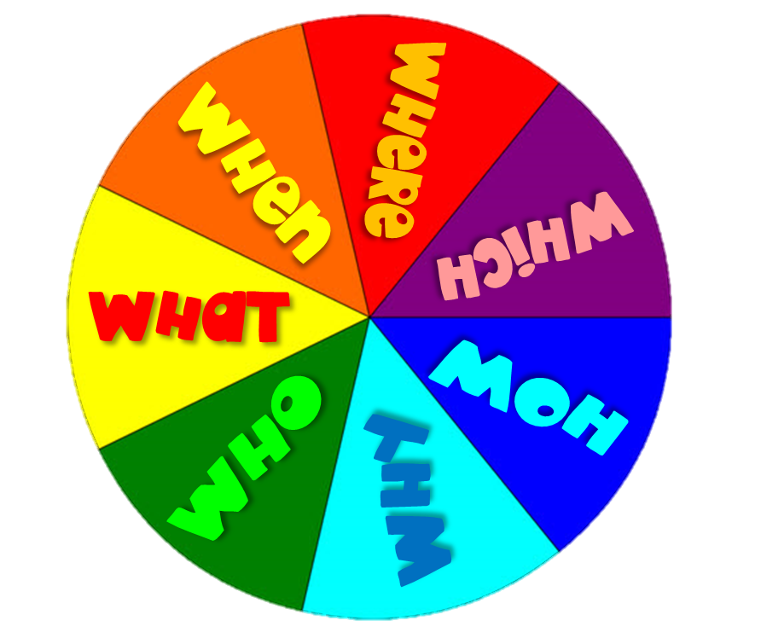




Slide 2
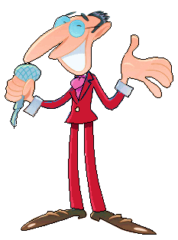

Spin the wheel.
Use the pointed word to make the question corresponding to the right answer within the time limit (10 seconds).
Click on the answer to check.

Slide 3





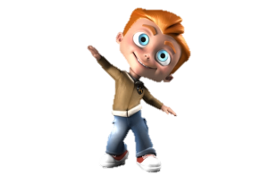
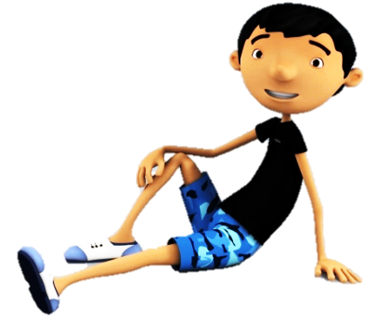
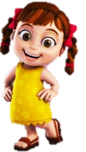
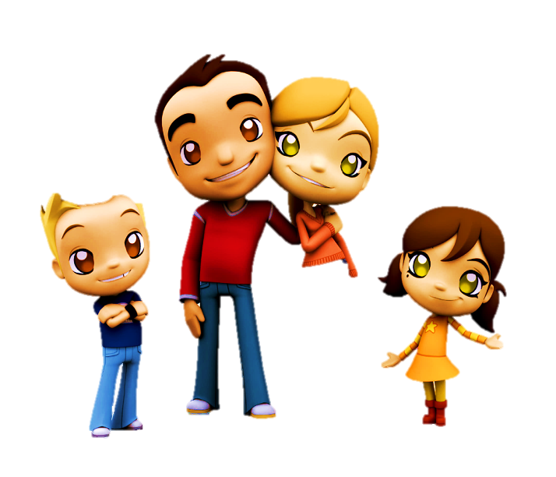

1/10
9
7
5
4
8
2
6
1
3
10
0
TIME’S UP
What is your father’s job?
I’m happy because it’s my birtuday.
I go to the beach by car.
My father is a firefighter.
I go running
in that park.

Slide 4
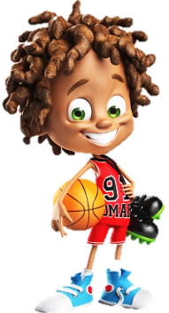
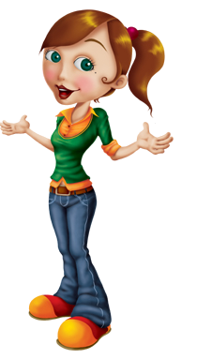
2/10
9
7
5
4
8
2
6
1
3
10
0
TIME’S UP
Where do you live?
I play basketball.
I live in Spain.
I go to school by car.
I go to the cinema on Sunday.

Slide 5
3/10
9
7
5
4
8
2
6
1
3
10
0
TIME’S UP
Who is your best friend?
Megan is my best friend.
I go to school by bus.
My favourite food is pizza.
I like the blue dress.

Slide 6
4/10
9
7
5
4
8
2
6
1
3
10
0
TIME’S UP
How do you go to school?
My favourite colour is yellow.
I like pets.
I go to school
by bus.
I go running
in that park.

Slide 7
5/10
9
7
5
4
8
2
6
1
3
10
0
TIME’S UP
When did you go to Rome?
I’m happy because
it’s my birthday .
I went to Rome last month.
I go to school by car.
They are my parents.

Slide 8
6/10
9
7
5
4
8
2
6
1
3
10
0
TIME’S UP
Which dress do you like?
I like veggies because they’re healthy.
I go to the beach by car.
That is my friend Paul.
I like the blue dress.

Slide 9
7/10
9
7
5
4
8
2
6
1
3
10
0
TIME’S UP
Who is that girl?
That girl is
my friend Lisa
I go to the beach by car.
My favourite colour is red.
I like the green dress.

Slide 10
8/10
9
7
5
4
8
2
6
1
3
10
0
TIME’S UP
Why are you happy?
I’m happy because it’s my birthday.
I want to be a doctor.
My favourite colour is green.
I like the green dress.

Slide 11
9/10
9
7
5
4
8
2
6
1
3
10
0
TIME’S UP
Where are you from?
I play basketball.
I’m from Spain.
I am a student.
I live in London.

Slide 12
10/10
9
7
5
4
8
2
6
1
3
10
0
TIME’S UP
What is your favourite colour?
I’m happy because it’s my birtuday.
I go to the beach by car.
My favourite colour is red.
I go running
in that park.
EXIT

