Slide 1
SPIN THE WHEEL!

Slide 2
Instructions
Choose one of the wheels (6, 12 or 24 options).
Click on “Home > Replace” to replace the example words on the wheel or double click on each word to change them for any other text you need, for example: categories, the name of your students or numbers. – BE EXTRA CAREFUL WHEN EDITING, IF YOU DELETE ANY WORD BY MISTAKE, CLICK UNDO. – The words and the sections are all linked to their corresponding slides, and everything is grouped together for the animation to work correctly.
If you need less than 6, 12 or 24 simply type some “Free Passes”.
To play, click on Slide Show, this template is to be used in presentation mode.
To spin the wheel, click on the needle. To stop it, click the needle again.
Click on the selected section to go to its corresponding slide.
Click on the small wheel on the bottom right to spin the wheel again.
** This template currently works only in PowerPoint desktop version. – NOT in Google Slides nor PowerPoint web version.

Slide 3
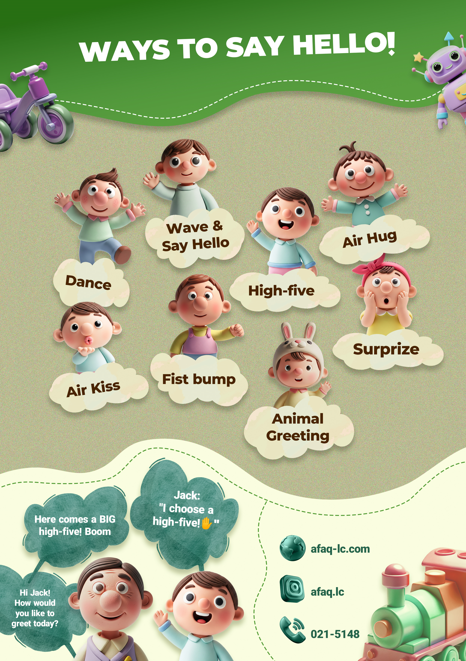
DANCE
HIGH-FIVE
WAVE AND SAY HELLO
AIR HUG
DANCE
HIGH-FIVE
FIST BUMP
AIR KISS
ANIMAL GREETING
FIST BUMP
SUPRIZE
AIR HUG
Click the needle to start and then again to stop the wheel. Then click on the selected section.

Slide 4
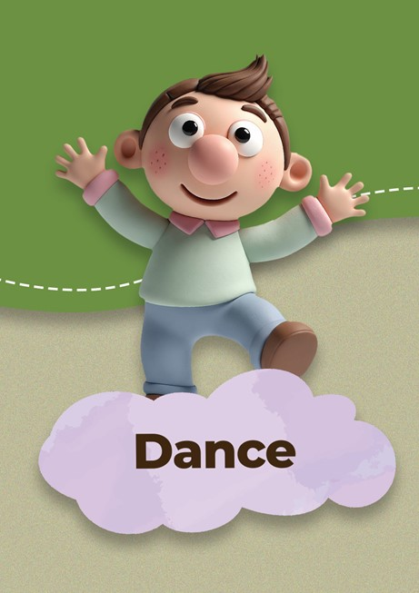
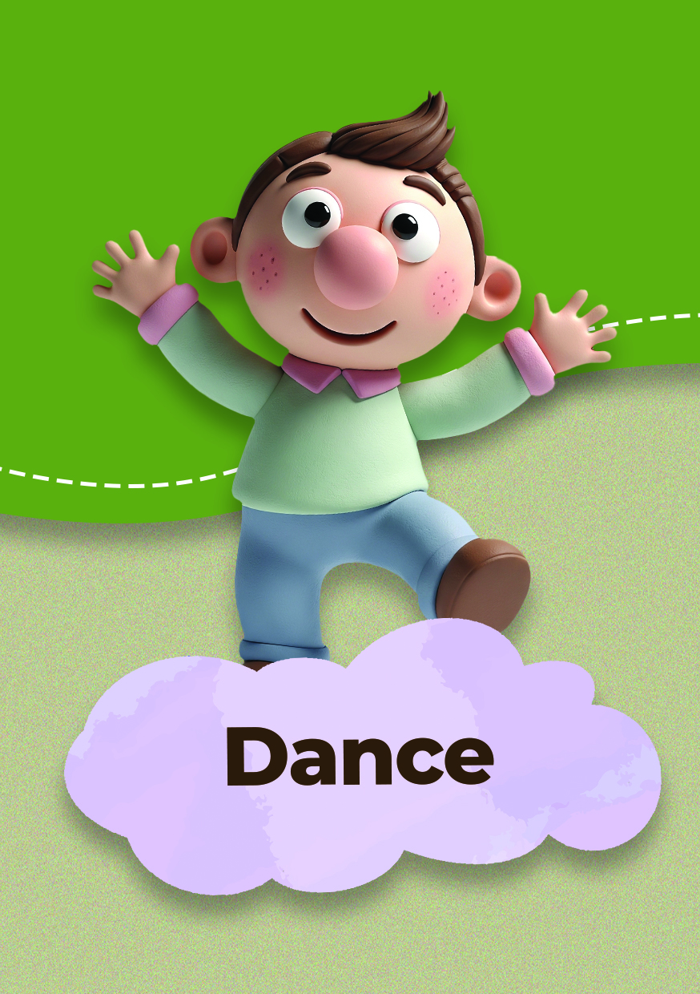

Slide 5
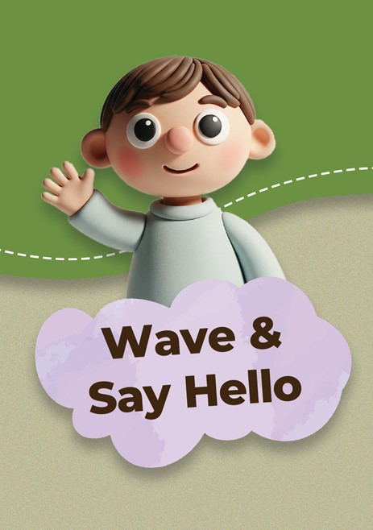
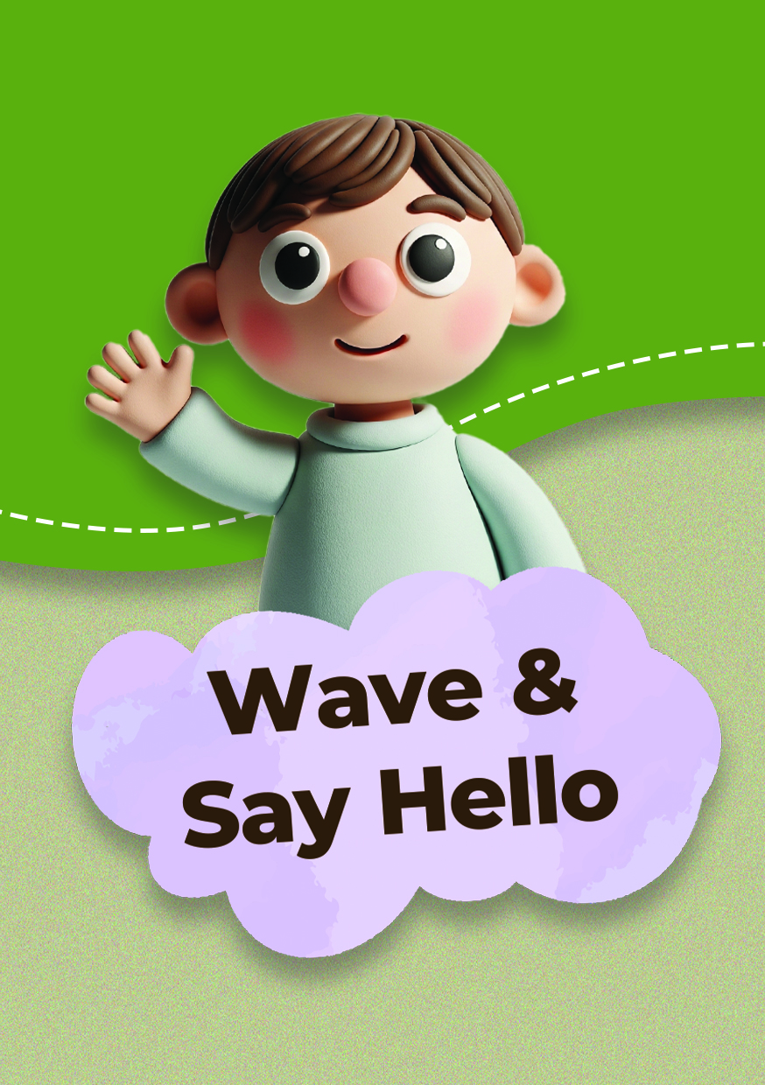

Slide 6
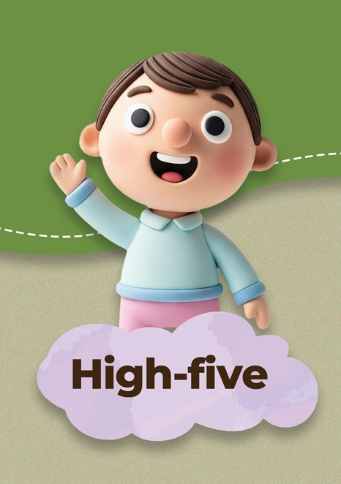
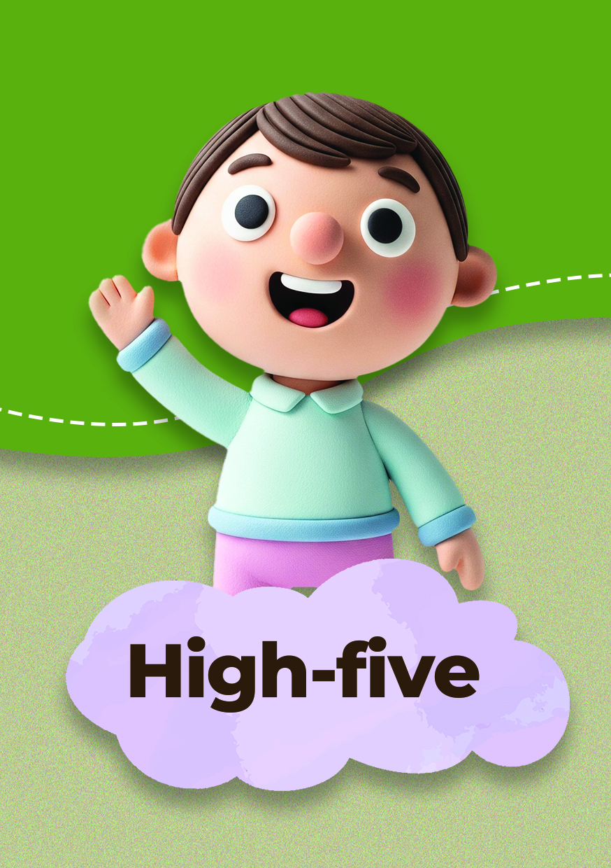

Slide 7
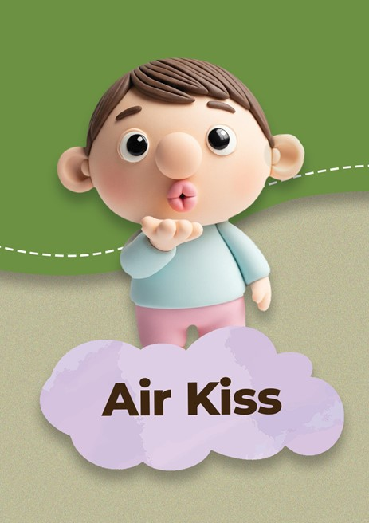
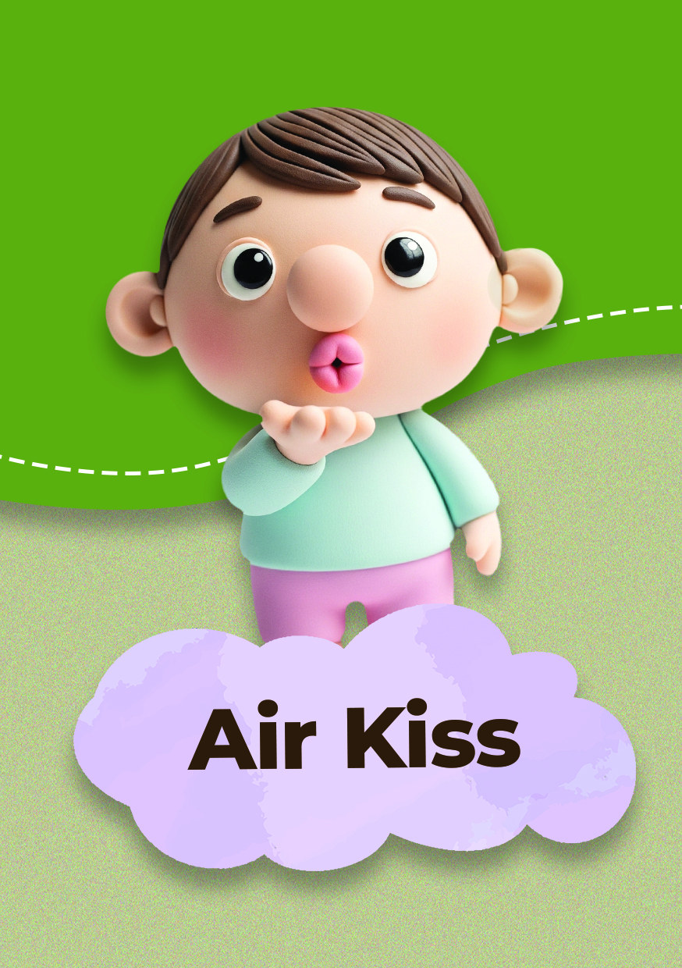

Slide 8
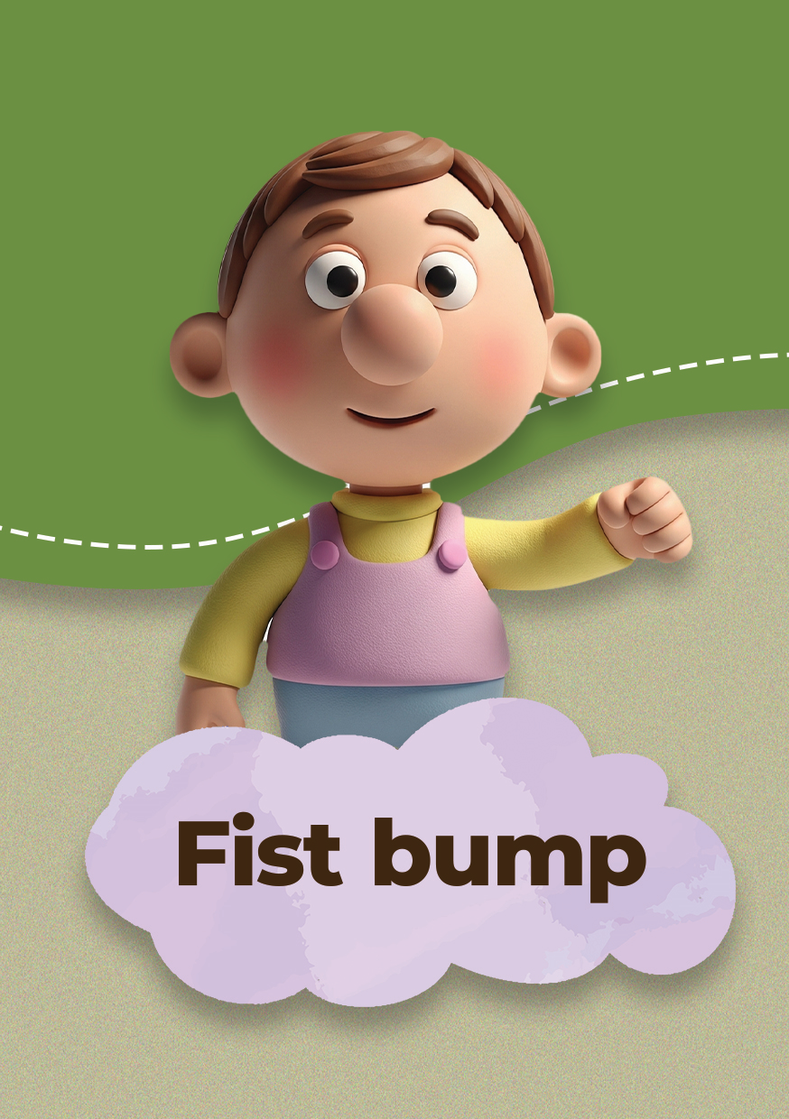
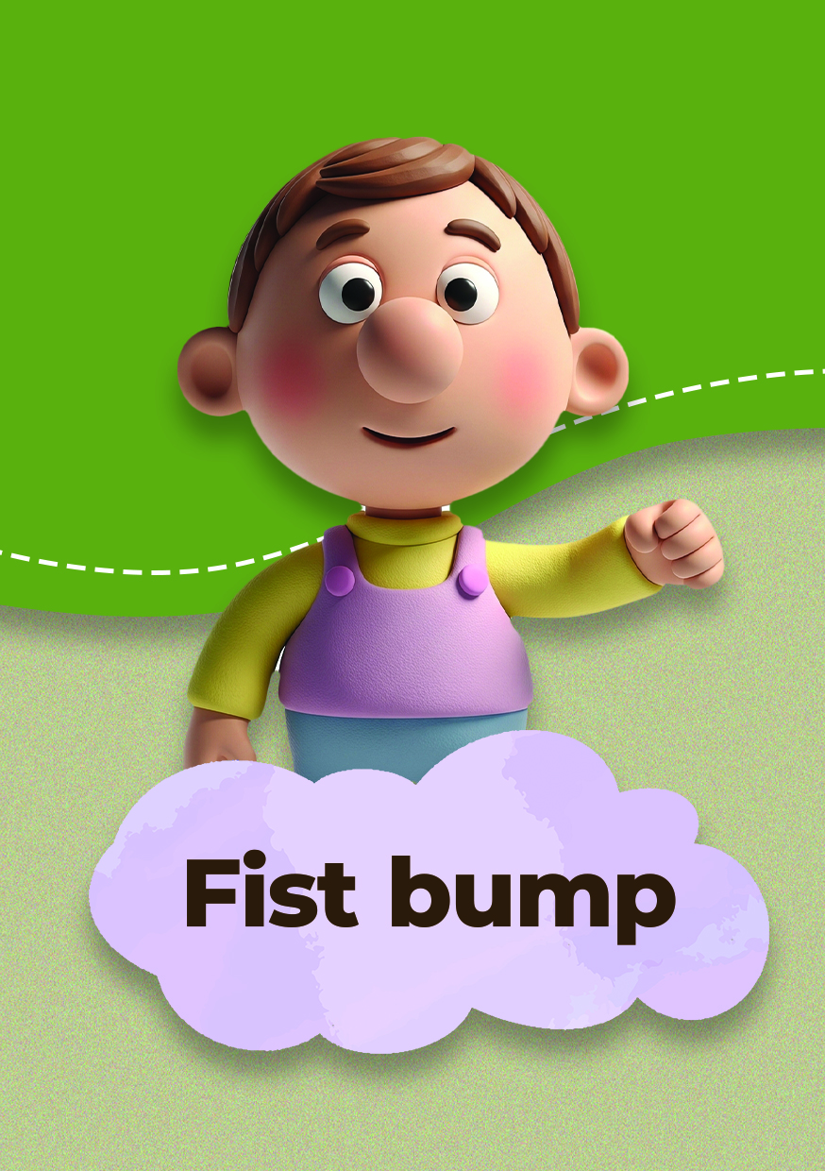

Slide 9
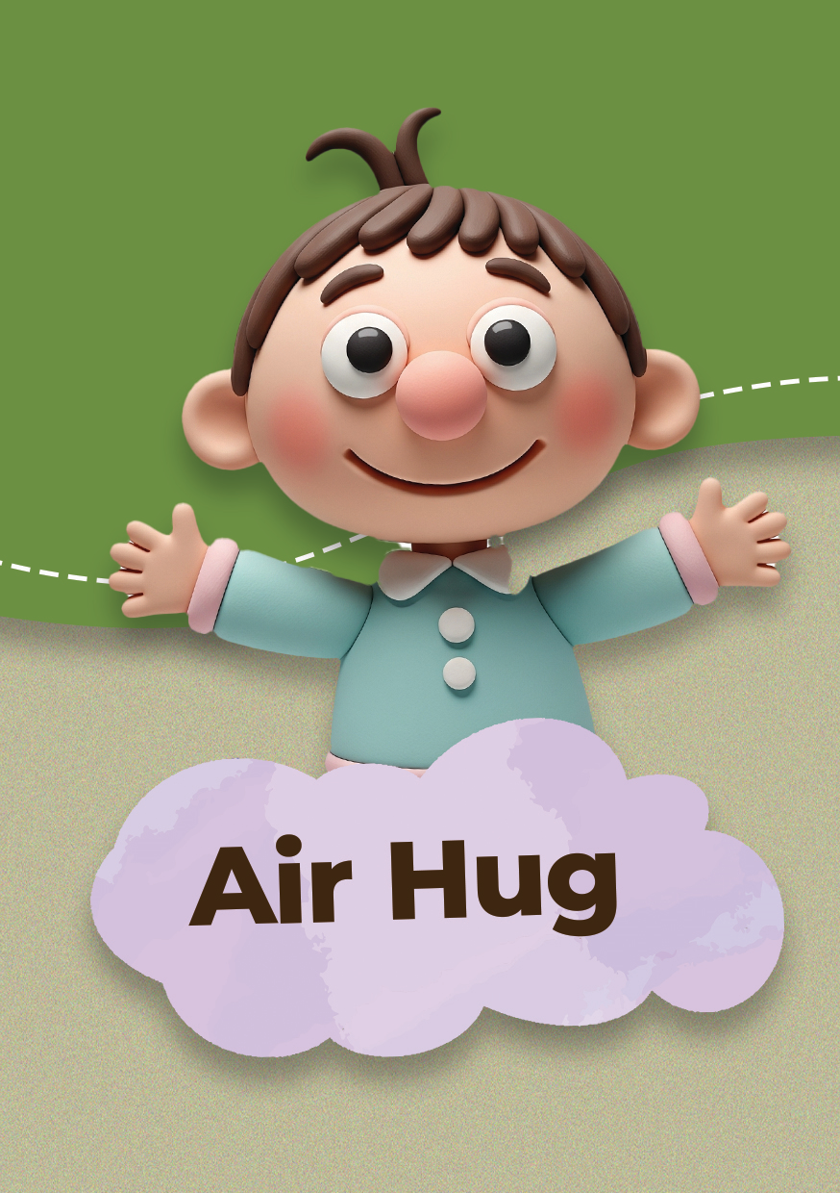
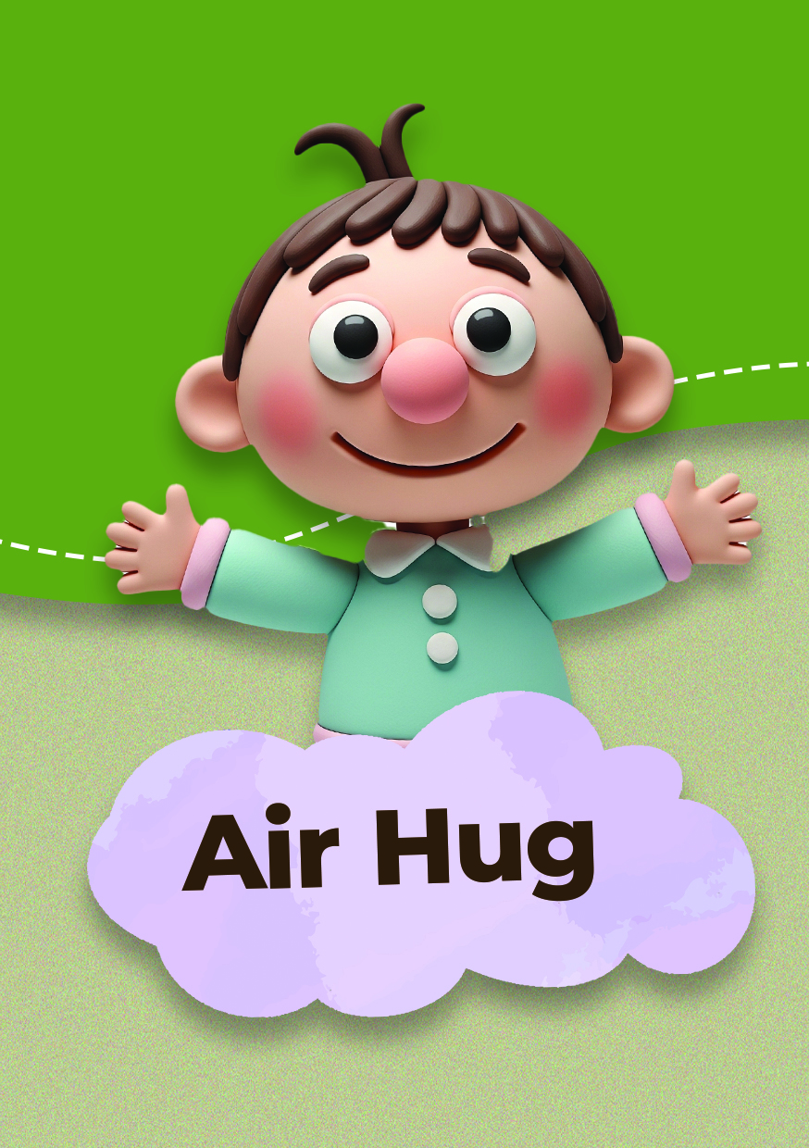

Slide 10
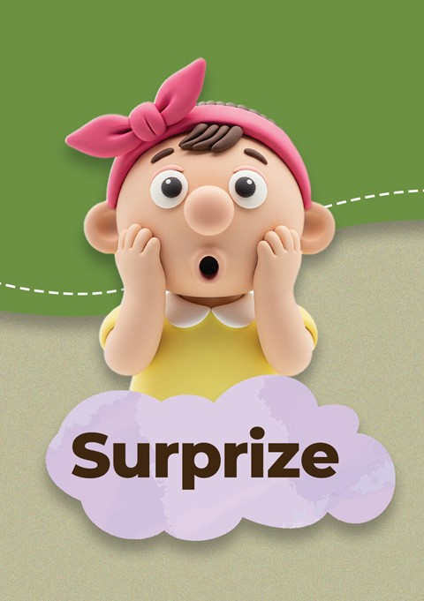
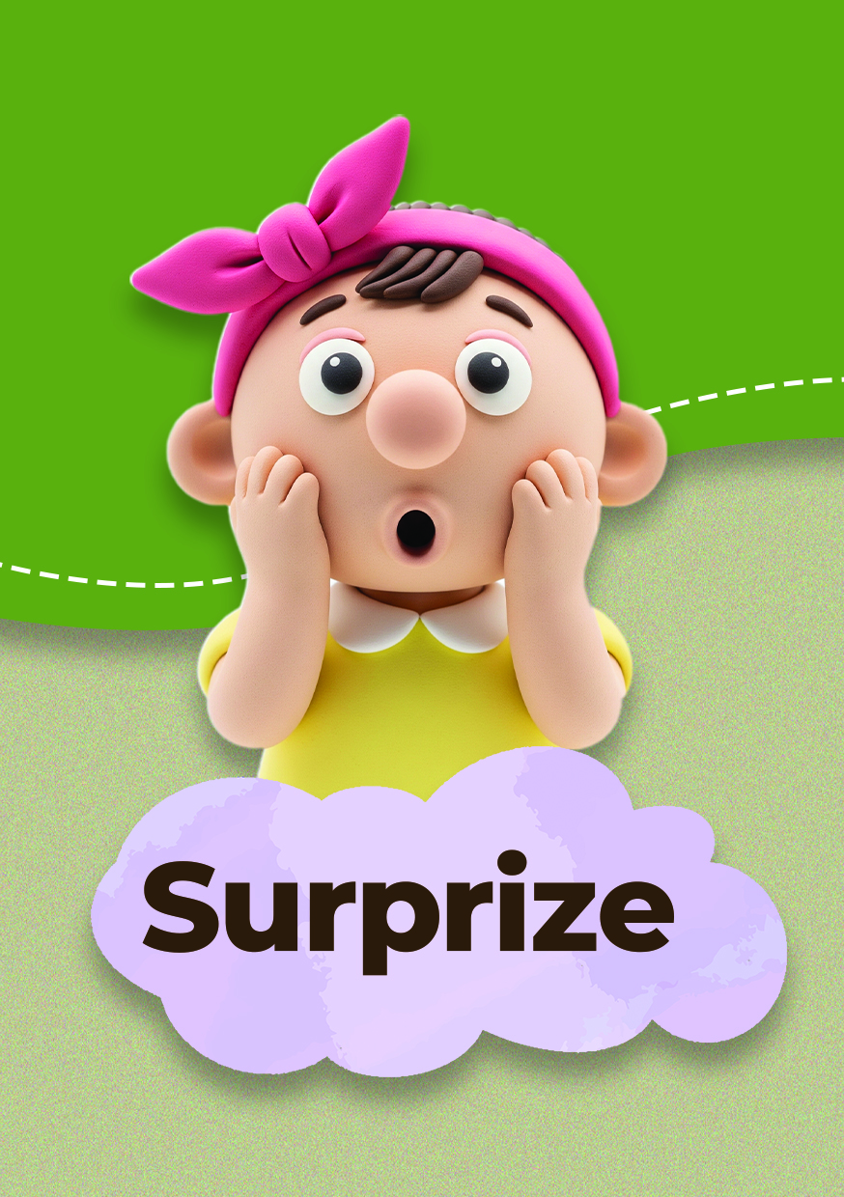

Slide 11
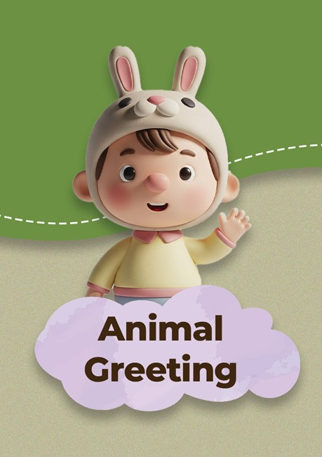
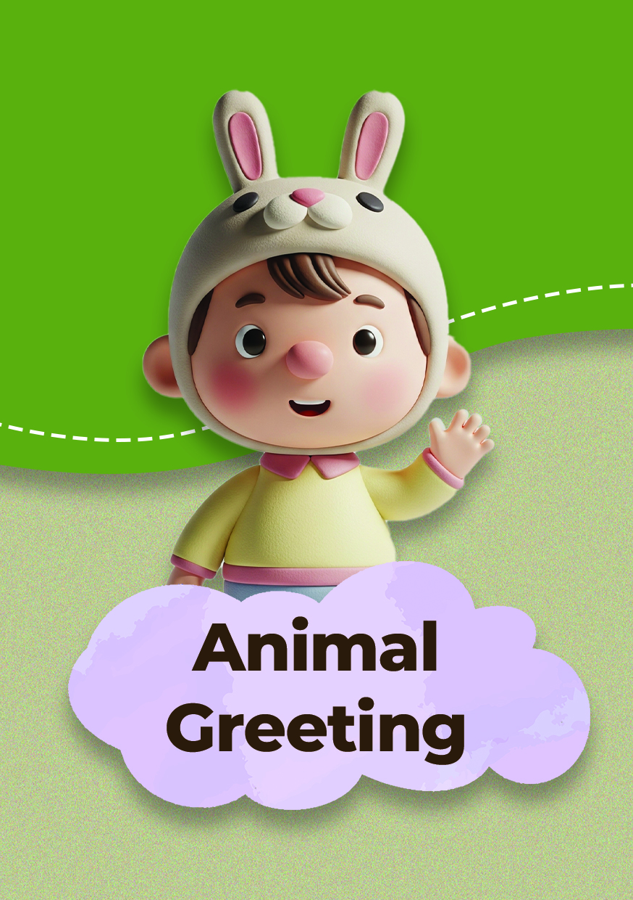

Slide 12


Slide 13


Slide 14


Slide 15
